Slide 1
Biology
Sylvia S. Mader
Michael Windelspecht
Chapter 23
Plant Evolution and Diversity
Lecture Outline
See separate FlexArt PowerPoint slides for all figures and tables pre-inserted into PowerPoint without notes.
Copyright 2022 © McGraw Hill LLC. All rights reserved. No reproduction or distribution without the prior written consent of McGraw Hill LLC.

Slide 2
Outline
23.1 Ancestry and Features of Land Plants
23.2 Evolution of Bryophytes: Colonization of Land
23.3 Evolution of Lycophytes: Vascular Tissue
23.4 Evolution of Pteridophytes: Megaphylls
23.5 Evolution of Seed Plants: Full Adaptation to Land
Notes:
EXAM FOCUS (Low)
Questions follow these five sections in order; expect about 10-14 from Ch 23, most from 23.1 and 23.5. Use the section titles as headings in your notes. Traps on Unit 1: the look-alike term from the same slide; absolute words (only, always, all, must, every), which were never in a correct answer; and terms borrowed from other chapters (e.g. peptidoglycan, hyphae, zoospores).

Slide 3
23.1 Ancestry and Features of Land Plants
Plants are multicellular, photosynthetic eukaryotes
Plant systematists use molecular and morphological information to classify plants
  Plants are thought to have evolved from a freshwater green algae about 590 MYA
  Like plants, green algae
    Contain chlorophylls and accessory pigments
    Store excess carbohydrates as starch
    Have cellulose in their cell walls
  Difference between plants and algae: besides protecting the zygote, plants also protect and nourish the embryo
Notes:
NOT EXPLAINED ON ANY SLIDE
• Plant systematists: scientists who classify plants based on how they are related.
HOME NOTE
• Plants: what they are and how they differ from green algae
Also write here:
– Embryo Difference in Green Algae and Land Plants (23.1.7): Example: Oedogonium, a green alga, leaves its embryo unprotected; Capsella (shepherd's purse), a flowering plant, keeps its embryo protected and fed inside a seed.
EXAM FOCUS (High)
Likely:
• Plants evolved from freshwater green algae.
• Shared with green algae: chlorophylls and accessory pigments, starch storage, cellulose cell walls.
• The difference: plants protect AND nourish the embryo (charophytes only protect the zygote, 23.1.5).
Unlikely: The 590 MYA date; "plant systematists".
How:
• 'Which feature distinguishes land plants from green algae?' -> protecting and nourishing the embryo. Trap: cellulose walls, starch, chlorophyll (both have them).
• 'Which feature do plants share with green algae?' -> cellulose cell walls (or starch storage, chlorophylls). Trap: a protected, nourished embryo (plants only).
Write: Two columns:
• Shared with green algae: chlorophylls + accessory pigments, starch, cellulose walls
• Only plants: embryo protected AND nourished (e.g. Capsella seed vs Oedogonium, 23.1.7)

Slide 4
Characteristics of Plants
Table 23.1 Characteristics of Plants
DOMAIN: Eukarya SUPERGROUP: Archaeplastida KINGDOM Plantae
CHARACTERISTICS Multicellular; apical tissue produces specialtzed tissues altemations-of- generation life cycle: protection of the embryo: gametangla produces gametes waxy cuticle prevents water loss
Nonvascular Plants The Bryophytes Liverworts, hornworts, and mosses are low lying and live in moist environments. Dominant gametophyte produces flagellated sperm unbranched, dependent sporophyte produces windblown spores.
Seedless Vascular Plants - The Lycophytes and Pteridophytes Dominate branched sporophyte has vascular tissue: Lignified xylem transports water, and phloem transports organic nutrients: typically has roots, stems and leaves sporangia borne on sides of leaves that produce windblown spores Independent and separate gametophyte produces flagellated sperm. Lycophyte leaves are microphylls with a single, unbranched vein. Pteridophyte leaves are megaphylls with branched veins.
Seeded Vascular Plants–The Gymnosperms and Angiosperms Leaves are megaphylls: dominant sporophyte produces heterosperes that become dependent male and female gametophytes Male gametophyte is pollen grain, and female gametophyte occurs within ovule, which becomes a seed. Gymnosperms are cone bearing: sporophyte bears pollen cones. which produce windtown pollen (male gametopyte, and seed cones which produce seeds Angiosperm sporophytes bear flowers, which produce pollen grain and beat vules within an ovary Following double fertilization, ovules become seeds that enclose a sporophyte embryo and endosperm. Fruit develops from ovary
Table summarizes characteristics of plants including Eukarya, supergroup: Archaeplastida and kingdom: Plantae.
Notes:
NOT EXPLAINED YET
• Apical tissue: a patch of cells at the tips of roots and shoots that keeps dividing; it makes the plant grow longer and produces its other tissues. (24.1.6)
• Alternation of generations: a plant's life switches between two different many-celled forms: a haploid gametophyte, which makes eggs and sperm, and a diploid sporophyte, which makes spores. (23.1.12)
• Gametangia: the small organs where eggs and sperm are made. (23.1.12)
• Waxy cuticle: a waxy, waterproof coating on the plant's surface that keeps it from drying out. (23.1.9)
• Dominant generation: the form of the plant you actually see, the bigger, longer-lived one. (23.1.14)
• Liverworts: small bryophytes with a flat, ribbon-like body or tiny leaves. (23.2.17)
• Hornworts: small bryophytes whose spore-making stalks stick up like horns. (23.2.19)
• Xylem and phloem: the plant's transport tissues. Xylem carries water up from the roots (its cells are lignified: stiffened with a tough substance called lignin); phloem carries sugars and other nutrients. (24.1.13)
• Lycophytes: small seedless vascular plants such as club mosses; their leaves are microphylls. (23.3.34)
• Microphylls and megaphylls: microphylls are small leaves with a single, unbranched vein; megaphylls are broad leaves with a branching network of veins. (23.4.37)
• Pteridophytes: ferns and their relatives (horsetails and whisk ferns); seedless vascular plants whose leaves are megaphylls. (23.4.36)
• Heterospores: two kinds of spores: microspores, which grow into male gametophytes, and megaspores, which grow into female gametophytes. (23.3.34)
• Pollen grain: the tiny male gametophyte of a seed plant; it carries the sperm to the egg. (27.1.12)
• Ovule: a small structure where the female gametophyte (with its egg) develops; after fertilization it becomes the seed. (27.1.14)
• Pollen cones and seed cones: a conifer's male cones (small; make pollen) and female cones (larger; make seeds). (23.5.68)
• Ovary: the swollen base of a flower's female part; it holds the ovules and later becomes the fruit. (23.5.84)
• Double fertilization: in flowering plants, one sperm fertilizes the egg (forming the zygote, which grows into the embryo) and a second sperm fuses with two other nuclei to make endosperm, the seed's food supply. (23.5.89)
COVERED ELSEWHERE
Bryophytes (23.2.16) · Seedless vascular plants (23.3.32) · Gymnosperms vs angiosperms (23.5.56)
EXAM FOCUS (Medium)
Likely: Nothing of its own: it summarizes the chapter, so questions come from the slides that explain each row.
Unlikely: The table's exact wording.
How: The same facts as the later slides, e.g. 'Which group has a dominant gametophyte?' -> bryophytes. Trap: ferns (the fern itself is the sporophyte).
Write: Group comparison table (only here; it answers "which group..." questions fast):
• Bryophytes: gametophyte dominant · no vascular tissue · spores · sperm swim in water
• Lycophytes and pteridophytes: sporophyte dominant · vascular · windblown spores · sperm swim in water
• Gymnosperms: sporophyte dominant · vascular · "naked" seeds, usually on cones · pollen tube, no water needed
• Angiosperms: sporophyte dominant · vascular · flowers; seeds inside a fruit · pollen tube; double fertilization

Slide 5
The Ancestry of Land Plants
Land plants are most closely related to freshwater green algae known as charophytes
  Charophytes and land plants are in the same clade
    Ancestors of land plants were most closely related to the charophytes Chara and Coleochaete
      Most important to the evolution of plants, charophytes protect the zygote
Notes:
NOT EXPLAINED ON ANY SLIDE
• Clade: a group made of one common ancestor and all of its descendants.
• Coleochaete: another charophyte; it grows as a flat disc of cells (pictured on 23.1.8).
HOME NOTE
• Charophytes (closest relatives of land plants)
Also write here:
– Charophytes (23.1.8): Pictures: Chara looks like a small plant with stem-like and leaf-like parts; Coleochaete grows as a flat disc of cells, each with one nucleus.
COVERED ELSEWHERE
Evolutionary tree of plants (23.1.6)
EXAM FOCUS (High)
Likely: Land plants' closest relatives are the charophytes (Chara, Coleochaete); charophytes protect the zygote.
Unlikely: Clade terminology.
How: 'Which green algae are most closely related to land plants?' -> charophytes (Unit 1 asked this from Ch 21). Trap: chlorophytes, red or brown algae.
Write: One line: charophytes (Chara, Coleochaete) = closest living relatives; they protect the zygote, plants also nourish the embryo.

Slide 6
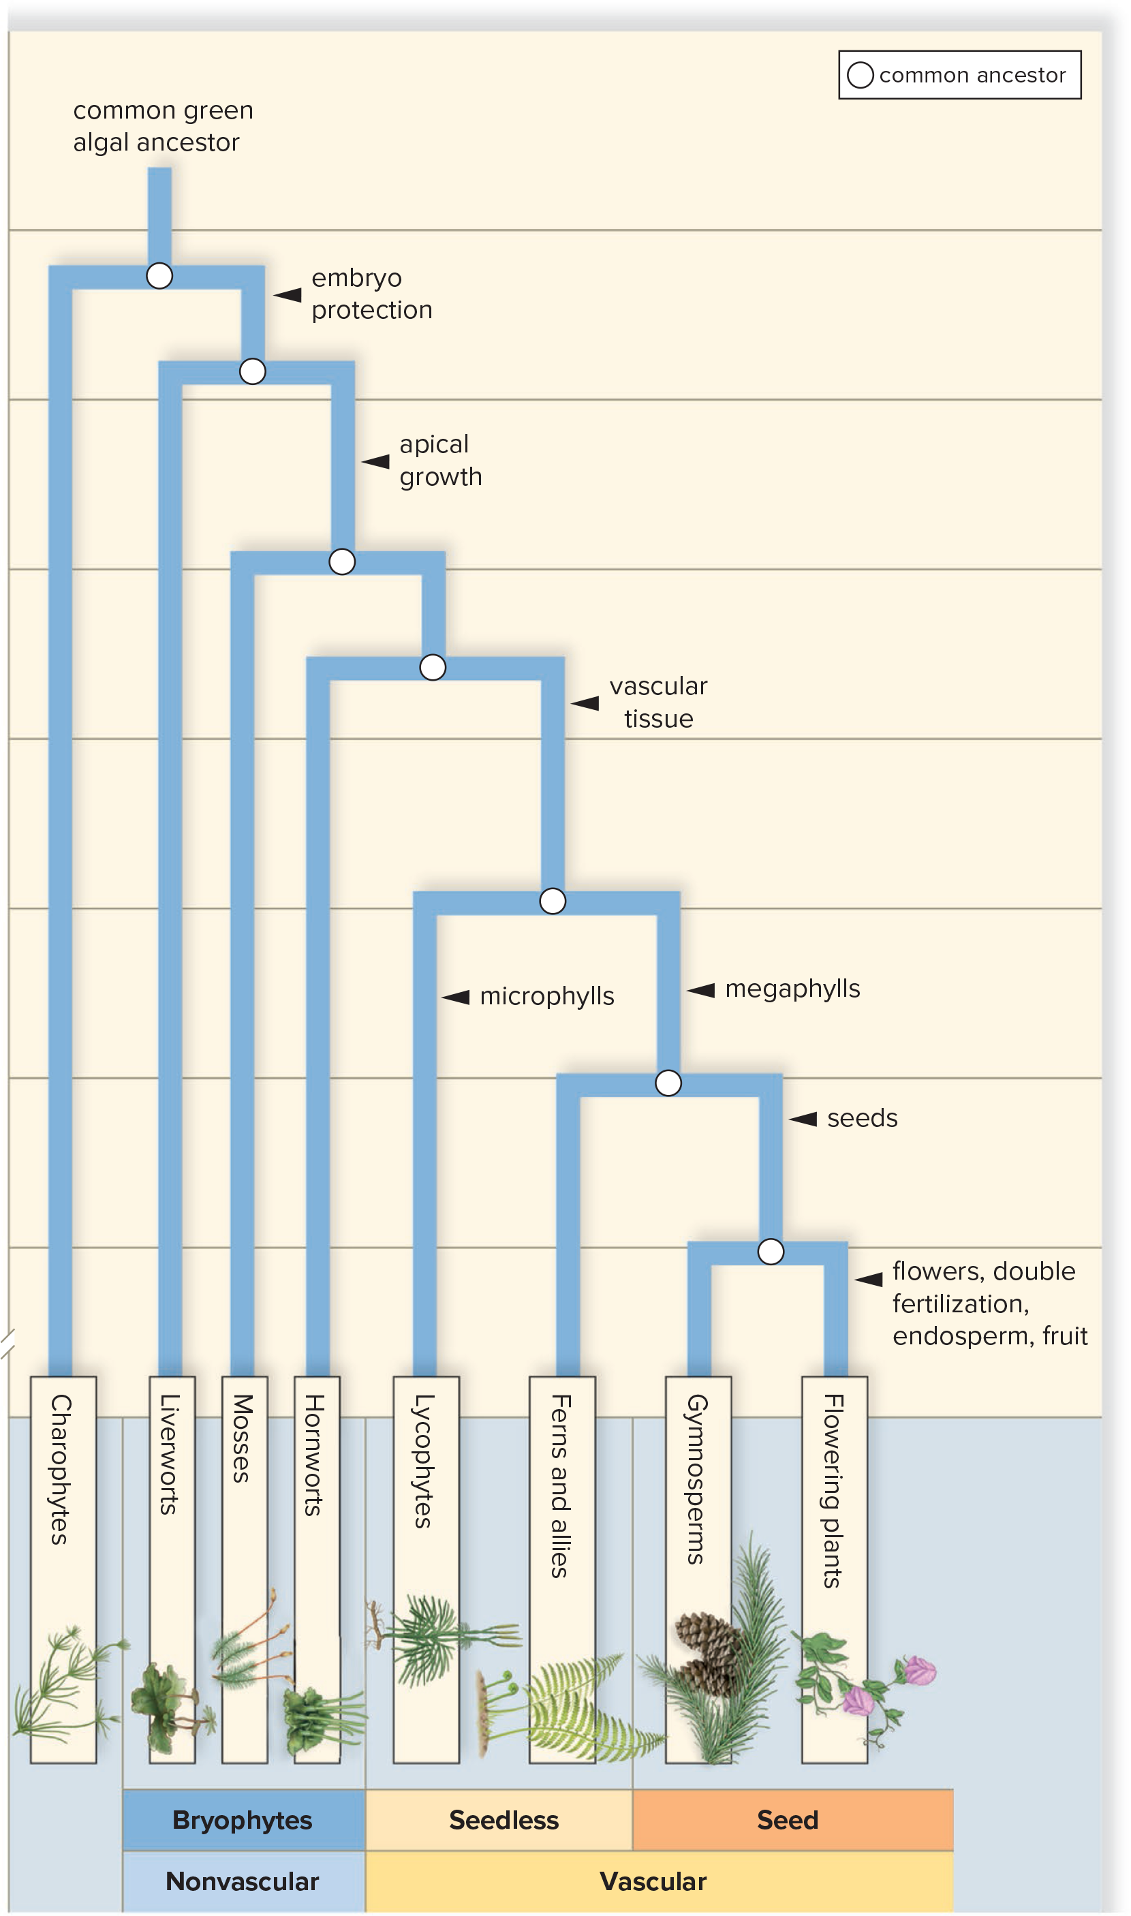
Evolutionary History of Plants
Figure 23.1
Access the text alternative for slide images.
Notes:
IMAGE DESCRIPTION
Common green algal ancestor leads to vascular (seed) through flowering plants and gymnosperms.
Common green algal ancestor leads to vascular (seedless) through ferns and allies and lycophytes.
Common green algal ancestor leads to nonvascular (bryophytes) through hornworts, mosses and liverworts.
Common green algal ancestor leads to charophytes.
NOT EXPLAINED ON ANY SLIDE
• Cladogram: a branching diagram showing how groups are related; each fork is a common ancestor.
NOT EXPLAINED YET
• Bryophytes (nonvascular plants): liverworts, hornworts and mosses: small, low-growing land plants with no vascular tissue. (23.2.16)
• Liverworts: small bryophytes with a flat, ribbon-like body or tiny leaves. (23.2.17)
• Hornworts: small bryophytes whose spore-making stalks stick up like horns. (23.2.19)
• Vascular: having vascular tissue, tubes that carry water (xylem) and food (phloem) through the plant. (24.1.13)
• Seedless vascular plants: vascular plants that spread by spores instead of seeds (lycophytes, ferns and their allies). (23.3.32)
• Lycophytes: small seedless vascular plants such as club mosses. (23.3.34)
• Ferns and allies: ferns plus their relatives, the horsetails and whisk ferns. (23.4.36)
• Gymnosperms and angiosperms: the two groups of seed plants. Gymnosperms (e.g., pines) have "naked" seeds, usually on cones; angiosperms are the flowering plants, whose seeds develop inside a fruit. (23.5.56)
HOME NOTE
• Evolutionary tree of plants
EXAM FOCUS (Low)
Likely: The order of groups: charophytes -> bryophytes (nonvascular) -> lycophytes and ferns (seedless vascular) -> gymnosperms and flowering plants (seed plants).
Unlikely: Reading the tree itself: Unit 1 asked nothing from phylogeny trees.
How: If asked: 'Which group has vascular tissue but no seeds?' -> ferns or lycophytes. Trap: mosses (no vascular tissue), gymnosperms (seeds).
Write: The one-line sequence above.

Slide 7
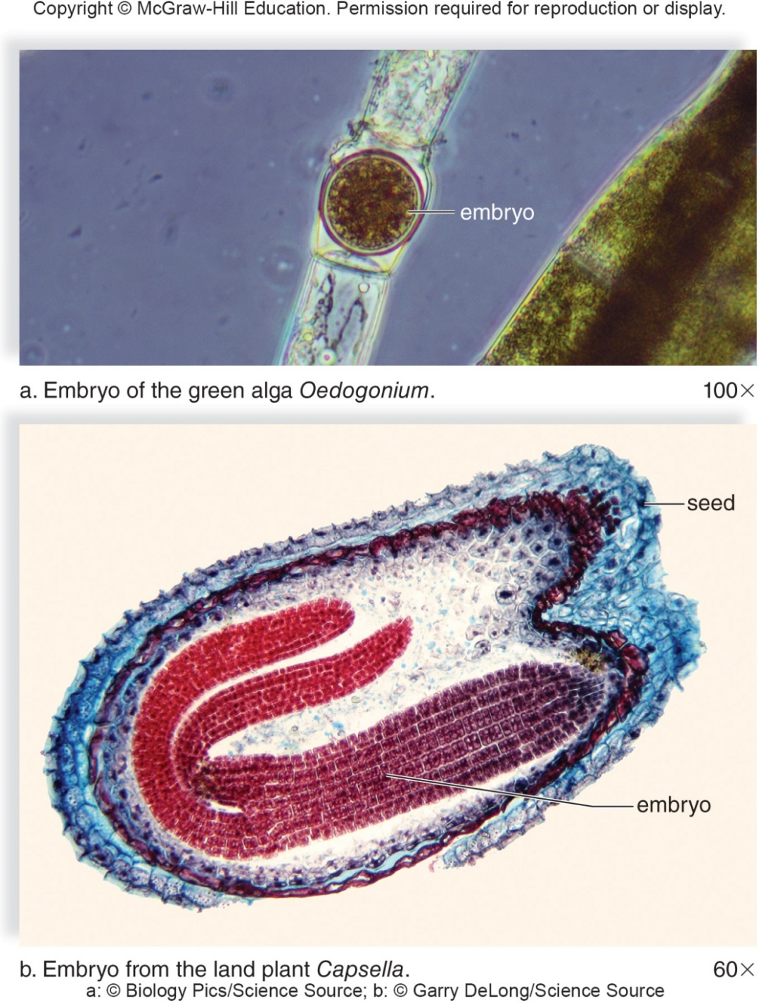
Embryo Difference in Green Algae and Land Plants
Figure 23.2
Access the text alternative for slide images.
(a): Biology Pics/Science Source; (b): Garry DeLong/Science Source
Notes:
IMAGE DESCRIPTION
A) Microscopic view of embryo of Oedogonium is depicted a tube-like alga with unprotected embryo. B) Microscopic view shows a nourished and protected embryo of Capsella encapsulated in seed.
NOT EXPLAINED ON ANY SLIDE
• Oedogonium: a green alga made of threads of cells.
• Capsella (shepherd's purse): a small flowering plant.
ADDS TO
Plants: what they are and how they differ from green algae (23.1.3)
EXAM FOCUS (Low)
Picture for 23.1.3 (embryo unprotected in a green alga, protected and fed in a plant seed); see its exam note.

Slide 8
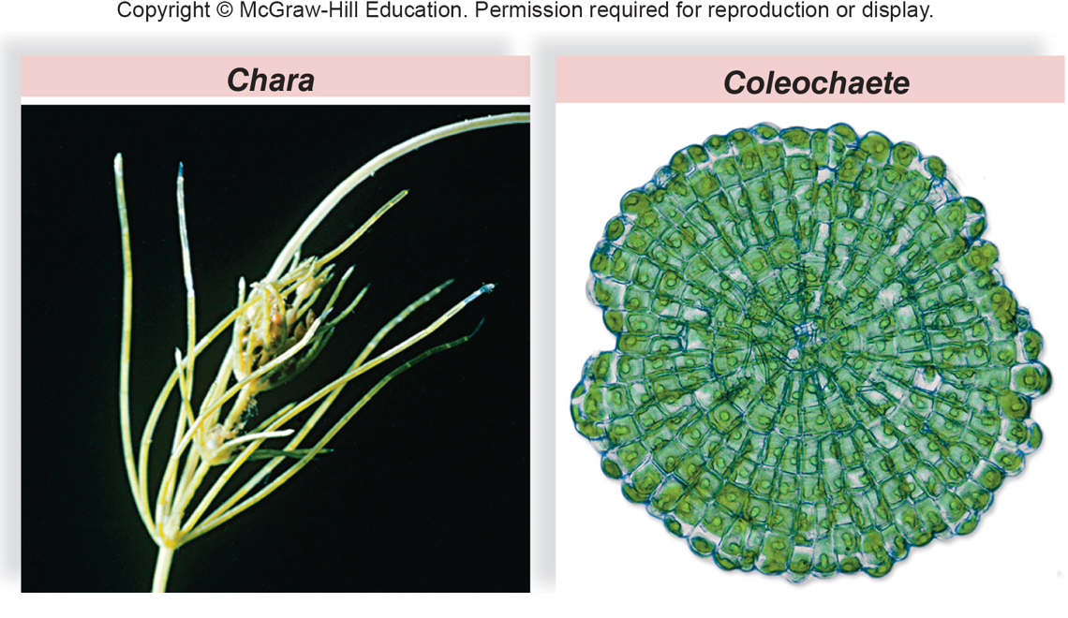
Charophytes
Figure 23.3
Notes:
IMAGE DESCRIPTION
A) Chara is depicted as stem-like and leaf-like structures.
B) Micrograph shows concentric rings of green, uninucleated cells.
NOT EXPLAINED ON ANY SLIDE
• Uninucleated: each cell has one nucleus.
ADDS TO
Charophytes (closest relatives of land plants) (23.1.5)
EXAM FOCUS (Low)
Pictures of the charophytes Chara and Coleochaete; see 23.1.5.

Slide 9
Adaptation to Land
Being on land required plants to evolve mechanisms to minimize dehydration, move water and nutrients against gravity, and damage from UV radiation:
  Waxy covering called a cuticle protects most land plants from desiccation
    Cuticle covers exposed surfaces and is relatively impermeable
    Small openings, called stomata, are found mostly on the underside of leaves and allow for gas exchange between the plant and the environment
  To move water against the force of water many plants have tracheids, specialized cells with proteins that resist gravity and facilitate the upward transport of water and minerals
Notes:
NOT EXPLAINED ON ANY SLIDE
• Desiccation: drying out.
HOME NOTE
• Adaptations to land
Also write here:
– Land Plants (23.1.11): Plant bodies are made of tissues (solid layers of cells) instead of thin, branching threads like many algae. A solid body has less surface for its size (a lower surface-area-to-volume ratio), so it loses less water. Plants also have both a haploid and a diploid generation (explained on 23.1.12), which helps against UV: land plants get more UV than algae in water, and UV causes mutations. A diploid cell has two copies of every gene, so a working copy can hide a harmful one. A shift toward a bigger, longer-lasting diploid generation also gives more genetic variety.
– Dominant Generation (23.1.14): The shift to a bigger, dominant sporophyte is itself an adaptation to land: only the sporophyte has vascular tissue, so it can grow large and carry water up from the ground.
– Conifers (23.5.58): Pine needles have an extra-thick cuticle, which saves water.
ADDS TO
Stomata (24.5.52) · Tracheids (24.1.15)
EXAM FOCUS (High)
Likely:
• Land problems: drying out, moving water up against gravity, UV damage.
• Cuticle: waxy, relatively impermeable covering on exposed surfaces; prevents drying out.
• Stomata: small openings, mostly on the leaf underside, for gas exchange.
• Tracheids: specialized cells that move water and minerals upward against gravity.
Unlikely: Microscope details of the leaf surface.
How:
• 'Which structures let gases pass between a leaf and the air?' -> stomata. Trap: cuticle.
• 'A waxy covering on leaves mainly prevents...' -> water loss (desiccation). Trap: gas exchange, UV damage.
• 'Which cells help land plants move water upward against gravity?' -> tracheids. Trap: stomata, rhizoids.
Write: Problem -> solution table:
• Drying out -> cuticle (pines: extra-thick cuticle)
• Gas exchange -> stomata (details at 24.5.52)
• Water upward -> tracheids / vascular tissue
• Water loss -> body made of tissues (lower surface-area-to-volume ratio)
• UV damage -> a diploid generation (a second gene copy hides a harmful allele)
• Sporophyte dominance is itself a land adaptation (only the sporophyte has vascular tissue)

Slide 10
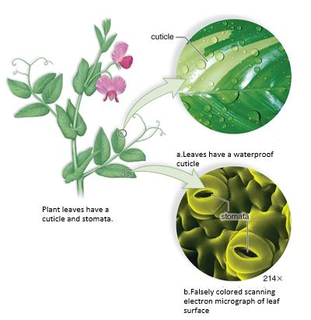
Leaf Adaptation to Prevent Desiccation
Figure 23.4
Access the text alternative for slide images.
(a): Ingram Publishing/age fotostock RF; (b): Dr Jeremy Burgess/Science Source
Notes:
IMAGE DESCRIPTION
A) Leaves have a waterproof cuticle:
Enlarged diagram shows the presence of white cuticle.
B) Falsely colored scanning electron micrograph of leaf surface:
Micrograph (enlarged 214 times) shows presence of eye shaped stomata across the surface of leaf.
NOT EXPLAINED ON ANY SLIDE
• Scanning electron micrograph: a highly magnified picture of a surface taken with an electron microscope; "falsely colored" means the color was added afterward.
COVERED ELSEWHERE
Adaptations to land (23.1.9) · Stomata (24.5.52)
EXAM FOCUS (Low)
Picture of the cuticle and stomata; see 23.1.9.

Slide 11
Land Plants
    Land plants have tissues which reduces water loss to the environment because they have a lower surface-area-to-volume ratio than do branched filaments
    To reduce the effects of UV radiation, plants have both a haploid and diploid generation
      Diploid generation helps to hide the effect of a single deleterious allele
      Evolutionary shift toward a more dominant diploid generation also allows for greater genetic variability in land plants
Notes:
NOT EXPLAINED ON ANY SLIDE
• Surface-area-to-volume ratio: how much outside surface something has compared with its size. Thin, branching shapes have a lot of surface, so they lose water fast.
• Deleterious allele: a harmful version of a gene.
NOT EXPLAINED YET
• Haploid and diploid generation: a plant's life switches between two forms: a haploid one (the gametophyte, which makes eggs and sperm) and a diploid one (the sporophyte, which makes spores). (23.1.12)
• Dominant generation: the form of the plant you actually see, the bigger, longer-lived one. (23.1.14)
ADDS TO
Adaptations to land (23.1.9)
EXAM FOCUS (High)
Likely:
• Bodies made of tissues have a lower surface-area-to-volume ratio than branched filaments -> less water loss.
• Land plants have a haploid and a diploid generation: UV raises the chance of mutations, and a diploid can hide a single harmful allele.
• A shift toward a more dominant diploid generation gives more genetic variability.
Unlikely: Calculating surface-area-to-volume ratios.
How:
• 'How does a diploid generation help land plants cope with UV radiation?' -> it can hide the effect of a single harmful allele. Trap: 'makes plants immune to mutations' (absolute).
• 'Why do plant bodies made of tissues lose less water than algal filaments?' -> a lower surface-area-to-volume ratio. Trap: 'tissues have no surface'.
Write: Nothing here; these go in the 23.1.9 table.

Slide 12
Alternation of Generations
All land plants exhibit alternation of generations:
  Plant alternates between a multicellular haploid (n) phase and a multicellular diploid (2n) phase
    Multicellular haploid individuals are called gametophytes
    Gametophytes produce gametes (eggs and sperm) by mitosis within tissue called gametangia
      Male gametangia are called antheridia
      Female gametangia are called archegonia
      Eggs and sperm combine to form diploid sporophytes
    Multicellular diploid individuals are called sporophytes
      Sporophytes produce spores by meiosis within a structure called the sporangium
      Spores are released and if they land on suitable substrate, germinate and grow by mitosis into gametophytes
Notes:
NOT EXPLAINED ON ANY SLIDE
• Substrate: the surface something grows on, like soil or rock.
HOME NOTE
• Alternation of generations
EXAM FOCUS (High)
Likely:
• Alternation of generations: a multicellular haploid (n) gametophyte alternates with a multicellular diploid (2n) sporophyte.
• The gametophyte makes gametes by MITOSIS in gametangia: antheridia (male, sperm) and archegonia (female, eggs).
• Egg + sperm -> diploid zygote -> sporophyte.
• The sporophyte makes spores by MEIOSIS in a sporangium; spores grow into gametophytes.
Unlikely: Nothing to skip; every point here is testable.
How:
• 'Which process makes spores from the sporophyte?' -> meiosis (like Unit 1's Ulva question). Trap: mitosis (that makes the gametes).
• 'Gametophytes produce gametes by...' -> mitosis. Trap: meiosis.
• 'The female gametangia that produce eggs are...' -> archegonia. Trap: antheridia.
Write: Alternation box:
• Gametophyte (n) -> gametes by mitosis, in gametangia: antheridia = sperm, archegonia = eggs
• Sperm + egg -> zygote (2n) -> sporophyte (2n)
• Sporophyte (2n) -> spores by meiosis, in a sporangium -> spores grow into gametophytes (n)

Slide 13
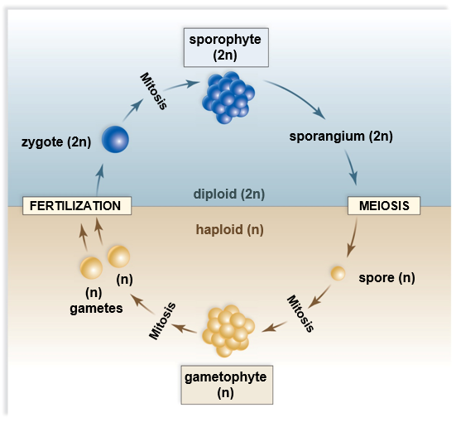
Alternation of Generations in Land Plants
Figure 23.5
Access the text alternative for slide images.
Notes:
IMAGE DESCRIPTION
In diploid phase, zygote(2n) on mitosis leads to sporophyte (2n), which further leads to sporangium (2).
In haploid phase (n), meiosis leads to spores (n), which on mitosis leads to gametophyte (n). Further, on mitosis, gametes (n) are formed which on fertilization leads to formation of zygote in diploid phase.
COVERED ELSEWHERE
Alternation of generations (23.1.12)
EXAM FOCUS (Medium)
Diagram of 23.1.12: know which step is meiosis (sporophyte -> spores) and which is fertilization (gametes -> zygote); see 23.1.12.

Slide 14
Dominant Generation
Land plants differ as to which generation is dominant (conspicuous)
  In early land plants like moss, the gametophyte is dominant
  In all other plants such as ferns, pine trees, and flowering plants, the sporophyte is dominant
      Shift to sporophyte dominance is adaptation to land
        Only sporophytes have vascular systems
        As the sporophyte becomes dominant, the gametophyte becomes reduced in size and dependent on sporophyte
Notes:
NOT EXPLAINED YET
• Vascular system (vascular tissue): tubes that carry water (xylem) and food (phloem) through the plant. (24.1.13)
HOME NOTE
• Dominant generation
Also write here:
– Reduction in the Size of the Gametophyte (23.1.15): Going from mosses to ferns to gymnosperms (e.g., pines) to flowering plants, the gametophyte gets smaller and the sporophyte gets bigger. Moss and fern gametophytes are separate plants anchored by root-like hairs (rhizoids); in gymnosperms and flowering plants the gametophyte is microscopic and depends on the sporophyte.
ADDS TO
Adaptations to land (23.1.9)
EXAM FOCUS (High)
Likely:
• Dominant = the conspicuous generation.
• Mosses (and the other bryophytes): gametophyte dominant; all other plants (ferns, pines, flowering plants): sporophyte dominant.
• The shift to sporophyte dominance is a land adaptation: only sporophytes have vascular systems.
• As the sporophyte becomes dominant, the gametophyte gets smaller and dependent on it.
Unlikely: Nothing to skip; every point here is testable.
How:
• 'In which plants is the gametophyte the dominant generation?' -> mosses (bryophytes). Trap: ferns, pines, flowering plants.
• 'Why is sporophyte dominance considered an adaptation to land?' -> only the sporophyte has a vascular system. Trap: 'gametophytes cannot photosynthesize'.
Write: One line: dominant generation per group (it's a column of the 23.1.4 table) + the reason; trend from 23.1.15: the gametophyte shrinks from moss -> fern -> gymnosperm -> flowering plant.

Slide 15
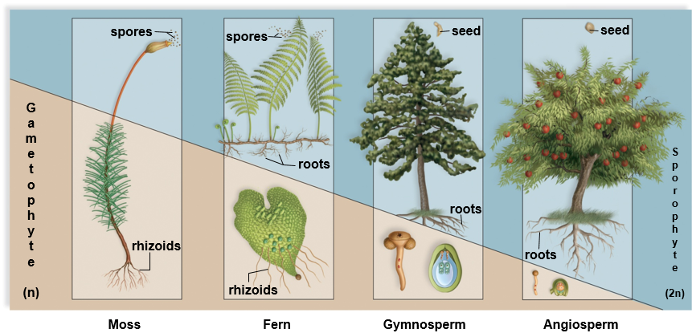
Reduction in the Size of the Gametophyte
Figure 23.6
Access the text alternative for slide images.
Notes:
IMAGE DESCRIPTION
Illustration shows reduction in the size of the gametophyte and increase in sporophytes from moss to angiosperm.
The data is as follows:
Gametophyte (n):
Moss: rhizoids.
Fern: rhizoids
Gymnosperm: blank
Angiosperm: blank
Sporophytes (2n):
Moss: spores
Fern: spores and roots
Gymnosperm: seed and roots
Angiosperm: seed and roots.
NOT EXPLAINED YET
• Rhizoids: root-like hairs that anchor the plant and help absorb water. (23.2.17)
• Gymnosperms and angiosperms: the two groups of seed plants. Gymnosperms (e.g., pines) have "naked" seeds, usually on cones; angiosperms are the flowering plants, whose seeds develop inside a fruit. (23.5.56)
ADDS TO
Dominant generation (23.1.14)
EXAM FOCUS (Medium)
Figure for 23.1.14: from moss to fern to gymnosperm to flowering plant, the gametophyte shrinks and the sporophyte grows; see 23.1.14.

Slide 16
23.2 Evolution of Bryophytes: Colonization of Land
Nonvascular plants
  First plants to colonize land
    Absence of vascular tissue results in low-lying plants that
      Lack specialized means of transporting water and organic nutrients
      Do not have true roots, stems, and leaves
  Gametophyte dominant generation
    Produces eggs in archegonia
    Produces flagellated sperm in antheridia
    Sperm swim to egg in film of water
Notes:
NOT EXPLAINED YET
• True roots, stems and leaves: ones with vascular tissue (xylem and phloem) inside. Bryophytes only have look-alike parts without it. (24.2.18)
• Vascular tissue: tubes that carry water (xylem) and food (phloem) through the plant. (24.1.13)
HOME NOTE
• Bryophytes
EXAM FOCUS (High)
Likely:
• Bryophytes = nonvascular plants, the first to colonize land.
• No vascular tissue -> low-lying, no specialized transport of water and nutrients, no true roots, stems or leaves.
• The gametophyte is the dominant generation.
• Eggs in archegonia; flagellated sperm in antheridia; sperm swim to the egg in a film of water.
Unlikely: Nothing to skip; every point here is testable.
How:
• 'A small plant lacks vascular tissue, has a dominant gametophyte and sperm that swim through water. Which group?' -> bryophytes. Trap: ferns (swimming sperm, but vascular).
• 'Why are bryophytes low-growing?' -> no vascular tissue to move water and nutrients. Trap: 'they lack chlorophyll'.
Write: Bryophyte traits (the four points above); the three bryophyte groups go in the table at 23.2.17.

Slide 17
Liverworts
Liverwort gametophytes (n) are divided into two groups:
  Thallose liverworts: have a flattened body known as a thallus
  Leafy liverworts: superficially resemble mosses
Some liverworts like Marchantia contain rhizoids
  Hairy extensions that anchor plant in soil and aid in absorption
Liverworts can reproduce either sexually or asexually
  Gemmae are groups of cells that detach from the thallus and start a new plant (asexual)
  Sexual reproduction depends on two types of stalks bearing either antheridia (n) or archegonia (n)
    Sporophyte (2n) grows from a fertilized egg within the archegonia
    Sporophyte grows a capsule which produces and releases spores (n)
Notes:
NOT EXPLAINED YET
• Capsule: the top part of the sporophyte, where spores are made. (23.2.30)
HOME NOTE
• Liverworts
Also write here:
– Liverwort, Marchantia (23.2.18): Pictures of Marchantia: gemmae form in small cups on the flat body (thallus); antheridia are carried on stalks of the male plant, and archegonia on umbrella-shaped stalks of the female plant.
EXAM FOCUS (Medium)
Likely:
• Liverworts: thallose (flat thallus) or leafy (look like mosses).
• Marchantia has rhizoids: hairy extensions that anchor the plant and help absorb.
• Asexual reproduction: gemmae, cell clumps that detach and grow into new plants.
• Sexual: stalks bear antheridia or archegonia; the sporophyte grows from the fertilized egg and releases spores from a capsule.
Unlikely: Which stalk shape carries antheridia or archegonia.
How:
• 'Small clumps of cells detach from a liverwort and grow into new plants. What are they?' -> gemmae. Trap: spores, rhizoids, protonema.
• 'Which structures anchor a liverwort and help it absorb water?' -> rhizoids (Unit 1 asked about rhizoids in fungi). Trap: roots (bryophytes have no true roots).
Write: Bryophyte table (write all three rows here):
• Liverworts: flat thallus or leafy; rhizoids; gemmae (asexual); e.g. Marchantia
• Hornworts (23.2.19): horn-like sporophytes from a thin gametophyte; 1 chloroplast per sporophyte cell; cyanobacteria fix nitrogen; fragmentation
• Mosses (23.2.21): largest group; revive after drying out; protonema; peat moss -> soil water capacity

Slide 18
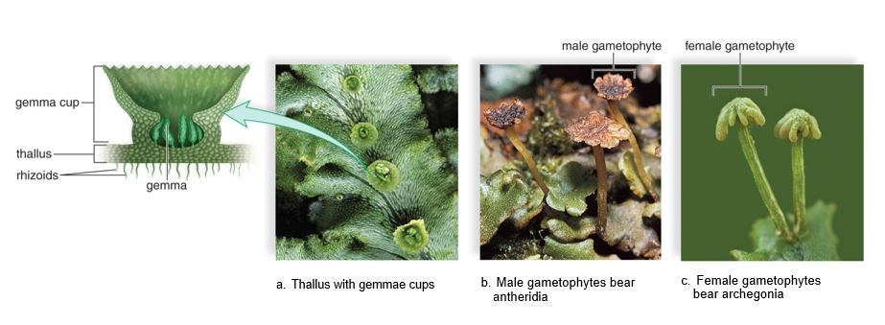
Liverwort, Marchantia
Figure 23.7
Access the text alternative for slide images.
(a): Ed Reschke/Getty Images; (b): J. M. Conrarder/Science Source; (c): Ed Reschke/Stone/Getty Images
Notes:
IMAGE DESCRIPTION
a) Microscopic view shows thallus present between gemma cup and rhizoids.
b) Male gametophytes bearing antheridia is depicted as sac-like structure of sterile cells.
c) Female gametophyte bearing archegonia is depicted as umbrella shaped structure on top of a stalk.
NOT EXPLAINED ON ANY SLIDE
• Gemma cup: a small cup on the liverwort's surface that holds gemmae until rain splashes them out.
• Sterile cells: cells that don't make eggs, sperm or spores.
ADDS TO
Liverworts (23.2.17)
EXAM FOCUS (Low)
Pictures of Marchantia (gemma cups, male and female stalks); see 23.2.17.

Slide 19
Hornworts
    Have small sporophytes rising out of thin gametophytes that carry on photosynthesis
    Sporophyte has one chloroplast per cell
    Most live in moist, well-shaded areas.
    Symbiotic relationship with cyanobacteria allow nitrogen fixation from the air
    Can bypass alternation of generations by reproducing asexually through fragmentation
Notes:
NOT EXPLAINED ON ANY SLIDE
• Fragmentation: a piece of the plant breaks off and grows into a new plant.
NOT EXPLAINED YET
• Nitrogen fixation: turning nitrogen gas from the air into a form living things can use. Plants can't do it themselves; some bacteria, like the cyanobacteria living in hornworts, can. (24.3.34)
HOME NOTE
• Hornworts
Also write here:
– Hornwort, Anthoceros sp. (23.2.20): The "horns" are sporophytes; they keep growing from a base anchored in the gametophyte.
– Why fragmentation skips alternation of generations: a broken-off piece just grows into a new gametophyte, with no spores or gametes involved.
EXAM FOCUS (Medium)
Likely:
• Hornworts: small sporophytes rising from thin, photosynthetic gametophytes.
• One chloroplast per sporophyte cell.
• Symbiotic cyanobacteria -> nitrogen fixation.
• Can reproduce asexually by fragmentation.
Unlikely: "Moist, well-shaded areas".
How:
• 'Which bryophyte partners with cyanobacteria that fix nitrogen?' -> hornworts. Trap: liverworts, mosses.
• 'A piece breaks off a hornwort and grows into a new plant. This is...' -> fragmentation (asexual). Trap: gemmae (liverworts).
Write: Nothing here; it's the hornwort row of the table at 23.2.17.

Slide 20
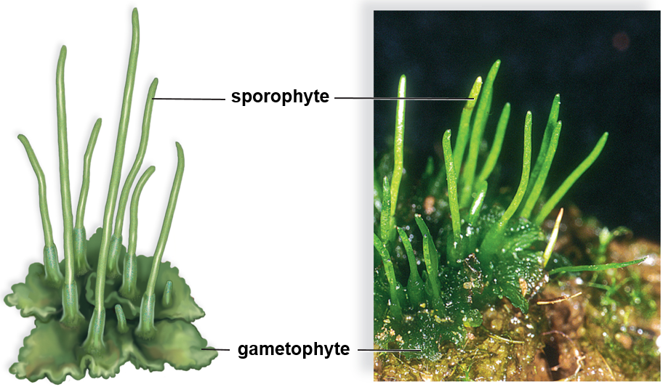
Hornwort, Anthoceros sp.
Figure 23.8
(photo): Steven P. Lynch
Notes:
IMAGE DESCRIPTION
The “horns” of a hornwort are sporophytes that grow continuously from a base anchored in gametophyte tissue.
ADDS TO
Hornworts (23.2.19)
EXAM FOCUS (Low)
Photo: a hornwort's "horns" are its sporophytes; see 23.2.19.

Slide 21
Mosses
  Largest phyla of nonvascular plants
  Mostly found in moist environments
  In dry environments they may become shriveled, turn brown, and look dead but when it rains they resume metabolic activity and turn green
  Three distinct groupings of mosses:
    Peat mosses, granite mosses, true mosses
      Peat moss has great commercial and ecological importance to humans
        Used to improve the water-capacity of soil
        Was used as wound dressing on battlefields
Notes:
NOT EXPLAINED ON ANY SLIDE
• Phylum (plural phyla): a large group of related organisms, one level below kingdom.
EXAM FOCUS (Medium)
Likely:
• Mosses: the largest group of nonvascular plants; mostly in moist places.
• In dry conditions they shrivel and look dead, then revive when it rains.
• Peat moss improves the water-holding capacity of soil (and was used as a wound dressing).
Unlikely: The three groupings (peat, granite, true mosses); the battlefield history.
How: 'Which plant is used to improve the water-holding capacity of soil?' -> peat moss (uses are asked as "which group gives X", like Unit 1's agar question). Trap: ferns, liverworts.
Write: Nothing here; it's the moss row of the table at 23.2.17 (with the peat moss use).

Slide 22
Life Cycle of Moss
Gametophyte (n) of a moss is called the protonema
  Precedes and produces upright, leafy shoots that sprout rhizoids
  Shoots bear either antheridia (sperm-producing) or archegonia (egg-producing)
  Sporophyte is enclosed in female gametophyte tissue
  Sporophyte has three parts:
    A foot, a stalk, and an upper capsule
      Capsule contains the sporangium, where spores are produced
      Moss sporophyte is always attached to the gametophyte
Notes:
CLARIFICATION
The protonema is only the first, thread-like stage of the moss gametophyte, not the whole gametophyte; it then produces the leafy shoots (see 23.2.29).
ADDS TO
Moss life cycle (23.2.30)
EXAM FOCUS (Medium)
Likely: Protonema = the first, thread-like stage of the moss gametophyte; the moss sporophyte = foot + stalk + capsule (sporangium) and stays attached to the gametophyte.
Unlikely: Labels of each step.
How: 'The thread-like first stage of a moss gametophyte is the...' -> protonema. Trap: prothallus (the fern gametophyte), rhizoid, capsule.
Write: Nothing here; it goes in the moss life-cycle box (23.2.30).

Slide 23
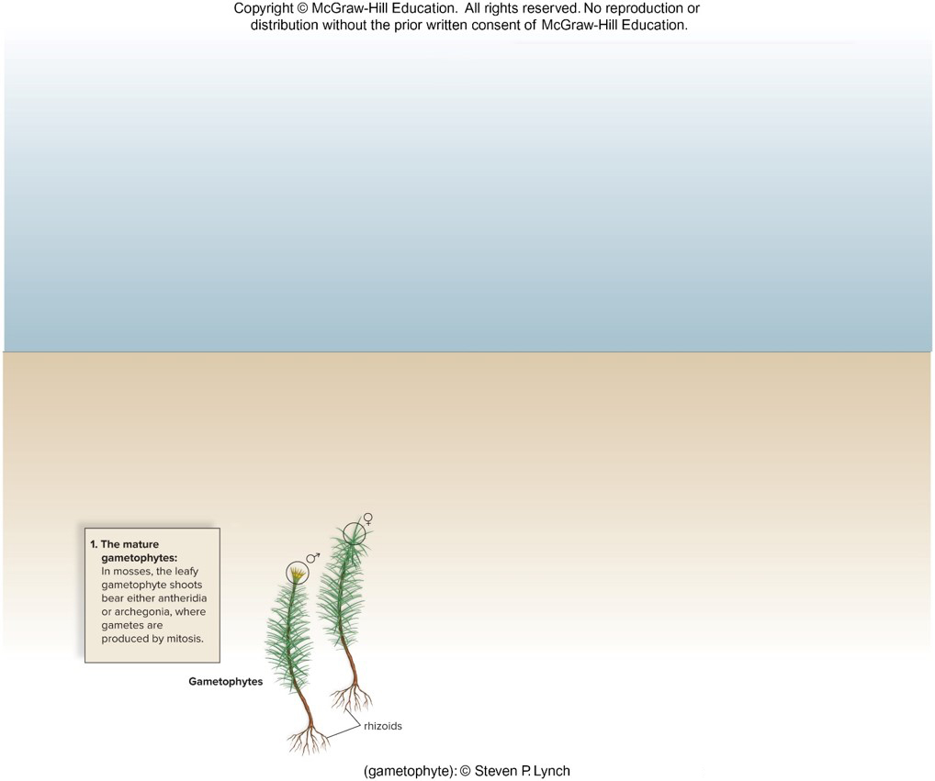
Moss Life Cycle 1
Figure 23.9
(gametophyte):© Steven P. Lynch
Notes:
IMAGE DESCRIPTION
Mature gametophytes are leafy shoots that bear either antheridia or archegonia, where gametes are produced by mitosis.
COVERED ELSEWHERE
Moss life cycle (23.2.30)
EXAM FOCUS (Low)
Step 1 of the moss cycle (gametes made by mitosis in antheridia and archegonia); see 23.2.30.

Slide 24
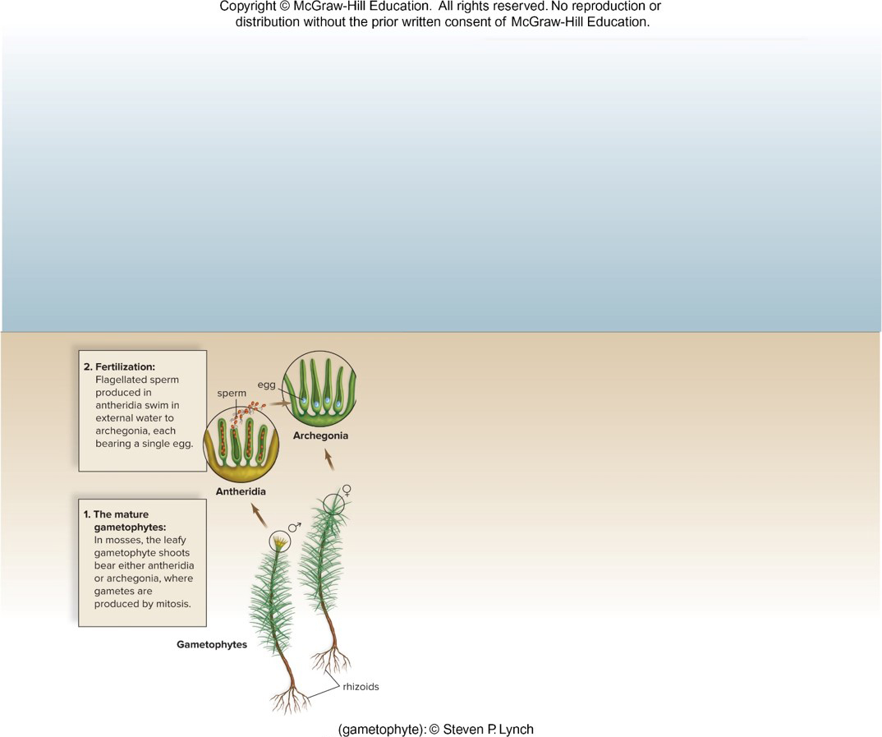
Moss Life Cycle 2
Figure 23.9
(gametophyte):© Steven P. Lynch
Notes:
IMAGE DESCRIPTION
Step 2, Fertilization: Flagellate sperm produced in antheridia swim in external water to archegonia, each bearing a single egg.
COVERED ELSEWHERE
Moss life cycle (23.2.30)
EXAM FOCUS (Low)
Step 2 of the moss cycle (sperm swim through water to the egg); see 23.2.30.

Slide 25
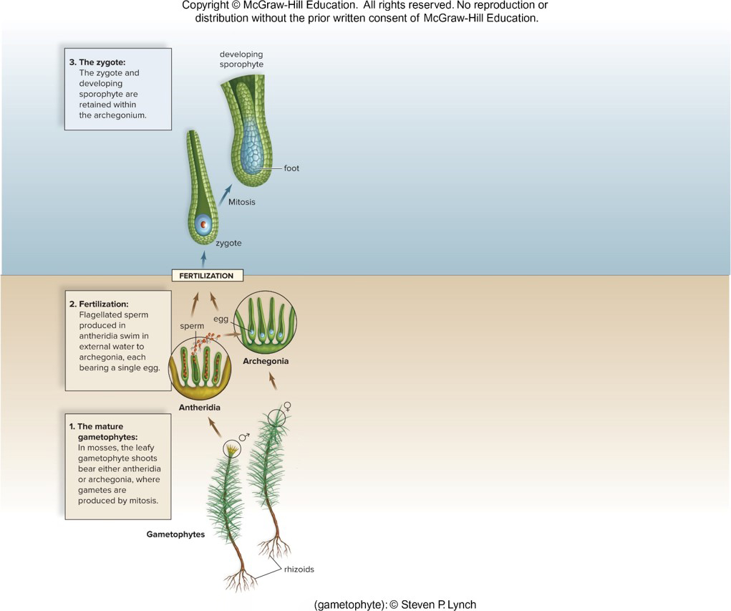
Moss Life Cycle 3
Figure 23.9
(gametophyte):© Steven P. Lynch
Notes:
IMAGE DESCRIPTION
Step 3, the zygote and developing sporophyte are retained within the archegonium.
COVERED ELSEWHERE
Moss life cycle (23.2.30)
EXAM FOCUS (Low)
Step 3 of the moss cycle (zygote and young sporophyte stay inside the archegonium); see 23.2.30.

Slide 26
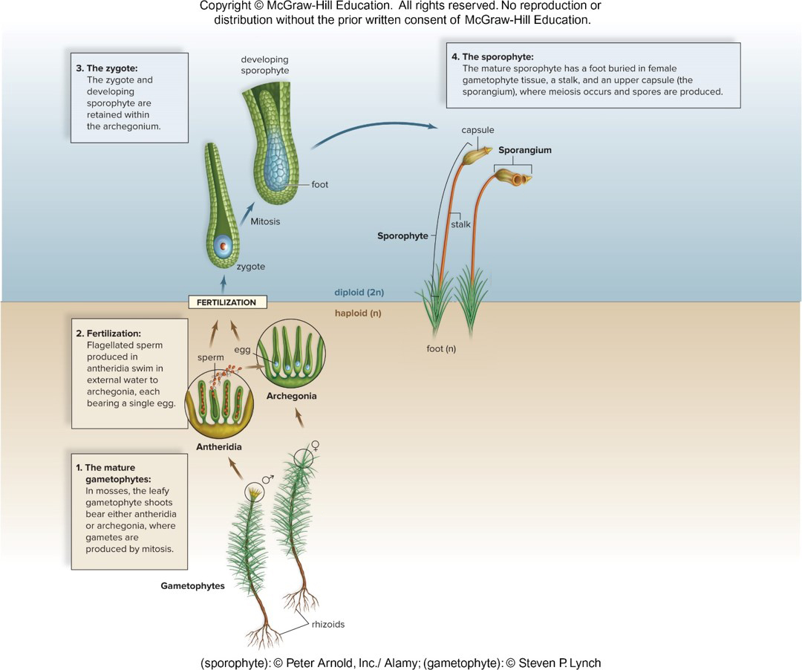
Moss Life Cycle 4
Figure 23.9
Access the text alternative for slide images.
(gametophyte):© Steven P. Lynch
Notes:
IMAGE DESCRIPTION
The mature sporophyte has a foot buried in female gametophyte tissue, a stalk, and an upper capsule (the sporangium), where meiosis occurs and spores are produced.
COVERED ELSEWHERE
Moss life cycle (23.2.30)
EXAM FOCUS (Low)
Step 4 of the moss cycle (meiosis in the capsule makes spores); see 23.2.30.

Slide 27
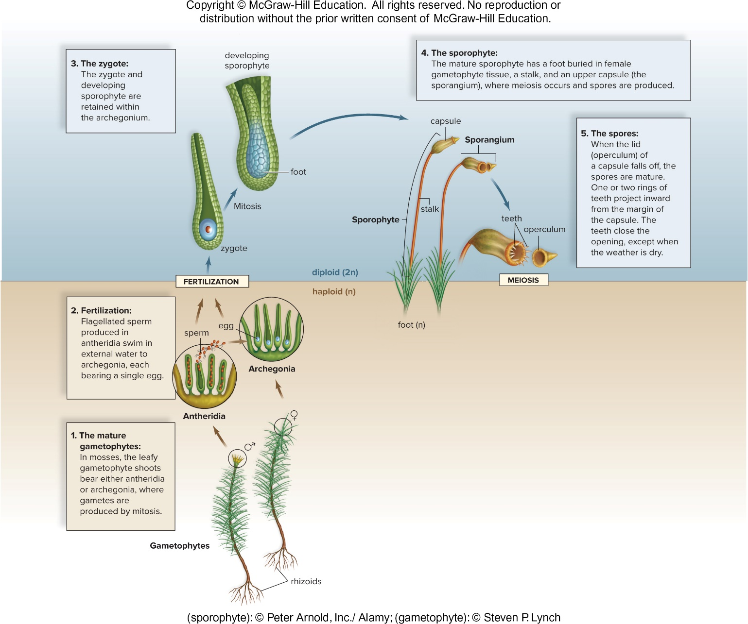
Moss Life Cycle 5
Figure 23.9
Access the text alternative for slide images.
(gametophyte):© Steven P. Lynch
Notes:
IMAGE DESCRIPTION
When the lid (operculum) of a capsule falls of, the spores are mature. One or two rings of teeth project inward from the margin of the capsule. The teeth close the opening, except when the weather is dry.
COVERED ELSEWHERE
Moss life cycle (23.2.30)
EXAM FOCUS (Low)
Step 5 of the moss cycle (spores mature in the capsule); see 23.2.30.

Slide 28
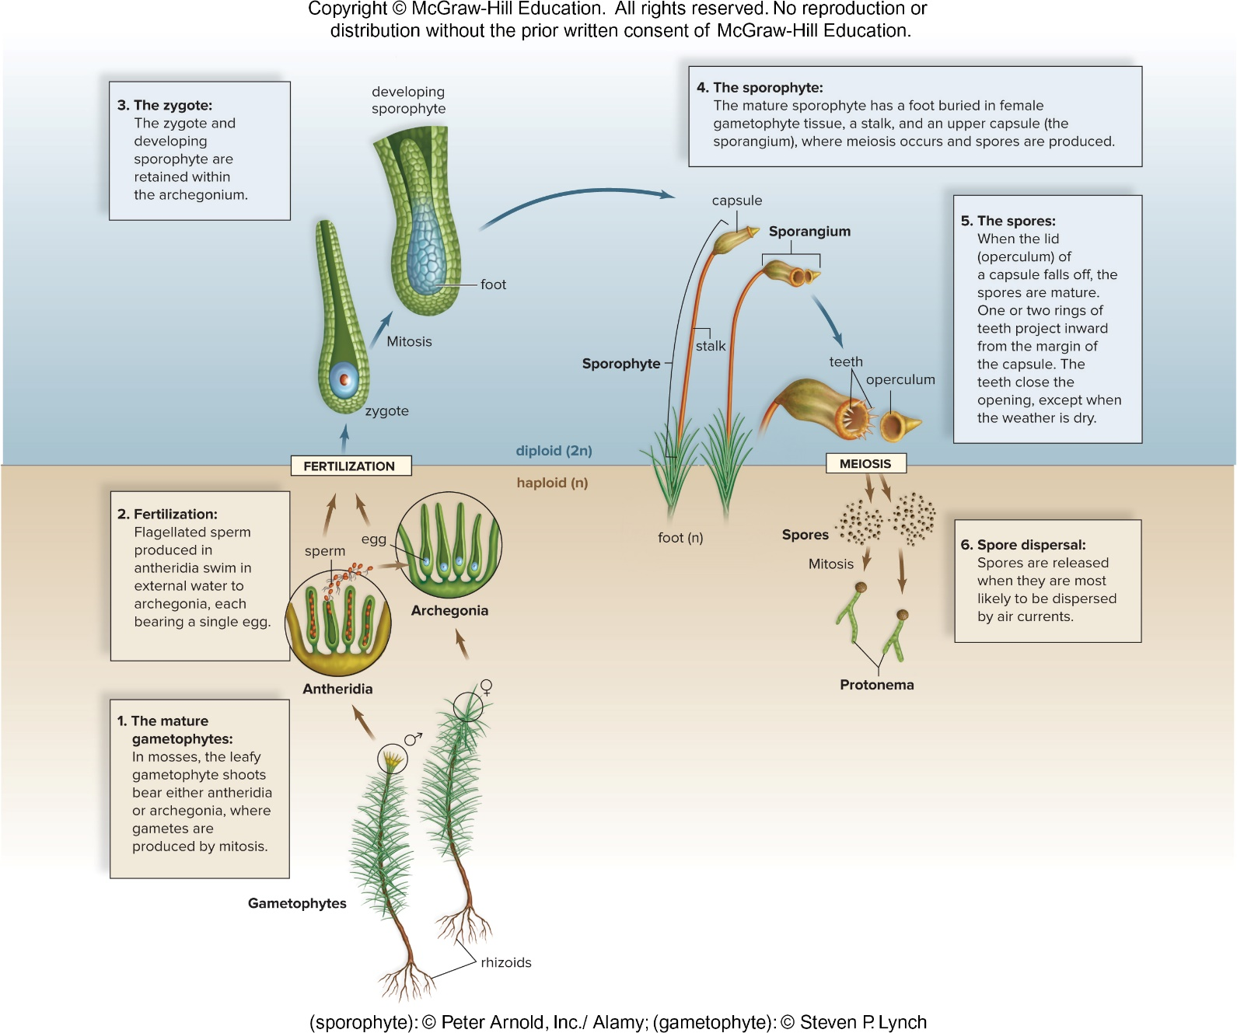
Moss Life Cycle 6
Figure 23.9
(gametophyte):© Steven P. Lynch
Notes:
IMAGE DESCRIPTION
Step 6, spores are released when they are most likely to be dispersed by air currents.
COVERED ELSEWHERE
Moss life cycle (23.2.30)
EXAM FOCUS (Low)
Step 6 of the moss cycle (spores dispersed by air); see 23.2.30.

Slide 29
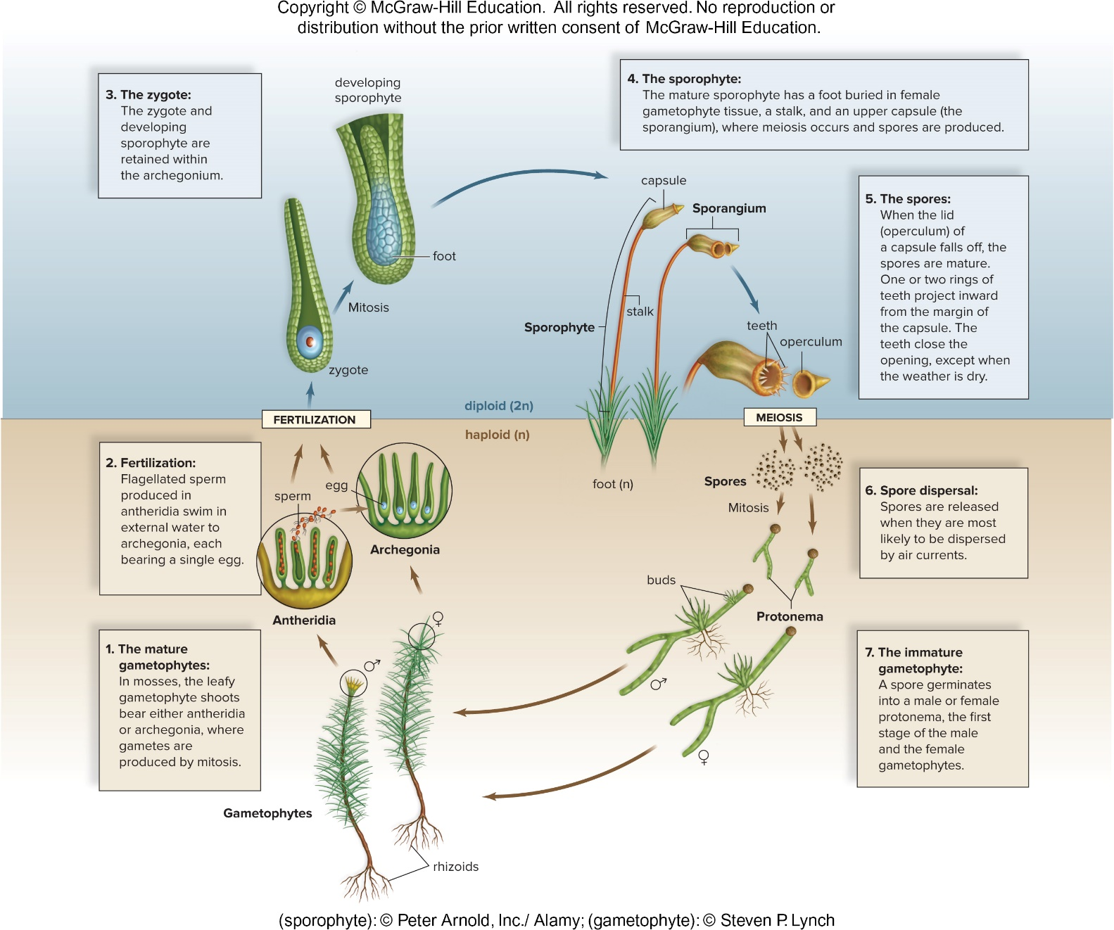
Moss Life Cycle 7
Figure 23.9
(gametophyte):© Steven P. Lynch
Notes:
IMAGE DESCRIPTION
Step 7, the immature gametophyte reads: spore germinates into male or a female protonema, the first stage of the male and the female gametophytes.
COVERED ELSEWHERE
Moss life cycle (23.2.30)
EXAM FOCUS (Low)
Step 7 of the moss cycle (spore -> protonema); see 23.2.30.

Slide 30
Moss Life Cycle 8
Figure 23.9
Access the text alternative for slide images.
(sporophyte): © Peter Arnold, Inc./Alamy: (gametophyte): © Steven P. Lynch
Notes:
IMAGE DESCRIPTION
The details of the moss life cycle between fertilization and meiosis are as follows:
1. The mature gametophytes:
In mosses, the leafy gametophyte shoots bear either antheridia or archegonia, where gametes are produced by mitosis.
2. Fertilization:
Flagellate sperm produced in antheridia swim in external water to archegonia, each bearing a single egg.
3. The zygote:
The zygote and developing sporophyte are retained within the archegonium.
4. The sporophyte:
The mature sporophyte has a foot buried in female gametophyte tissue, a stalk, and an upper capsule (the sporangium), where meiosis occurs and spores are produced.
5. The spores:
When the lid (operculum) of a capsule falls of, the spores are mature. One or two rings of teeth project inward from the margin of the capsule. The teeth close the opening, except when the weather is dry.
6. Spore dispersal:
Spores are released when they are most likely to be dispersed by air currents.
7. The immature gametophyte:
A spore germinates into a male or female protonema, the first stage of the male and the female gametophytes.
HOME NOTE
• Moss life cycle
Also write here:
– Life Cycle of Moss (23.2.22): The sporophyte stays attached to the female gametophyte for its whole life, and the upright leafy shoots grow rhizoids (root-like hairs).
EXAM FOCUS (High)
Likely:
• The gametophyte (n) is dominant: leafy shoots bear antheridia or archegonia; gametes are made by mitosis.
• Sperm swim through external water to the egg in the archegonium.
• The zygote and young sporophyte stay in the archegonium; the sporophyte (foot, stalk, capsule) stays attached to the gametophyte.
• Meiosis in the capsule (sporangium) makes spores; spores spread by air.
• Spore -> protonema -> leafy gametophyte.
Unlikely: Operculum and capsule-teeth labels.
How:
• 'Where does meiosis occur in the moss life cycle?' -> in the capsule (sporangium) of the sporophyte. Trap: antheridia, archegonia (they make gametes by mitosis).
• 'Which part of a moss is diploid?' -> the sporophyte (foot, stalk, capsule). Trap: protonema, leafy shoot.
• 'Why do mosses need water to reproduce?' -> their sperm swim to the egg. Trap: 'their spores need water to form'.
Write: Moss life-cycle box (use the same rows for fern, pine and flowering plant):
• Dominant: gametophyte (the leafy green moss, n)
• Meiosis: in the capsule on top of the sporophyte -> spores (n)
• Gametophyte: spore -> protonema -> leafy shoots with antheridia or archegonia
• Fertilization: sperm swim through water to the egg; water needed
• Sporophyte (2n): foot + stalk + capsule; always attached to the gametophyte

Slide 31
23.3 Evolution of Lycophytes: Vascular Tissue
Vascular plants (tracheophytes) dominate the natural terrestrial landscape
  Can achieve great heights because of roots and vascular tissue and nutrient-conducting tissue:
    Xylem conducts water and dissolved minerals up from roots
      Lignin strengthens cell walls of conducting cells in xylem
    Phloem conducts sucrose and other organic compounds throughout the plant
Notes:
NOT EXPLAINED ON ANY SLIDE
• Sucrose: table sugar; the form in which plants move sugar around.
ADDS TO
Xylem and phloem (24.1.13)
EXAM FOCUS (High)
Likely:
• Vascular plants (tracheophytes) can grow tall thanks to roots and vascular tissue.
• Xylem: water and dissolved minerals up from the roots; lignin strengthens the walls of its conducting cells.
• Phloem: sucrose and other organic compounds throughout the plant.
Unlikely: The word "tracheophytes" beyond "vascular plants".
How:
• 'Which tissue carries sugars throughout the plant?' -> phloem. Trap: xylem.
• 'What does lignin do in xylem?' -> strengthens the walls of the conducting cells. Trap: 'carries sugar'; 'waterproofs leaves' (that's the cuticle).
Write: Nothing here; it goes in the xylem vs phloem table at 24.1.13 (this slide's lignin and height points are already listed there).

Slide 32
The Origin of Vascular Plants
Fossil record indicates that the first vascular plants, such as Cooksonia, were more likely bushes than trees
  Branching of Cooksonia was significant for two reasons:
    More sporangia were produced, and therefore many more spores
    Indicative of vascular tissue
  Sporangia of Cooksonia produced windblown spores
    This classifies it (and other lycophytes and pteridophytes) as seedless vascular plants
  Lycophytes and all other vascular plants have a dominant sporophyte generation
Notes:
NOT EXPLAINED YET
• Vascular tissue: tubes that carry water (xylem) and food (phloem) through the plant. (24.1.13)
• Lycophytes: small seedless vascular plants such as club mosses. (23.3.34)
• Pteridophytes: ferns and their relatives, the horsetails and whisk ferns. (23.4.36)
HOME NOTE
• Seedless vascular plants
• Cooksonia (early vascular plant)
Also write here:
– A Cooksonia Fossil (23.3.33): The fossil is only a few centimeters tall, and its branches end in sporangia.
EXAM FOCUS (Medium)
Likely:
• Cooksonia: one of the first vascular plants; small and bushy.
• Its branching mattered: more sporangia -> many more spores, and a sign of vascular tissue.
• Windblown spores -> a seedless vascular plant (like lycophytes and pteridophytes).
• Lycophytes and all other vascular plants have a dominant sporophyte.
Unlikely: Fossil size; bushes vs trees.
How: 'Why was branching in Cooksonia significant?' -> more sporangia (so more spores) and evidence of vascular tissue. Trap: 'it produced seeds'.
Write: One line: Cooksonia branching -> more spores + evidence of vascular tissue; windblown spores = seedless vascular plant.

Slide 33
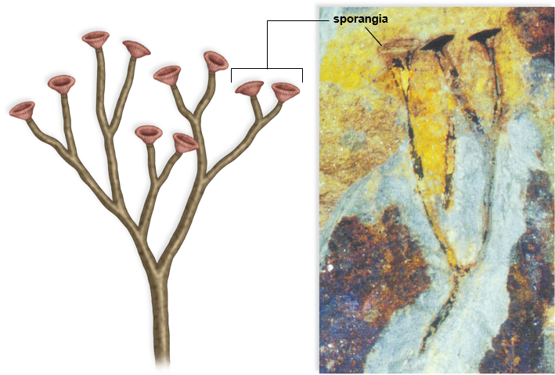
A Cooksonia Fossil
Figure 23.10
(photo): Hans Steur, the Netherlands
Notes:
IMAGE DESCRIPTION
The fossil, which is no more than a few centimeters tall and terminated in sporangia is evidence of vascular plant evolution.
ADDS TO
Cooksonia (early vascular plant) (23.3.32)
EXAM FOCUS (Low)
Photo of the Cooksonia fossil; see 23.3.32.

Slide 34
Lycophytes
    Roots evolved as lower extensions of the stem
    Leaves are microphylls
      Have only one strand of vascular tissue
      Most likely evolved as simple side extensions of the stem
    Cone-shaped structure called a strobili produce spores by meiosis
    Some lycophytes have spores that grow into one type of gamete (homosporous), others produce two types of spores (heterosporous)
    Microspores (become male gametophyte) and megaspores (become female gametophyte)
  Three main groups of lycophytes:
      Ground pines (Lycopodium), spike mosses (Selaginella), and quillworts (Isoetes)
Notes:
CLARIFICATION
Homosporous means making only one type of spore (which grows into a gametophyte that makes both eggs and sperm). The slide's "one type of gamete" should read "one type of spore."
NOT EXPLAINED YET
• Vascular tissue: tubes that carry water (xylem) and food (phloem) through the plant. (24.1.13)
HOME NOTE
• Lycophytes
Also write here:
– Lycophytes Example (23.3.35): Pictures: a spike moss (Selaginella) and a club moss. The club moss has strobili (cones of sporangia) at the top, small microphyll leaves, branches, an above-ground stem, a stem that runs sideways underground (rhizome), and roots.
• Homospory and heterospory
ADDS TO
Microphylls and megaphylls (23.4.37)
EXAM FOCUS (High)
Likely:
• Lycophytes: roots (lower extensions of the stem); leaves are microphylls (one strand of vascular tissue).
• Spores are made by meiosis in cone-shaped strobili.
• Homosporous = one type of spore; heterosporous = two types: microspores (-> male gametophyte) and megaspores (-> female gametophyte).
• Groups: ground pines (club mosses), spike mosses, quillworts.
Unlikely: The genus names Lycopodium, Selaginella, Isoetes.
How:
• 'A plant makes two kinds of spores that grow into male and female gametophytes. It is...' -> heterosporous. Trap: homosporous.
• 'Leaves with a single strand of vascular tissue are...' -> microphylls. Trap: megaphylls.
• 'Lycophytes produce their spores in...' -> strobili. Trap: sori (ferns).
Write: Seedless vascular table (write all four rows here) + look-alikes:
• Lycophytes: microphylls; spores in strobili; club mosses, spike mosses, quillworts; some heterosporous
• Horsetails (23.4.38): Equisetum; small leaves in whorls at the nodes; strobili; silica-stiffened stems; spring-loaded spores
• Whisk ferns (23.4.40): Psilotum; no leaves; stems fork again and again from a rhizome; sporangia on short side branches
• Ferns (23.4.42): fronds (megaphylls) divided into leaflets; sori under the fronds; dominant sporophyte; both generations independent
• Look-alikes: homosporous (1 spore type) vs heterosporous (micro + mega); microspore -> male vs megaspore -> female gametophyte; strobili (cones; lycophytes, horsetails) vs sori (under fern fronds)

Slide 35
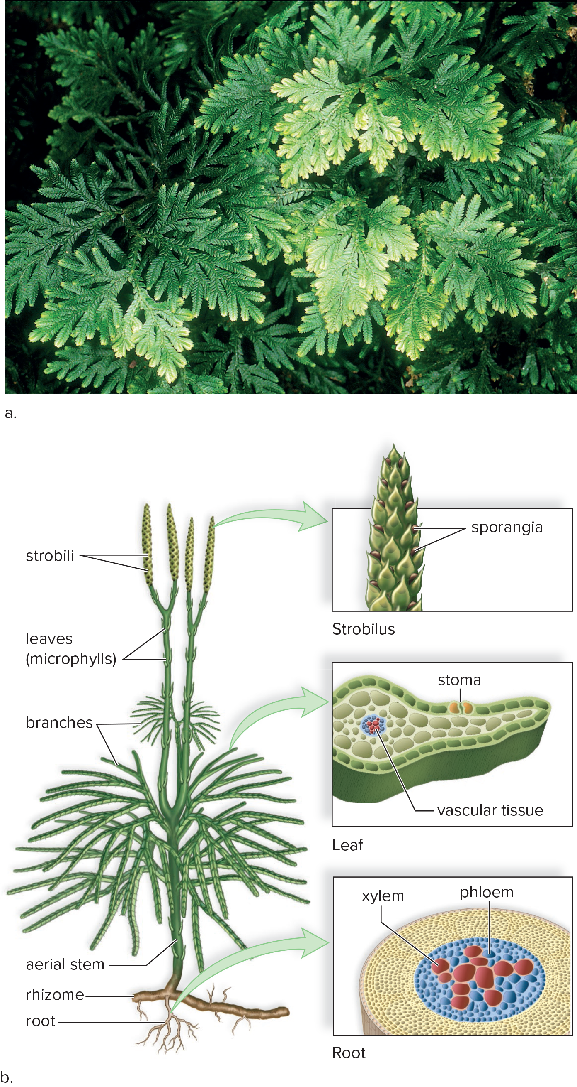
Lycophytes Example
Figure 23.11
Access the text alternative for slide images.
(a): Steven P. Lynch
Notes:
IMAGE DESCRIPTION
A) A spike moss, Selaginella.
B) The upper part of club moss consists of strobili (which further consists of sporangia units) and leaves (microphylls), the middle parts consists of branches and the lower part consists of aerial stem, lateral rhizome and root.
NOT EXPLAINED ON ANY SLIDE
• Aerial stem: a stem that grows above ground.
NOT EXPLAINED YET
• Rhizome: a stem that grows sideways underground. (24.4.48)
• Microphylls: small leaves with a single, unbranched vein. (23.4.37)
ADDS TO
Lycophytes (23.3.34)
EXAM FOCUS (Low)
Pictures of a spike moss and a club moss (strobili, microphylls); see 23.3.34.

Slide 36
23.4 Evolution of Pteridophytes: Megaphylls
Pteridophytes are seedless vascular plants
    Dominant from late Devonian through Carboniferous period
    Include ferns and their allies (horsetails and whisk ferns)
    Have megaphylls (broad leaves with several strands of vascular tissue)
      Allow plants to efficiently collect solar energy, allowing the production of more food and possibly more offspring
        Resulted in increased fitness for plants
Notes:
NOT EXPLAINED ON ANY SLIDE
• Devonian and Carboniferous: periods in Earth's history, about 419-359 and 359-299 million years ago; the Carboniferous had huge swamp forests that later became coal.
• Fitness: how many offspring an organism leaves; higher fitness means more offspring.
NOT EXPLAINED YET
• Vascular tissue: tubes that carry water (xylem) and food (phloem) through the plant. (24.1.13)
• Horsetails (Equisetum): fern relatives with jointed stems and small leaves in rings at the joints. (23.4.38)
• Whisk ferns: leafless fern relatives whose stems fork again and again. (23.4.40)
HOME NOTE
• Pteridophytes (ferns and allies)
ADDS TO
Microphylls and megaphylls (23.4.37)
EXAM FOCUS (High)
Likely:
• Pteridophytes = seedless vascular plants with megaphylls: ferns and their allies (horsetails, whisk ferns).
• Megaphylls (broad, several vascular strands) collect solar energy efficiently -> more food -> possibly more offspring -> higher fitness.
Unlikely: The Devonian and Carboniferous period names.
How: 'What advantage did megaphylls give plants?' -> more efficient sunlight collection, so more food and possibly more offspring. Trap: 'they prevent all water loss' (absolute).
Write: Nothing here; the benefit goes in the microphyll vs megaphyll entry (23.4.37).

Slide 37
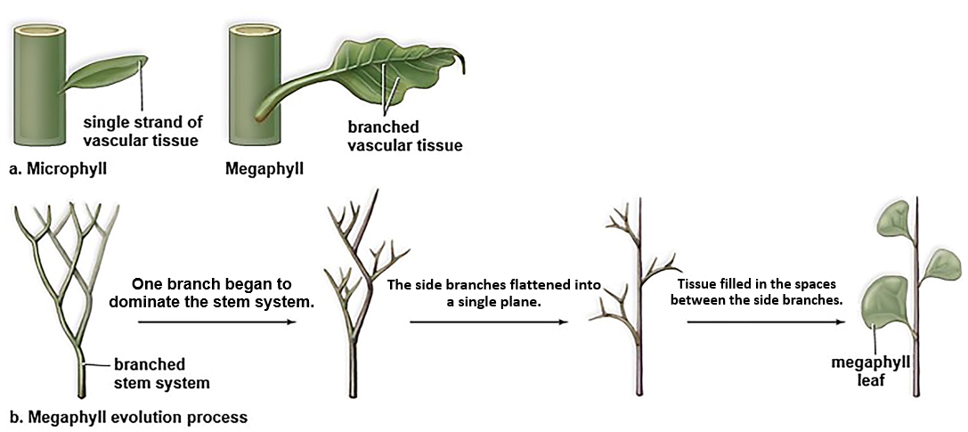
Microphylls and Megaphylls
Figure 23.12
Access the text alternative for slide images.
Notes:
IMAGE DESCRIPTION
A) Microphyll:
It consists of a single strand of vascular tissue.
Megaphyll:
It consists of branched vascular tissue.
B) Megaphyll evolution process:
The branched stem system leads to one branch began to dominate the stem system, leading to the side branches flattened into a single plane which further leads to tissue filled in the spaces between the side branches and megaphyll leaf.
NOT EXPLAINED YET
• Vascular tissue: tubes that carry water (xylem) and food (phloem) through the plant. (24.1.13)
HOME NOTE
• Microphylls and megaphylls
Also write here:
– Lycophytes (23.3.34): Microphylls most likely evolved as simple side-flaps growing out of the stem.
– Evolution of Pteridophytes: Megaphylls (23.4.36): A megaphyll's broad surface collects sunlight efficiently, so the plant makes more food and possibly more offspring; this raised plants' fitness.
EXAM FOCUS (Medium)
Likely:
• Microphyll: a single, unbranched strand of vascular tissue; megaphyll: branched vascular tissue.
• Megaphylls evolved from a branched stem: one branch took over, side branches flattened into one plane, and tissue filled the spaces between them.
Unlikely: Reciting the evolution steps in order.
How: 'Which describes a megaphyll?' -> a broad leaf with branched veins. Trap: a single unbranched vein (microphyll).
Write: Microphyll vs megaphyll:
• Microphyll: 1 unbranched vein · lycophytes · evolved as side flaps of the stem
• Megaphyll: broad, branched veins · ferns and seed plants · evolved from flattened, filled-in branches · more sunlight -> more food -> higher fitness

Slide 38
Horsetails
Horsetails consist of one genus, Equisetum, and approximately 15 species of seedless vascular plants
  Most horsetails inhabit wet, marshy environments
  Equisetum can be branched or unbranched, with leaves that may have been megaphylls at one time but now are reduced and form whorls at the nodes
  Branches bear resemblance to a horse’s tail
  Many have strobili at the tips of stems
  Spores germinate into inconspicuous and independent gametophytes
  Equisetum spores are sensitive to humidity and are “spring-loaded”
    Spores have been known to be ejected and travel upward of 2 mph
  Stems are tough and rigid because of silica deposited in cell walls
Notes:
NOT EXPLAINED ON ANY SLIDE
• Whorl: three or more leaves or branches growing in a ring around the stem at the same point.
• Silica: the hard mineral that sand and glass are made of.
NOT EXPLAINED YET
• Node: the point on a stem where leaves or branches attach. (24.2.20)
HOME NOTE
• Horsetails
EXAM FOCUS (Medium)
Likely:
• Horsetails: one genus, Equisetum; mostly wet, marshy places.
• Small (reduced) leaves in whorls at the nodes; branches look like a horse's tail.
• Strobili at the stem tips; spores grow into small, independent gametophytes and are "spring-loaded".
• Silica in the cell walls makes the stems tough and rigid.
Unlikely: 15 species; spore speed (2 mph).
How: 'A plant has jointed stems with rings of small leaves at the nodes and gritty, silica-stiffened stems. Which group?' -> horsetails. Trap: whisk ferns (no leaves), club mosses.
Write: Nothing here; it's the horsetail row of the table at 23.3.34.

Slide 39
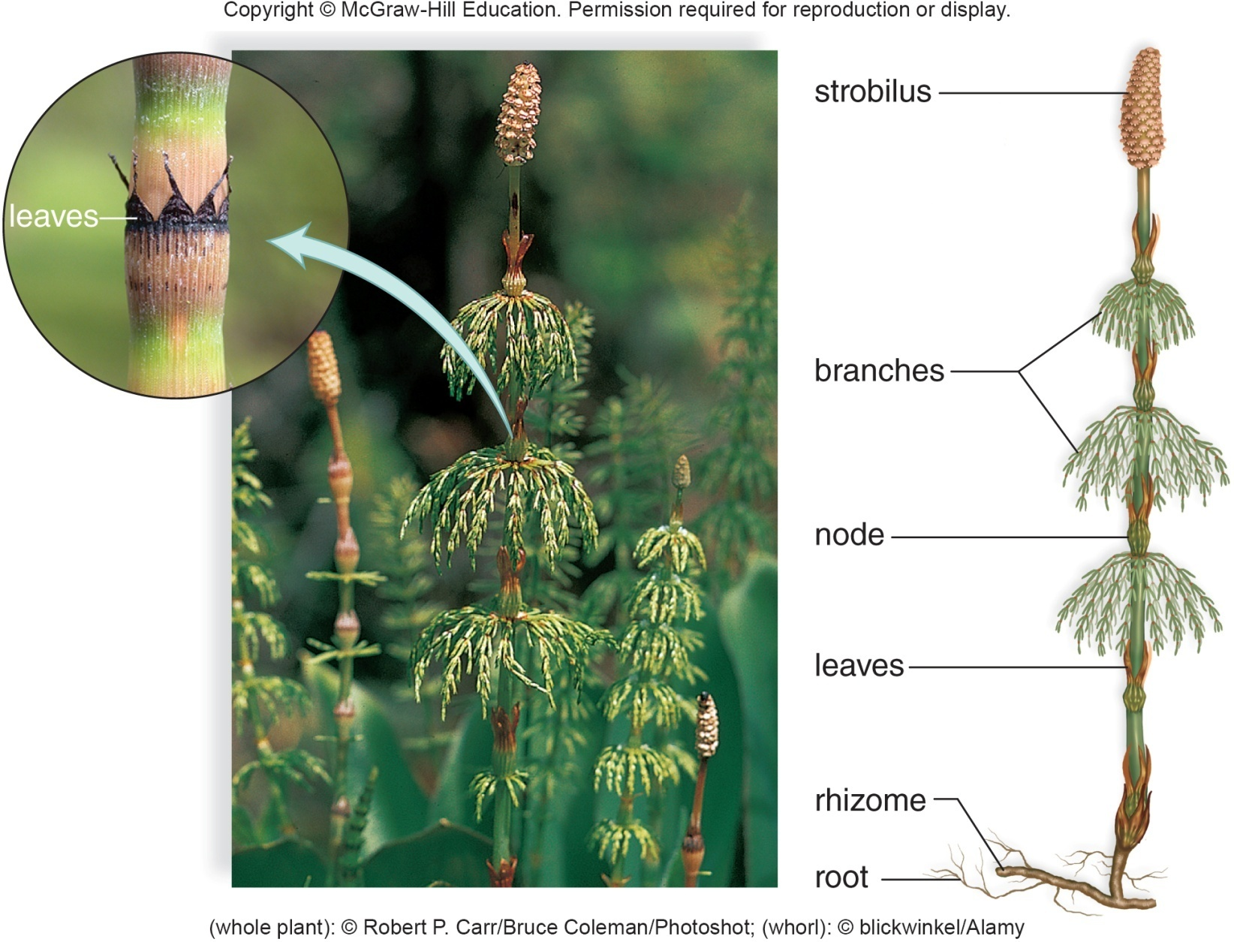
Horsetail, Equisetum
Figure 23.13
(leaves): blickwinkel/Alamy Stock Photo; (plant): Robert Carr/Photoshot
Notes:
IMAGE DESCRIPTION
Diagram of horsetail plant shows labels for root, rhizome, leaves, node, branches, and strobilus.
NOT EXPLAINED YET
• Rhizome: a stem that grows sideways underground. (24.4.48)
• Node: the point on a stem where leaves or branches attach. (24.2.20)
COVERED ELSEWHERE
Horsetails (23.4.38)
EXAM FOCUS (Low)
Labeled horsetail diagram; see 23.4.38.

Slide 40
Whisk Ferns
Whisk ferns consist of two genera: Psilotum and Tmesipteris
  Resemble whisk brooms because they have no leaves
  Horizontal rhizome gives rise to aboveground stems that repeatedly fork
  Pumpkin-shaped sporangia are on short side branches
  Tmesipteris species have appendages resembling reduced megaphylls
Notes:
NOT EXPLAINED YET
• Rhizome: a stem that grows sideways underground. (24.4.48)
HOME NOTE
• Whisk ferns
EXAM FOCUS (Medium)
Likely:
• Whisk ferns: Psilotum and Tmesipteris.
• No leaves (they look like whisk brooms); stems fork again and again from a horizontal rhizome.
• Pumpkin-shaped sporangia on short side branches.
Unlikely: Tmesipteris's appendages.
How: 'Which seedless vascular plant has no leaves and repeatedly forking stems?' -> whisk ferns. Trap: horsetails (small whorled leaves).
Write: Nothing here; it's the whisk-fern row of the table at 23.3.34.

Slide 41
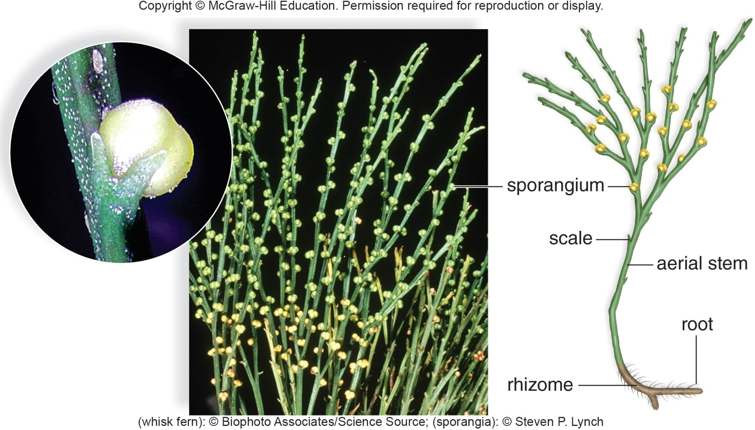
Whisk Fern, Psilotum
Figure 23.14
(sporangia): Steven P. Lynch; (plant): Biophoto Associates/Science Source
Notes:
(sporangia): Steven P. Lynch; (plant): Biophoto Associates/Science Source
IMAGE DESCRIPTION
Close-up of sporangium (left). Diagram of whisk fernroot plant (right) shows labels for rhizome, root, aerial stem, scale and sporangium.
NOT EXPLAINED YET
• Rhizome: a stem that grows sideways underground. (24.4.48)
COVERED ELSEWHERE
Whisk ferns (23.4.40)
EXAM FOCUS (Low)
Psilotum pictures; see 23.4.40.

Slide 42
Ferns
    Approximately 11,000 species
    Most abundant in warm, moist, tropical regions
    Range in size from 1 cm in diameter to 20 m in height
    Large, conspicuous megaphylls are called fronds
      Divided into leaflets
      Sporangia are in clusters called sori on the undersides of fronds
    Dominant sporophyte produces windblown spores by meiosis within sporangia
Notes:
NOT EXPLAINED YET
• Leaflets: the small separate blades that make up a divided (compound) leaf, like the many small segments of a fern frond. (24.5.54)
HOME NOTE
• Ferns
Also write here:
– Diversity of Ferns (23.4.44): Examples: tree fern, leatherleaf fern and hart's tongue fern.
EXAM FOCUS (High)
Likely:
• Ferns: large, conspicuous megaphylls called fronds, divided into leaflets.
• Sori = clusters of sporangia on the undersides of the fronds.
• The dominant sporophyte makes windblown spores by meiosis in the sporangia.
Unlikely: About 11,000 species; size range; tropical distribution.
How:
• 'Clusters of sporangia on the underside of a fern frond are called...' -> sori. Trap: strobili, gemmae.
• 'A fern's large leaves are called...' -> fronds. Trap: microphylls.
Write: Nothing here; it's the fern row of the table at 23.3.34.

Slide 43
Fern Life Cycle
  Windblown spores eventually germinate into gametophytes which produce sperm
  Sperm swim from antheridium to archegonium where fertilization occurs
  When the gametophyte disappears the sporophyte is independent
    Both generations of a fern are considered to be independent of one another
Notes:
ADDS TO
Fern life cycle (23.4.52)
EXAM FOCUS (Medium)
Likely: The fern gametophyte makes sperm that swim from the antheridium to the archegonium; both fern generations are independent.
Unlikely: Nothing to skip; every point here is testable.
How: 'Unlike in mosses, in ferns both generations...' -> live independently (the moss sporophyte stays attached). Trap: 'the sporophyte depends on the gametophyte for life'.
Write: Nothing here; it goes in the fern life-cycle box (23.4.52).

Slide 44
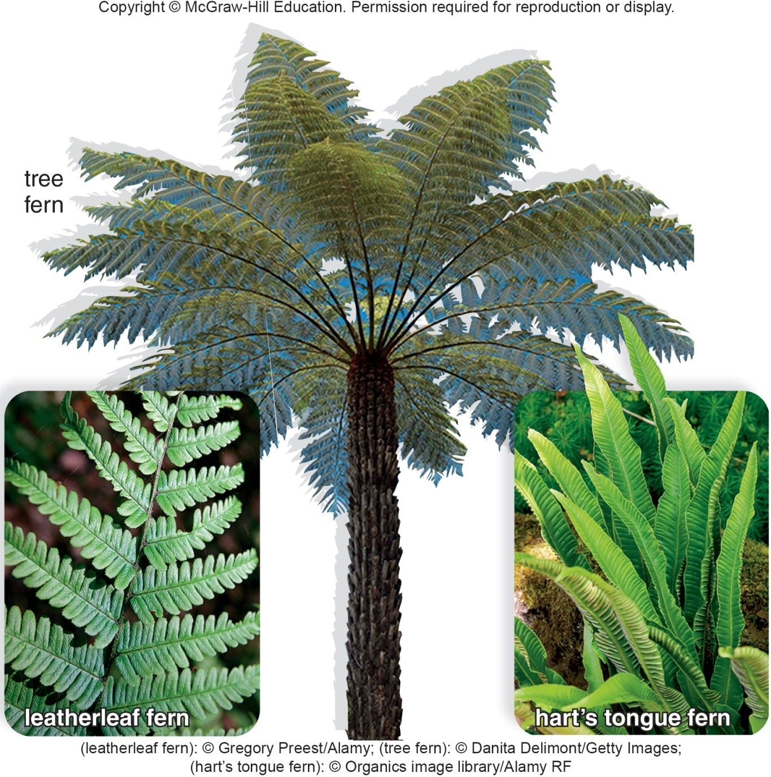
Diversity of Ferns
Figure 23.15
(leatherleaf fern): Gregory Preest/Alamy Stock Photo; (tree fern): Danita Delimont/Gallo Images/Getty Images; (hart’s tongue fern): Organics/image library/Alamy Stock Photo
Notes:
IMAGE DESCRIPTION
Photos of a tree fern, a feather leaf fern, and a hart’s tongue fern.
ADDS TO
Ferns (23.4.42)
EXAM FOCUS (Low)
Photos of fern diversity (tree fern, leatherleaf, hart's tongue); see 23.4.42.

Slide 45
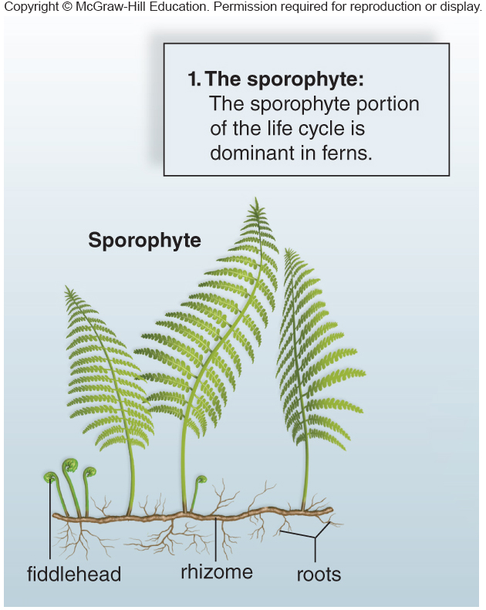
Fern Life Cycle 1
Figure 23.16
Notes:
IMAGE DESCRIPTION
The sporophyte portion of the life cycle is dominant in ferns.
COVERED ELSEWHERE
Fern life cycle (23.4.52)
EXAM FOCUS (Low)
Fern cycle: the sporophyte is dominant; see 23.4.52.

Slide 46
Fern Life Cycle 2
Figure 23.16
Notes:
CLARIFICATION
The picture on this slide is actually the moss life cycle (the same picture as 23.2.30), but the slide title and the image description are about the fern life cycle (23.4.52).
IMAGE DESCRIPTION
Step 1, the sporophyte portion of the life cycle is dominant in ferns.
COVERED ELSEWHERE
Fern life cycle (23.4.52)
EXAM FOCUS (Low)
Fern cycle step 1 (dominant sporophyte); see 23.4.52.

Slide 47
Fern Life Cycle 3
Figure 23.16
Notes:
CLARIFICATION
The picture on this slide is actually the moss life cycle (the same picture as 23.2.30), but the slide title and the image description are about the fern life cycle (23.4.52).
IMAGE DESCRIPTION
Step 2, in this fern, the sporangia are located within sori, on the underside of the leaflets, and protected by the indusium.
NOT EXPLAINED ON ANY SLIDE
• Indusium: a thin flap of tissue covering a sorus (cluster of sporangia).
NOT EXPLAINED YET
• Leaflets: the small separate blades that make up a divided (compound) leaf, like the many small segments of a fern frond. (24.5.54)
COVERED ELSEWHERE
Fern life cycle (23.4.52)
EXAM FOCUS (Low)
Fern cycle step 2 (sporangia in sori under the leaflets); see 23.4.52.

Slide 48
Fern Life Cycle 4
Figure 23.16
Notes:
CLARIFICATION
The picture on this slide is actually the moss life cycle (the same picture as 23.2.30), but the slide title and the image description are about the fern life cycle (23.4.52).
IMAGE DESCRIPTION
Step 3, within a sporangium, meiosis occurs and spores are produced. When a sporangium opens, the spores are released.
COVERED ELSEWHERE
Fern life cycle (23.4.52)
EXAM FOCUS (Low)
Fern cycle step 3 (meiosis in sporangia makes spores); see 23.4.52.

Slide 49
Fern Life Cycle 5
Figure 23.16
Notes:
CLARIFICATION
The picture on this slide is actually the moss life cycle (the same picture as 23.2.30), but the slide title and the image description are about the fern life cycle (23.4.52).
IMAGE DESCRIPTION
Step 4, a spore germinates into a prothallus (the gametophyte), which typically bears archegonia at the notch and antheridia at the tip between the rhizoids.
COVERED ELSEWHERE
Fern life cycle (23.4.52)
EXAM FOCUS (Low)
Fern cycle step 4 (spore -> prothallus with archegonia and antheridia); see 23.4.52.

Slide 50
Fern Life Cycle 6
Figure 23.16
Access the text alternative for slide images.
Notes:
CLARIFICATION
The picture on this slide is actually the moss life cycle (the same picture as 23.2.30), but the slide title and the image description are about the fern life cycle (23.4.52).
IMAGE DESCRIPTION
Fertilization takes place when moisture is present, because the flagellated sperm must swim in a film of water from the antheridia to the egg within the archegonium.
COVERED ELSEWHERE
Fern life cycle (23.4.52)
EXAM FOCUS (Low)
Fern cycle step 5 (sperm swim in water to the egg); see 23.4.52.

Slide 51
Fern Life Cycle 7
Figure 23.16
Access the text alternative for slide images.
Notes:
CLARIFICATION
The picture on this slide is actually the moss life cycle (the same picture as 23.2.30), but the slide title and the image description are about the fern life cycle (23.4.52). The short image description is the moss step (protonema); the full one is the fern step.
IMAGE DESCRIPTION
Step 6, spores germinate into male or female immature gametophytes (protonema).
The resulting sporophyte zygote begins its development inside an archegonium. As the distinctive first leaf appears above the prothallus, and the roots develop below it, the sporophyte becomes visible.
COVERED ELSEWHERE
Fern life cycle (23.4.52)
EXAM FOCUS (Low)
Fern cycle step 6 (zygote grows into a new sporophyte on the prothallus); see 23.4.52.

Slide 52
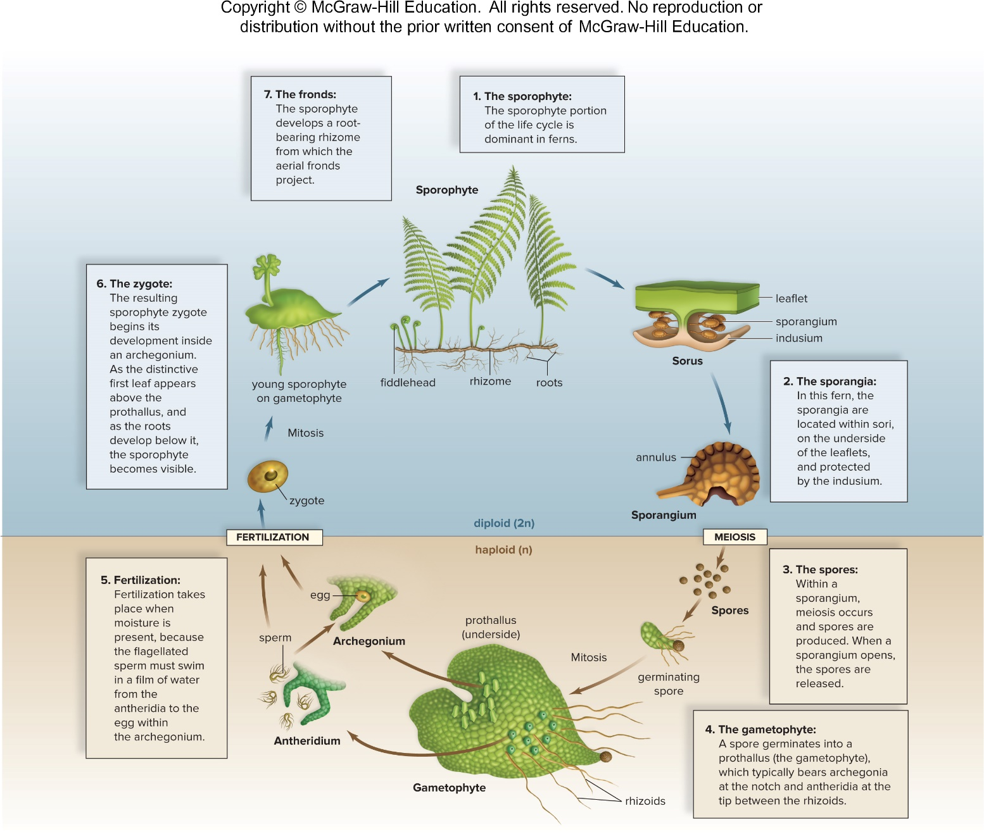
Fern Life Cycle 8
Figure 23.16
Access the text alternative for slide images.
Notes:
IMAGE DESCRIPTION
Details of the fern life cycle are shown. 1. The sporophyte: The sporophyte portion of the life cycle is dominant in ferns. 2. The sporangia: In this fern, the sporangia are located within sori, on the underside of the leaflets, and protected by the indusium. 3. The spores: Within a sporangium, meiosis occurs and spores are produced. When a sporangium opens, the spores are released. 4. The gametophyte: A spore germinates into a prothallus (the gametophyte), which typically bears archegonia at the notch and antheridia at the tip between the rhizoids. 5. Fertilization: Fertilization takes place when moisture is present, because the flagellated sperm must swim in a film of water from the antheridia to the egg within the archegonium. 6. The zygote: The resulting sporophyte zygote begins its development inside an archegonium. As the distinctive first leaf appears above the prothallus, and the roots develop below it, the sporophyte becomes visible. 7. The fronds: The sporophyte develops a root-bearing rhizome from which the aerial fronds project.
NOT EXPLAINED YET
• Rhizome: a stem that grows sideways underground. (24.4.48)
• Leaflets: the small separate blades that make up a divided (compound) leaf, like the many small segments of a fern frond. (24.5.54)
HOME NOTE
• Fern life cycle
Also write here:
– Fern Life Cycle (23.4.43): In ferns both generations live on their own: the gametophyte is a separate little plant, and once it dies the sporophyte is fully independent.
EXAM FOCUS (High)
Likely:
• The sporophyte (the fern) is dominant.
• Meiosis in sporangia (in sori under the fronds) makes spores.
• Spore -> prothallus (the gametophyte, n) with archegonia and antheridia.
• Flagellated sperm swim in a film of water to the egg, so fertilization needs moisture.
• The zygote grows into a new sporophyte on the prothallus; fronds rise from a rhizome.
Unlikely: The indusium and "notch" labels.
How:
• 'In ferns, which structure is the gametophyte?' -> the prothallus. Trap: protonema (moss), sorus, frond.
• 'Why do ferns need moisture to reproduce?' -> the sperm must swim to the egg. Trap: 'the fronds absorb water for the spores'.
• 'Where does meiosis occur in a fern?' -> in sporangia, in the sori. Trap: the prothallus.
Write: Fern life-cycle box (same rows as the moss box):
• Dominant: sporophyte (the fern)
• Meiosis: in sporangia, in sori under the fronds -> spores
• Gametophyte: spore -> prothallus (small, separate plant) with archegonia + antheridia
• Fertilization: sperm swim through water to the egg; moisture needed
• Sporophyte: grows out of the prothallus, which then dies; both generations independent

Slide 53
The Uses of Ferns
Ferns have economic and medicinal value
  Edible ferns are used as a food source
  Native Americans use them as an astringent during childbirth to stop bleeding
  Maidenhair fern is the source of a cold medicine
  Ferns are frequently used by florists in decorative bouquets and as ornamental plants in the home and garden
  Wood from tropical tree ferns is often used as a building material, because it resists decay, particularly by termites
Notes:
NOT EXPLAINED ON ANY SLIDE
• Astringent: something that makes body tissues tighten, which helps stop bleeding.
EXAM FOCUS (Low)
Uses (rarely asked): maidenhair fern -> cold medicine; tree-fern wood resists decay and termites. One line each.

Slide 54
23.5 Evolution of Seed Plants: Full Adaptation to Land
Seed plants are vascular plants that use seeds during the dispersal phase of their life cycle
  Seeds contain a sporophyte embryo and stored food within a protective seed coat
    Seed coat and stored food allow an embryo to survive harsh conditions during long periods of dormancy (arrested state) until environmental conditions become favorable for growth
    When a seed germinates, the stored food is a source of nutrients for the growing seedling
    Survival of seeds largely accounts for the dominance of seed plants today
Notes:
ADDS TO
Dormancy (27.3.33)
EXAM FOCUS (High)
Likely:
• Seed plants: vascular plants that use seeds to disperse.
• Seed = sporophyte embryo + stored food + protective seed coat.
• Coat + food let the embryo survive harsh conditions through dormancy; the stored food feeds the seedling.
• Seed survival largely explains why seed plants dominate today.
Unlikely: Nothing to skip; every point here is testable.
How:
• 'What lets a seed's embryo survive long periods of harsh conditions?' -> the seed coat and stored food. Trap: 'the embryo photosynthesizes inside the seed'.
• 'A seed contains...' -> an embryo, stored food and a seed coat. Trap: 'a gametophyte and spores'.
Write: Seed = embryo + stored food + seed coat; why seeds matter: survive dormancy, feed the seedling, explain seed plants' dominance.

Slide 55
Seed Plants
Seed plants are heterosporous (have microspores and megaspores)
Unlike other plant groups, seed plants retain the spores rather than release them into the environment
  Microspores become male gametophytes (pollen grains)
    Pollination occurs when wind or a pollinator carries pollen to the female gametophyte
      Sperm move toward the female gametophyte through a pollen tube
      Megaspore develops into a female gametophyte within an ovule, which becomes a seed following fertilization
      No external water is needed to accomplish fertilization
Notes:
NOT EXPLAINED YET
• Pollen grain: the tiny male gametophyte of a seed plant; it carries the sperm to the egg. (27.1.12)
• Ovule: a small structure where the female gametophyte (with its egg) develops; after fertilization it becomes the seed. (27.1.14)
ADDS TO
Pollination (27.1.15) · Pollen tube (27.1.17)
EXAM FOCUS (High)
Likely:
• Seed plants are heterosporous and RETAIN their spores instead of releasing them.
• Microspores -> pollen grains (male gametophytes).
• Pollination: wind or a pollinator carries pollen to the female gametophyte.
• Sperm reach the egg through a pollen tube, so no external water is needed.
• The megaspore -> female gametophyte inside an ovule; the ovule becomes the seed.
Unlikely: Nothing to skip; every point here is testable.
How:
• 'Why don't seed plants need water for fertilization?' -> a pollen tube delivers the sperm. Trap: 'sperm swim in a film of water' (bryophytes, ferns).
• 'In seed plants, the ovule becomes the...' -> seed. Trap: fruit (the ovary becomes the fruit).
• 'Unlike other plants, what do seed plants do with their spores?' -> keep (retain) them. Trap: release them into the wind.
Write: Non-seed vs seed plants:
• Non-seed (mosses, ferns): spores released; sperm swim through water
• Seed plants: spores kept; microspore -> pollen grain; megaspore -> female gametophyte in an ovule -> seed; pollen tube delivers the sperm, no water needed

Slide 56
Gymnosperms and Angiosperms
In gymnosperms (mostly cone-bearing seed plants), the ovules are not completely enclosed by sporophyte tissue at the time of pollination
In angiosperms (flowering plants), the ovules are completely enclosed within diploid sporophyte tissue (ovary), which becomes a fruit.
Notes:
NOT EXPLAINED YET
• Ovule: a small structure where the female gametophyte (with its egg) develops; after fertilization it becomes the seed. (27.1.14)
• Ovary: the swollen base of a flower's female part; it holds the ovules and later becomes the fruit. (23.5.84)
HOME NOTE
• Gymnosperms vs angiosperms
EXAM FOCUS (High)
Likely:
• Gymnosperms (mostly cone-bearing): ovules not completely enclosed by sporophyte tissue at pollination ("naked" seeds).
• Angiosperms (flowering plants): ovules completely enclosed in diploid tissue, the ovary, which becomes a fruit.
Unlikely: Nothing to skip; every point here is testable.
How:
• 'Which feature distinguishes angiosperms from gymnosperms?' -> ovules enclosed in an ovary that becomes a fruit. Trap: seeds, vascular tissue, pollen (both groups have them).
• 'Why are gymnosperm seeds called naked?' -> they aren't enclosed in an ovary or fruit. Trap: 'they have no seed coat'.
Write: Gymnosperm vs angiosperm:
• Gymnosperm: "naked" seeds, usually on cones; no flowers or fruit; e.g. pines
• Angiosperm: flowers; ovules inside an ovary, which becomes a fruit around the seeds

Slide 57
Gymnosperms
    Seeds are not enclosed by fruit—“naked” seeds.
    1,000 species divided into four extant groups:
      Conifers – Most plentiful
      Cycads
      Ginkgoes
      Gnetophytes
Notes:
NOT EXPLAINED ON ANY SLIDE
• Extant: still living today (not extinct).
NOT EXPLAINED YET
• Conifers: cone-bearing trees and shrubs with needle- or scale-like leaves, like pines. (23.5.58)
• Cycads: gymnosperms with large, finely divided leaves at the top of the stem and big cones. (23.5.70)
• Ginkgoes: a group with one surviving species, the ginkgo tree (Ginkgo biloba). (23.5.72)
• Gnetophytes: a small group of three genera (Gnetum, Ephedra, Welwitschia). (23.5.74)
COVERED ELSEWHERE
Gymnosperms vs angiosperms (23.5.56)
EXAM FOCUS (Medium)
Likely: Gymnosperm seeds aren't enclosed by fruit ("naked"); the four living groups: conifers (most plentiful), cycads, ginkgoes, gnetophytes.
Unlikely: About 1,000 species.
How: 'Which gymnosperm group is the most plentiful?' -> conifers. Trap: cycads, ginkgoes. (Or a "which is a gymnosperm" list with a fern or flowering plant as the trap.)
Write: Gymnosperm table (write all four rows here):
• Conifers (23.5.58): needles with a thick cuticle + recessed stomata; windblown pollen; monoecious; e.g. pine, spruce, juniper
• Cycads (23.5.70): big divided leaves at the stem top; huge cones on separate plants; insect-pollinated; swimming sperm
• Ginkgoes (23.5.72): one species; dioecious; pollution-tolerant; swimming sperm; extracts for blood circulation
• Gnetophytes (23.5.74): no archegonia; Ephedra (ephedrine), Welwitschia (2 strap leaves), Gnetum (trees or vines, broad leaves)

Slide 58
Conifers
  About 630 species
    Produce cones
    Tough, needlelike leaves of pines conserve water with a thick cuticle and recessed stomata
    Sporophyte is dominant
    Pollen grains are windblown
    Seed is the dispersal stage
    Monoecious – A single plant produces both pollen (male reproductive structure) and seed cones (female reproductive structure)
Notes:
NOT EXPLAINED YET
• Pollen cones and seed cones: male cones (small; make pollen) and female cones (larger; make seeds). (23.5.68)
HOME NOTE
• Conifers
Also write here:
– Conifer Examples (23.5.59): Examples: pine (with pollen cones and seed cones), spruce (needle leaves) and juniper (a tall shrub with scale-like leaves).
ADDS TO
Stomata (24.5.52) · Adaptations to land (23.1.9) · Monoecious vs dioecious (27.1.10)
EXAM FOCUS (Medium)
Likely:
• Conifers produce cones; they are the most plentiful gymnosperms.
• Tough needles with a thick cuticle and recessed stomata -> conserve water.
• Sporophyte dominant; windblown pollen; the seed is the dispersal stage.
• Monoecious: one plant has both pollen cones (male) and seed cones (female).
Unlikely: About 630 species.
How:
• 'One pine tree bears both pollen cones and seed cones. This is...' -> monoecious. Trap: dioecious.
• 'Which features help pine needles conserve water?' -> a thick cuticle and recessed stomata. Trap: broad megaphylls.
Write: Nothing here; it's the conifer row of the table at 23.5.57 (monoecious vs dioecious goes at 27.1.10).

Slide 59
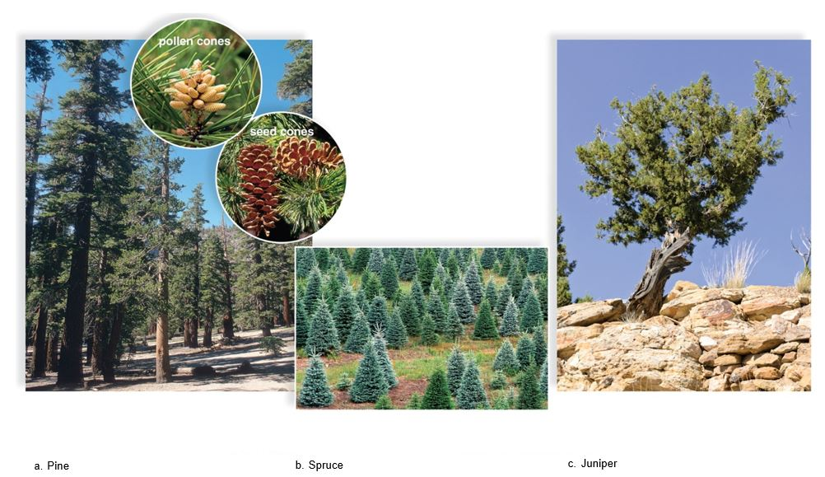
Conifer Examples
Figure 23.17
(a): (seed cones): Steven P. Lynch; (pollen cones): Maria Mosolova/Stockbyte/Getty Images; forest): Steven P. Lynch; (b): Ed Reschke/Stone/Getty Images; (c): Steffen Hauser/botanikfoto/Alamy Stock Photo
Notes:
IMAGE DESCRIPTION
Examples of conifer include pine having pollen and seed cones (a), spruce (needless leaves), and Juniper (tall shrub, scale-like leaves.
NOT EXPLAINED YET
• Pollen cones and seed cones: male cones (small; make pollen) and female cones (larger; make seeds). (23.5.68)
ADDS TO
Conifers (23.5.58)
EXAM FOCUS (Low)
Conifer examples (pine, spruce, juniper); see 23.5.58.

Slide 60
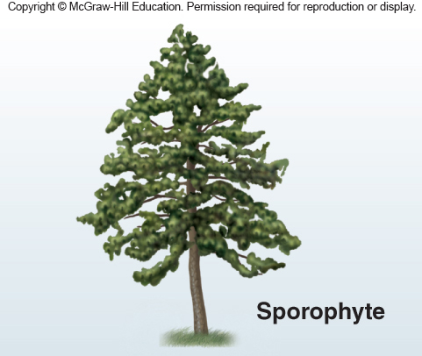
Pine Life Cycle 1
Figure 23.18
Notes:
IMAGE DESCRIPTION
The tree is the most prominent structure in the pine life cycle. It is diploid (2N) and a sporophyte. It has both pollen cones and pine cones.
ADDS TO
Pine life cycle (pollen and seed cones) (23.5.68)
EXAM FOCUS (Low)
Pine cycle: the tree is the diploid sporophyte with pollen and seed cones; see 23.5.68.

Slide 61
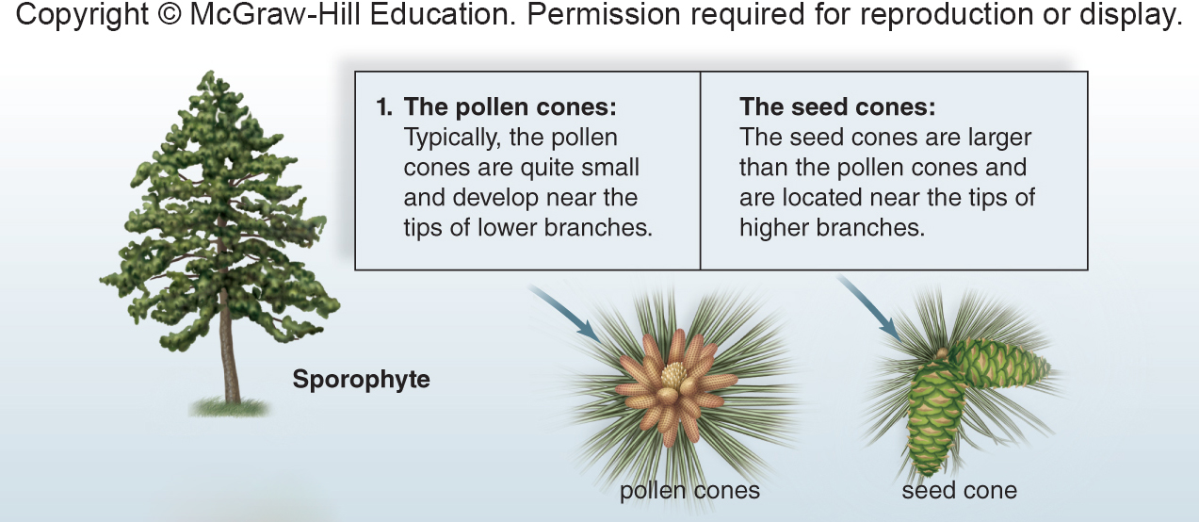
Pine Life Cycle 2
Figure 23.18
Notes:
IMAGE DESCRIPTION
Pollen cones are typically quite small and develop near the tips of lower branches whereas seed cones are larger and located at higher branches.
COVERED ELSEWHERE
Pine life cycle (pollen and seed cones) (23.5.68)
EXAM FOCUS (Low)
Pine cycle: small pollen cones low on the tree, larger seed cones higher up; see 23.5.68.

Slide 62
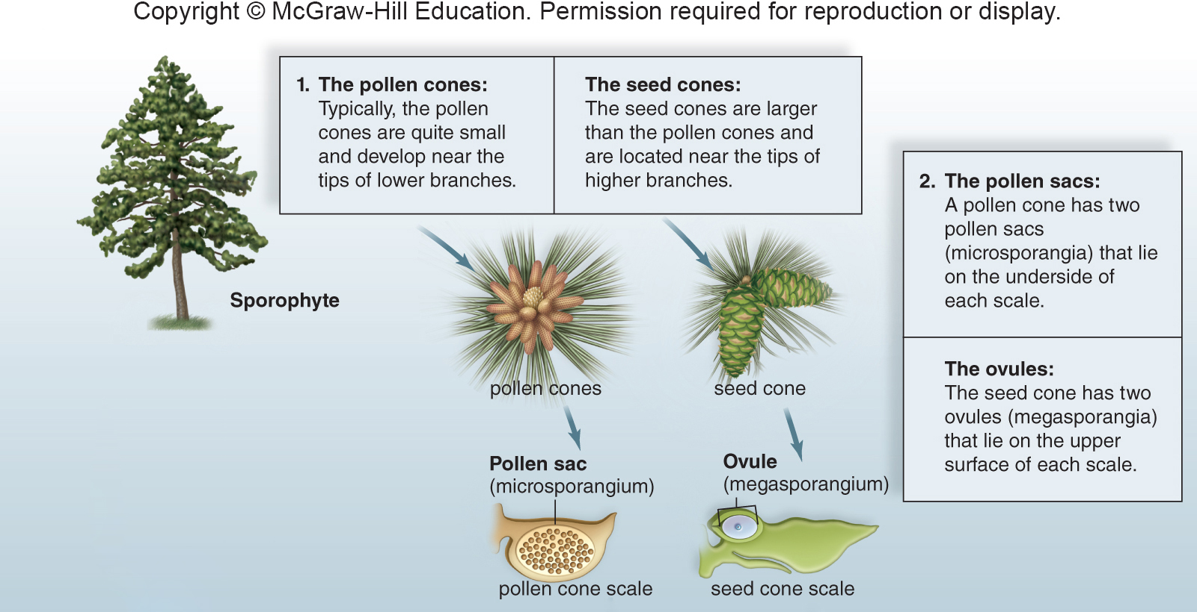
Pine Life Cycle 3
Figure 23.18
Access the text alternative for slide images.
Notes:
IMAGE DESCRIPTION
The pollen sac: A pollen cone has two pollen sacs (microsporangia) that lie on the underside of each scale. The ovules: The seed cone has two ovules (megasporangia) that lie on the upper surface of each scale.
NOT EXPLAINED ON ANY SLIDE
• Megasporangium (plural megasporangia): a sporangium that makes megaspores; in seed plants it is part of the ovule.
• Scale (of a cone): one of the flaps that make up a cone (woody in seed cones).
NOT EXPLAINED YET
• Ovule: the small structure on a seed-cone scale where the female gametophyte and its egg develop; it becomes the seed. (27.1.14)
• Pollen sacs (microsporangia): the sacs where pollen is made. (27.1.12)
COVERED ELSEWHERE
Pine life cycle (pollen and seed cones) (23.5.68)
EXAM FOCUS (Low)
Pine cycle: pollen sacs under the pollen-cone scales, ovules on top of the seed-cone scales; see 23.5.68.

Slide 63
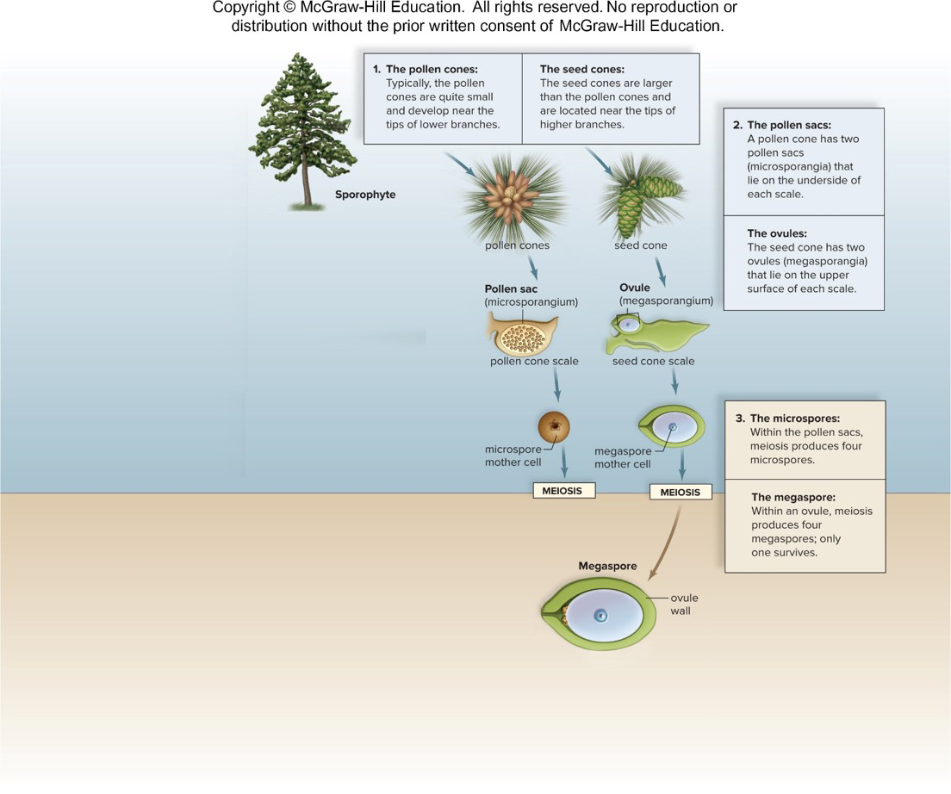
Pine Life Cycle 4
Figure 23.18
Notes:
IMAGE DESCRIPTION
Microspores: Within the pollen sacs, meiosis produces four microspores. Megaspore: Within an ovule, meiosis produces 4 megaspores; only 1 survives.
NOT EXPLAINED YET
• Pollen sacs: the sacs where pollen is made. (27.1.12)
• Ovule: a small structure where the female gametophyte (with its egg) develops; after fertilization it becomes the seed. (27.1.14)
COVERED ELSEWHERE
Pine life cycle (pollen and seed cones) (23.5.68)
EXAM FOCUS (Low)
Pine cycle: meiosis makes microspores in pollen sacs and 4 megaspores (1 survives) in each ovule; see 23.5.68.

Slide 64
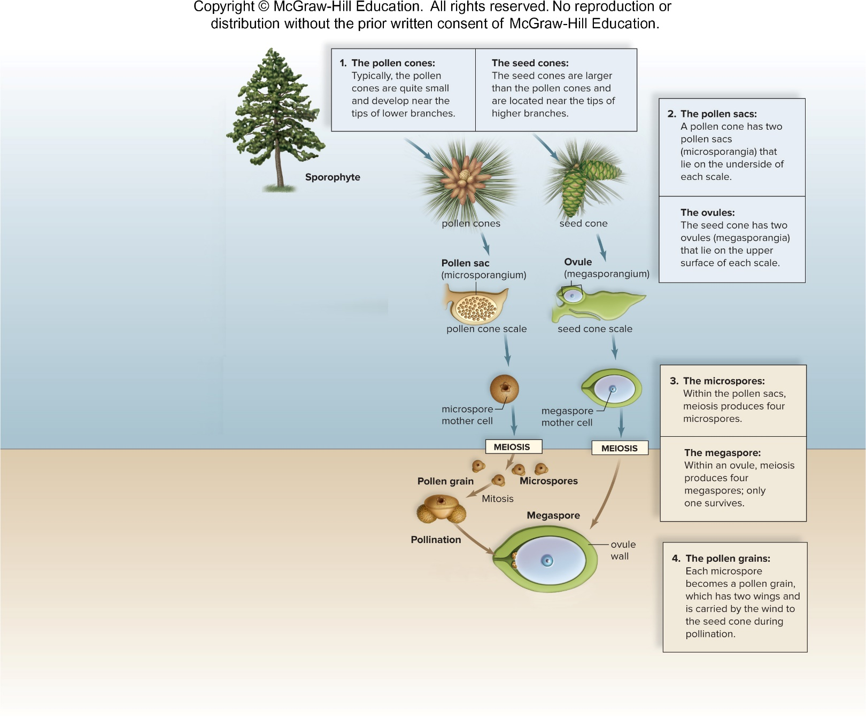
Pine Life Cycle 5
Figure 23.18
Notes:
IMAGE DESCRIPTION
The pollen grains: Each microspore becomes a pollen grain, which has two wings and is carried by the wind to the seed cone during pollination.
COVERED ELSEWHERE
Pine life cycle (pollen and seed cones) (23.5.68)
EXAM FOCUS (Low)
Pine cycle: winged pollen carried by wind (pollination); see 23.5.68.

Slide 65
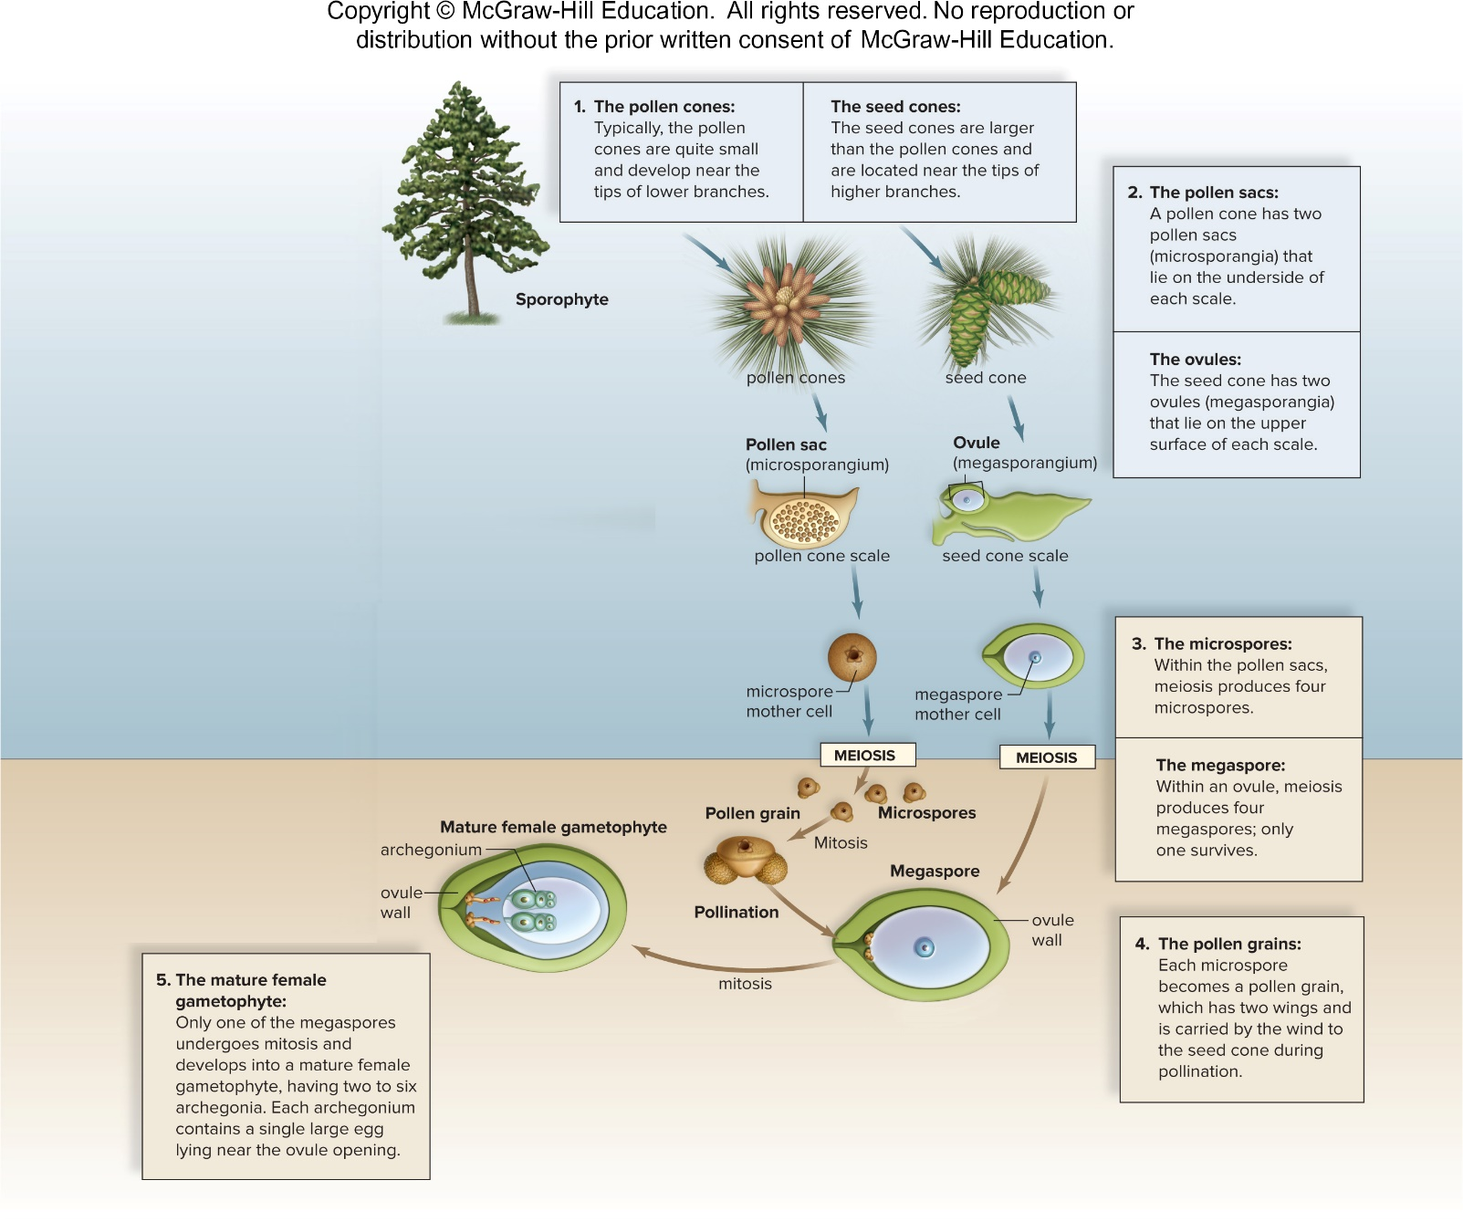
Pine Life Cycle 6
Figure 23.18
Access the text alternative for slide images.
Notes:
IMAGE DESCRIPTION
The mature female gametophyte: Only one of the megaspores undergoes mitosis and develops into a mature female gametophyte, having 2 to 6 archegonia. Each archegonium contains a single large egg lying near the ovule.
NOT EXPLAINED YET
• Ovule: a small structure where the female gametophyte (with its egg) develops; after fertilization it becomes the seed. (27.1.14)
COVERED ELSEWHERE
Pine life cycle (pollen and seed cones) (23.5.68)
EXAM FOCUS (Low)
Pine cycle: female gametophyte with archegonia and eggs; see 23.5.68.

Slide 66
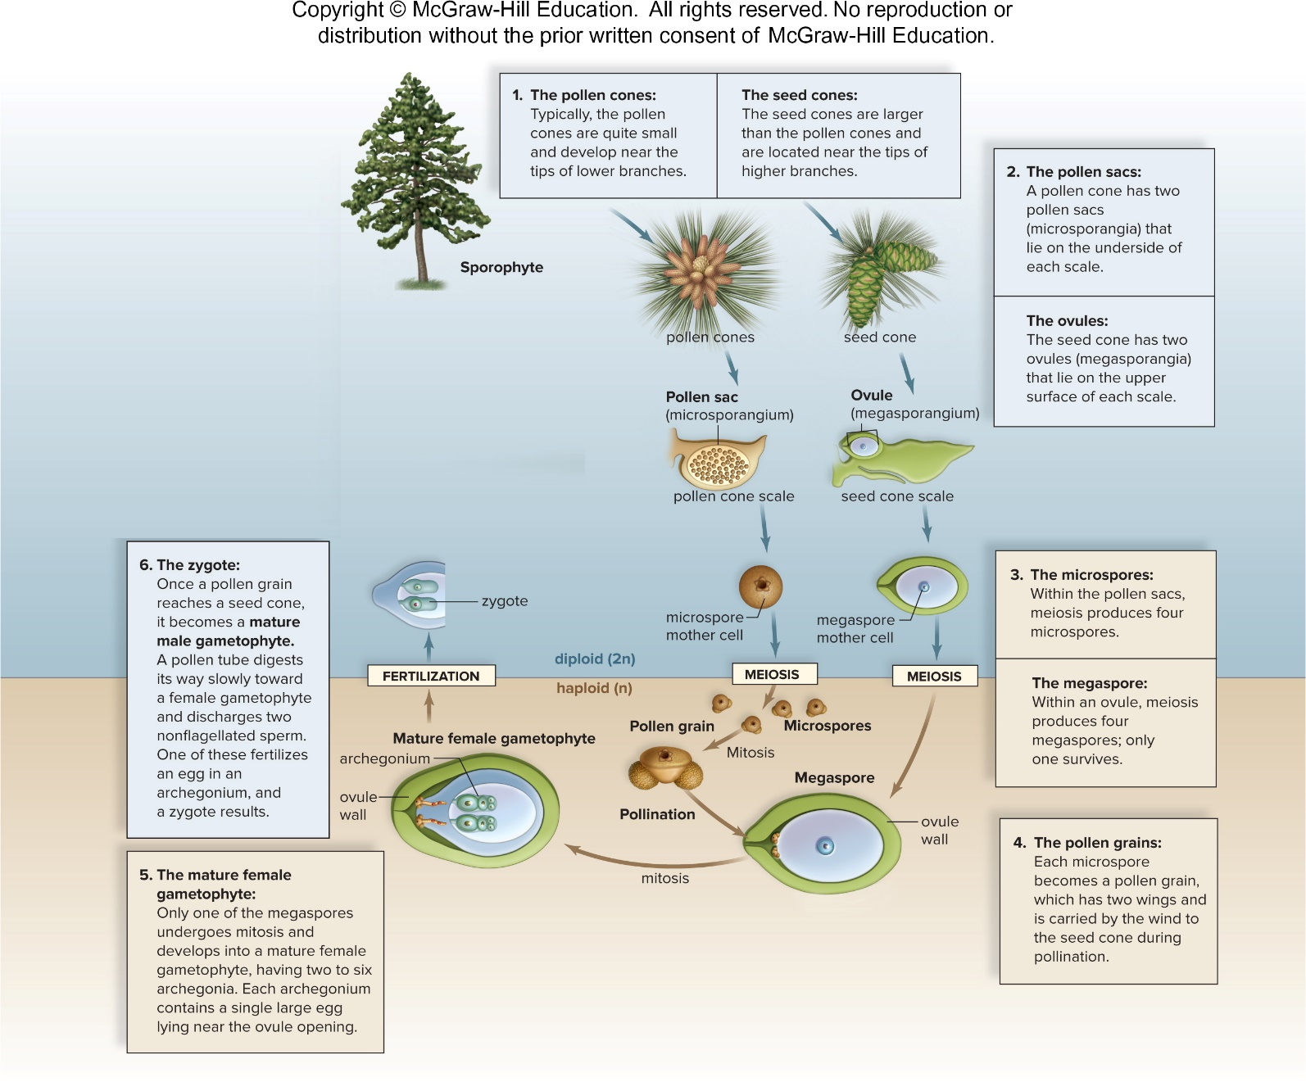
Pine Life Cycle 7
Figure 23.18
Access the text alternative for slide images.
Notes:
IMAGE DESCRIPTION
The zygote: Once a pollen grain reaches a seed cone, it becomes a mature male gametophyte. A pollen tube digests its way slowly toward a female gametophyte and discharges two nonflagellated sperm. One of these fertilizes an egg in an archegonium, and a zygote results.
COVERED ELSEWHERE
Pine life cycle (pollen and seed cones) (23.5.68)
EXAM FOCUS (Low)
Pine cycle: the pollen tube delivers non-swimming sperm; fertilization -> zygote; see 23.5.68.

Slide 67
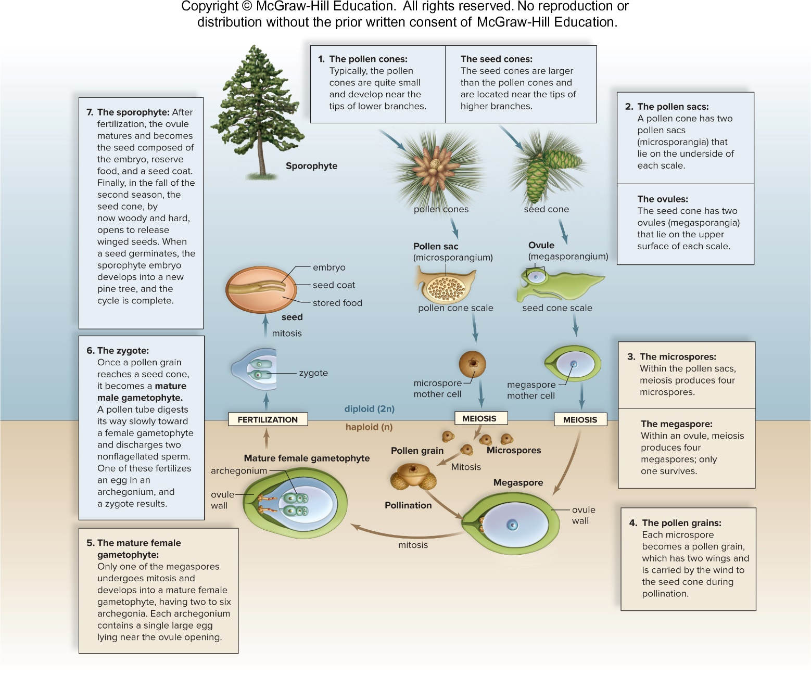
Pine Life Cycle 8
Figure 23.18
Access the text alternative for slide images.
Notes:
IMAGE DESCRIPTION
The sporophyte: After fertilization, the ovule matures and becomes the seed composed of the embryo, reserve food, and a seed coat. Finally, in the fall of the second season, the seed cone, by now woody and hard, opens to release winged seeds. When a seed germinates, the sporophyte embryo develops into a new pine tree, and the cycle is complete.
NOT EXPLAINED YET
• Ovule: a small structure where the female gametophyte (with its egg) develops; after fertilization it becomes the seed. (27.1.14)
COVERED ELSEWHERE
Pine life cycle (pollen and seed cones) (23.5.68)
EXAM FOCUS (Low)
Pine cycle: ovule -> seed (embryo + food + coat), released from the woody cone; see 23.5.68.

Slide 68
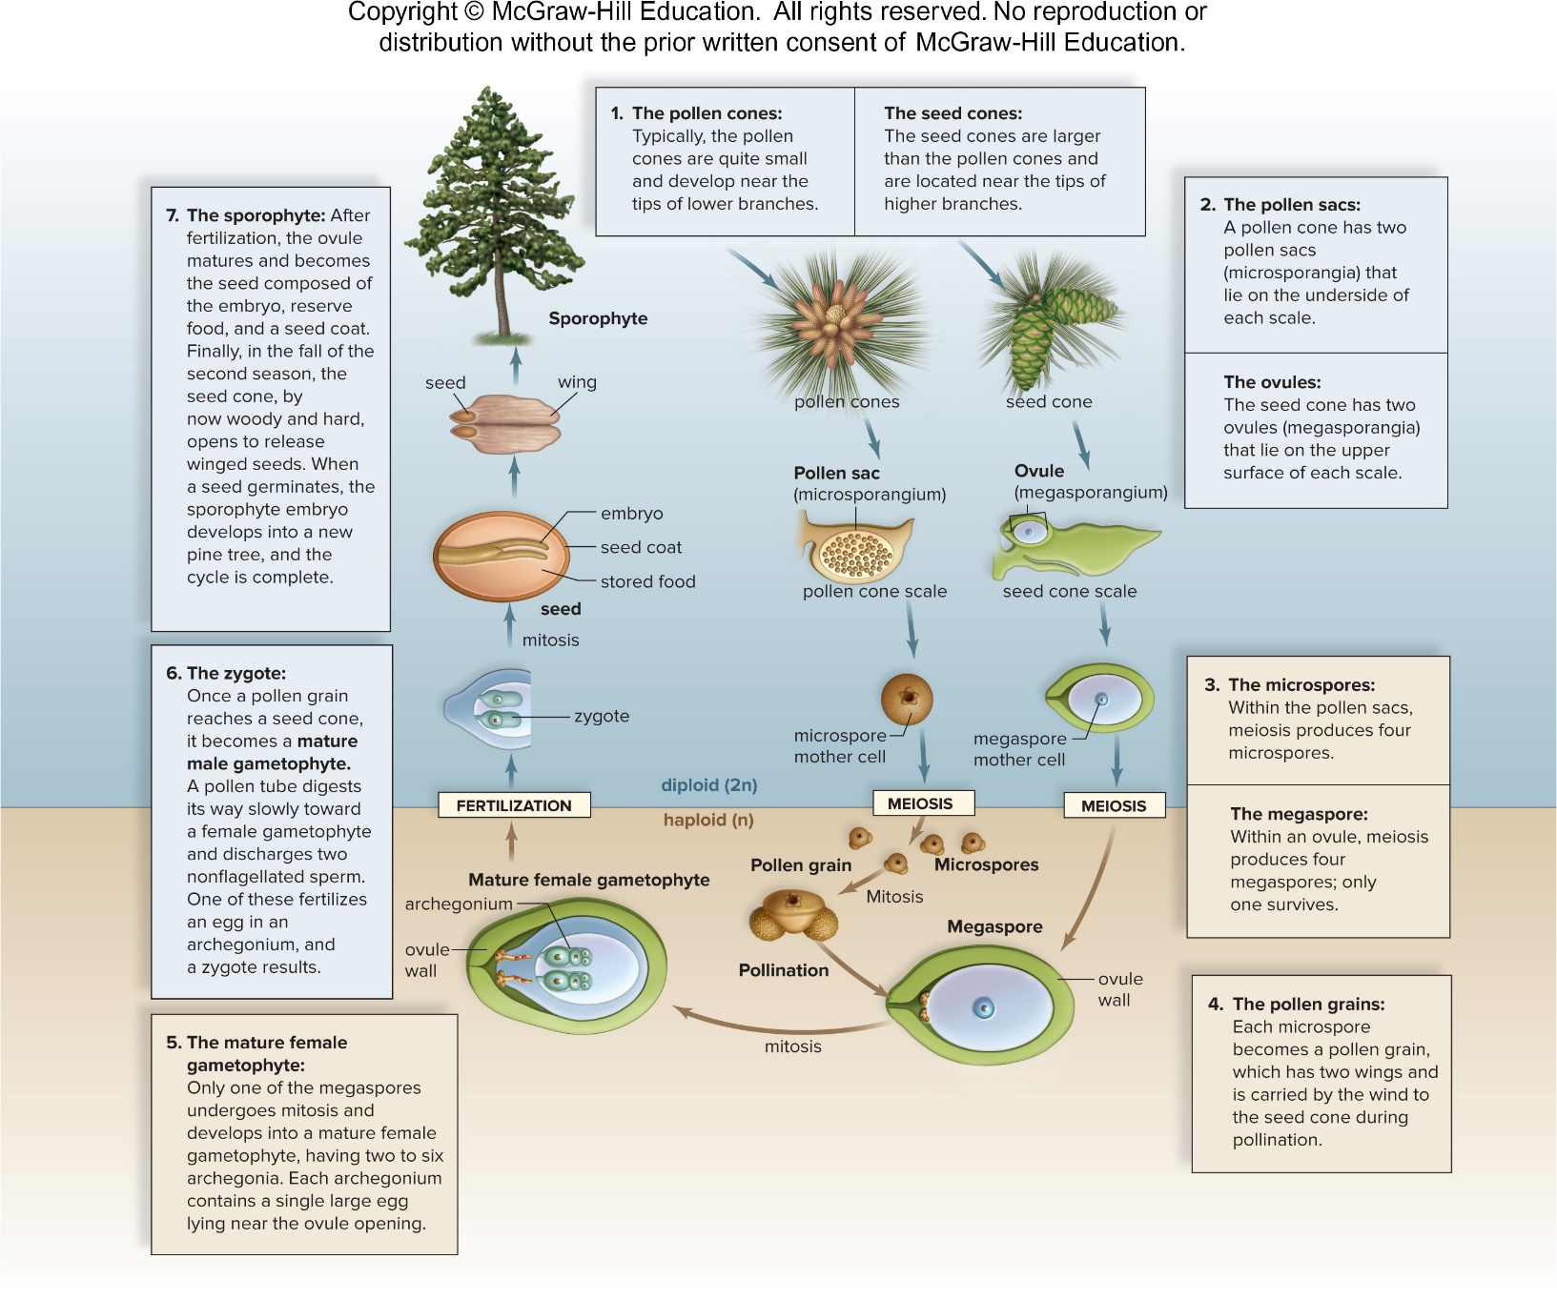
Pine Life Cycle 9
Figure 23.18
Access the text alternative for slide images.
Notes:
IMAGE DESCRIPTION
Details of a typical conifer life cycle are shown. 1. The pollen cones: Typically, the pollen cones are quite small and develop near the tips of lower branches. The seed cones: The seed cones are larger than the pollen cones and are located near the tips of higher branches. 2. The pollen sac: A pollen cone has two pollen sacs (microsporangia) that lie on the underside of each scale. The ovules: The seed cone has two ovules (megasporangia) that lie on the upper surface of each scale. 3. The microspores: Within the pollen sacs, meiosis produces four microspores. The megaspore: Within an ovule, meiosis produces four megaspores; only one survives. 4. The pollen grains: Each microspore becomes a pollen grain, which has two wings and is carried by the wind to the seed cone during pollination. 5. The mature female gametophyte: Only one of the megaspores undergoes mitosis and develops into a mature female gametophyte, having two to six archegonia. Each archegonium contains a single large egg lying near the ovule. 6. The zygote: Once a pollen grain reaches a seed cone, it becomes a mature male gametophyte. A pollen tube digests its way slowly toward a female gametophyte and discharges two nonflagellated sperm. One of these fertilizes an egg in an archegonium, and a zygote results. 7. The sporophyte: After fertilization, the ovule matures and becomes the seed composed of the embryo, reserve food, and a seed coat. Finally, in the fall of the second season, the seed cone, by now woody and hard, opens to release winged seeds. When a seed germinates, the sporophyte embryo develops into a new pine tree, and the cycle is complete.
HOME NOTE
• Pine life cycle (pollen and seed cones)
Also write here:
– Pine Life Cycle 1 (23.5.60): The pine tree itself is the diploid (2n) sporophyte.
COVERED ELSEWHERE
Pollen grain (27.1.12) · Ovule and embryo sac (27.1.14) · Pollen tube (27.1.17)
EXAM FOCUS (High)
Likely:
• The pine tree = the sporophyte (2n), with small pollen cones (lower branches) and larger seed cones (higher).
• Pollen cones: pollen sacs under each scale; meiosis -> microspores -> winged pollen grains.
• Seed cones: 2 ovules on each scale; meiosis -> 4 megaspores, only 1 survives -> female gametophyte with archegonia (eggs).
• Wind pollination; the pollen tube grows slowly and releases 2 non-swimming sperm; one fertilizes an egg.
• Ovule -> seed (embryo + food + coat), released when the woody cone opens.
Unlikely: "Fall of the second season"; the number of archegonia.
How:
• 'In pines, what carries the sperm to the egg?' -> the pollen tube. Trap: swimming through water; wind.
• 'Which generation is the pine tree?' -> the sporophyte. Trap: the gametophyte.
• 'In a pine ovule, how many of the megaspores made by meiosis survive?' -> one. Trap: all four.
Write: Pine life-cycle box:
• Dominant: sporophyte (the tree)
• Meiosis: pollen sacs -> microspores; ovules -> megaspores (1 of 4 survives)
• Gametophytes: male = winged pollen grain; female = inside the ovule, with archegonia
• Fertilization: pollen tube delivers non-swimming sperm; no water needed
• Seed: ovule -> seed (embryo + food + coat), released from the cone

Slide 69
Uses of Conifers
Pines are known for their beauty and pleasant smell
  Make attractive additions to parks and gardens
  Have medicinal value
    Needles and bark are rich in vitamins A and C
      Can be used to create teas that ease symptoms of a cold or cough
  Large pine seeds, called pine nuts, are sometimes harvested for use in cooking
  Pine oil is used to scent a number of household and personal care products, such as room sprays and deodorant
Notes:
EXAM FOCUS (Low)
Uses (rarely asked): pines -> vitamin A and C teas, pine nuts, pine oil. One line.

Slide 70
Cycads
    Include 10 genera and 300 species of distinctive gymnosperms
    Large, finely divided leaves that grow in clusters at the top of the stem
    Cones can be more than 1 m long
    Pollen and seed cones are on separate plants
    Pollinated by insects rather than wind
      Pollen tube bursts near egg and multiflagellated sperm swim to reach an egg
    Plentiful in Mesozoic era at the time of the dinosaurs
      Dinosaurs fed on cycad seeds
Notes:
NOT EXPLAINED ON ANY SLIDE
• Mesozoic era: the "age of dinosaurs," about 252-66 million years ago.
NOT EXPLAINED YET
• Pollen tube: a tube that grows out of the pollen grain and carries the sperm to the egg. (27.1.17)
HOME NOTE
• Cycads
ADDS TO
Monoecious vs dioecious (27.1.10)
EXAM FOCUS (Medium)
Likely:
• Cycads: large, finely divided leaves clustered at the top of the stem; cones can be over 1 m long.
• Pollen cones and seed cones grow on separate plants.
• Pollinated by insects, not wind.
• The pollen tube bursts near the egg and multiflagellated sperm swim to it.
Unlikely: 10 genera and 300 species; cone length; dinosaurs eating their seeds.
How:
• 'Which gymnosperm is pollinated by insects rather than wind?' -> cycads. Trap: conifers.
• 'Which gymnosperms have sperm that swim the last bit to the egg?' -> cycads and ginkgoes. Trap: conifers (non-swimming sperm).
Write: Nothing here; it's the cycad row of the table at 23.5.57 ("separate plants" = dioecious, 27.1.10).

Slide 71
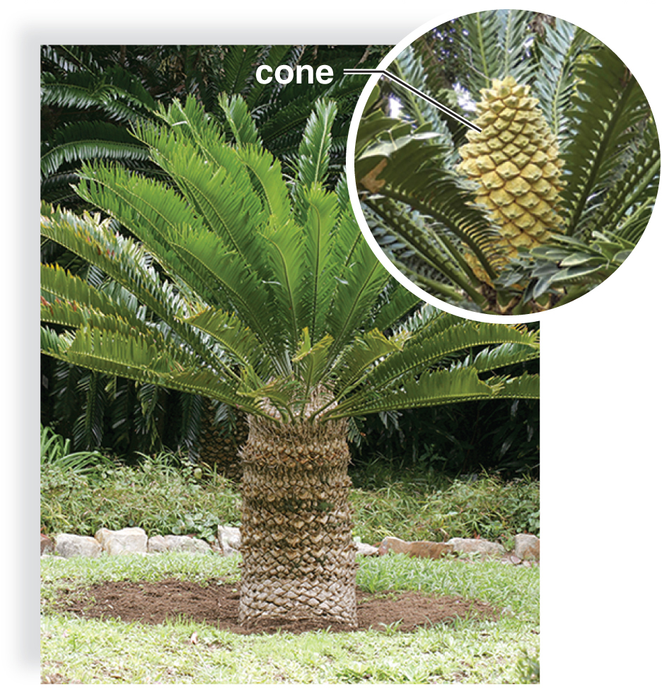
African Cycad
An African cycad
Figure 23.19
(a): (cycad): Hoberman Collection/Alamy Stock Photo; (cycad cone): PlazaCameraman/Getty Images
Notes:
IMAGE DESCRIPTION
A cycad exhibits trunk, leaves, with an inset on top-right depicting presence of cones on separate plants.
COVERED ELSEWHERE
Cycads (23.5.70)
EXAM FOCUS (Low)
Cycad photo (cones on separate plants); see 23.5.70.

Slide 72
Ginkgoes
One surviving species is Gingko biloba
  Dioecious
    Some trees produce seeds
    Other trees produce pollen
  Trees are resistant to pollution and do well along city streets and in city parks
  Native to China, and in Asia, ginkgo seeds are considered a delicacy
  Extracts have been used to improve blood circulation
  Like cycads, the pollen tube of ginkgo bursts to release multiflagellated sperm that swim to the egg
Notes:
NOT EXPLAINED YET
• Pollen tube: a tube that grows out of the pollen grain and carries the sperm to the egg. (27.1.17)
HOME NOTE
• Ginkgoes
Also write here:
– Ginkgo biloba, a Native of China (23.5.73): Ginkgo has broad leaves, and its fleshy seeds hang from the ends of stalks.
ADDS TO
Monoecious vs dioecious (27.1.10)
COVERED ELSEWHERE
Cycads (23.5.70)
EXAM FOCUS (Medium)
Likely:
• Ginkgo biloba is the one surviving species.
• Dioecious: some trees make seeds, others make pollen.
• Resistant to pollution, so planted along city streets and in parks.
• Like cycads, the pollen tube bursts to release multiflagellated sperm that swim to the egg.
• Extracts are used to improve blood circulation; the seeds are eaten in Asia.
Unlikely: "Native to China".
How:
• 'A gymnosperm is planted along city streets because it tolerates pollution. Which one?' -> Ginkgo. Trap: cycads.
• 'In ginkgo, some trees make only seeds and others only pollen. This is...' -> dioecious. Trap: monoecious.
Write: Nothing here; it's the ginkgo row of the table at 23.5.57.

Slide 73
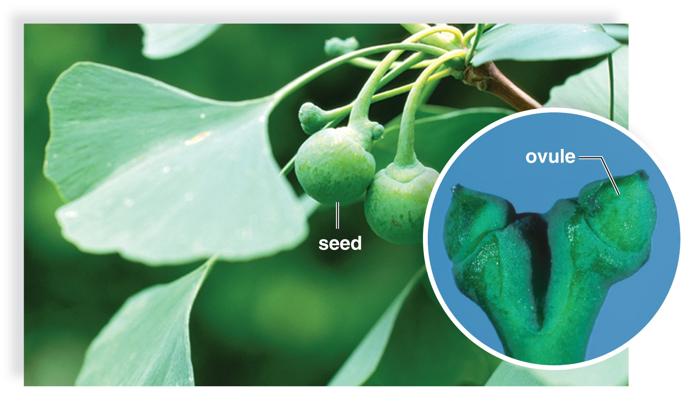
Ginkgo biloba, a Native of China
Ginkgo biloba, a native of China
Figure 23.19
(b): (Gingko leaves): blickwinkel/Koenig/Alamy Stock Photo, (ovule): Ken Robertson, University of Illinois/INHS
Notes:
IMAGE DESCRIPTION
A ginkgo tree has broad leaves and fleshy seeds borne at the end of stalk like megasporophylls.
NOT EXPLAINED ON ANY SLIDE
• Megasporophyll: a leaf-like stalk that carries ovules or seeds.
ADDS TO
Ginkgoes (23.5.72)
EXAM FOCUS (Low)
Ginkgo photo (broad leaves, fleshy seeds on stalks); see 23.5.72.

Slide 74
Gnetophytes
  Three living genera with 65 diverse species
  They have similarly structured xylem
  None have archegonia
  Strobili have similar construction
    Gnetum consists of trees or climbing vines with broad, leathery leaves arranged in pairs
    Ephedrine, a medicine with serious side effects, is extracted from Ephedra
    Welwitschia, found in southwestern Africa, has only two enormous, straplike leaves that fray as it gets older
Notes:
NOT EXPLAINED YET
• Xylem: the vascular tissue that carries water through the plant. (24.1.13)
HOME NOTE
• Gnetophytes
Also write here:
– Ephedra, a Type of Gnetophyte (23.5.75): Ephedra is a branched shrub with small, scale-like leaves; its pollen is made in microsporangia (pollen sacs).
EXAM FOCUS (Medium)
Likely:
• Gnetophytes: three living genera with similar xylem and similar strobili.
• None have archegonia.
• Gnetum: trees or climbing vines with broad, leathery leaves in pairs.
• Ephedra -> ephedrine (a medicine with serious side effects).
• Welwitschia: only two huge, strap-like leaves that fray with age.
Unlikely: 65 species; southwestern Africa.
How:
• 'Which gymnosperm group lacks archegonia?' -> gnetophytes. Trap: conifers, cycads.
• 'The medicine ephedrine comes from...' -> Ephedra (a gnetophyte). Trap: Ginkgo (its extracts are for circulation).
Write: Nothing here; it's the gnetophyte row of the table at 23.5.57.

Slide 75
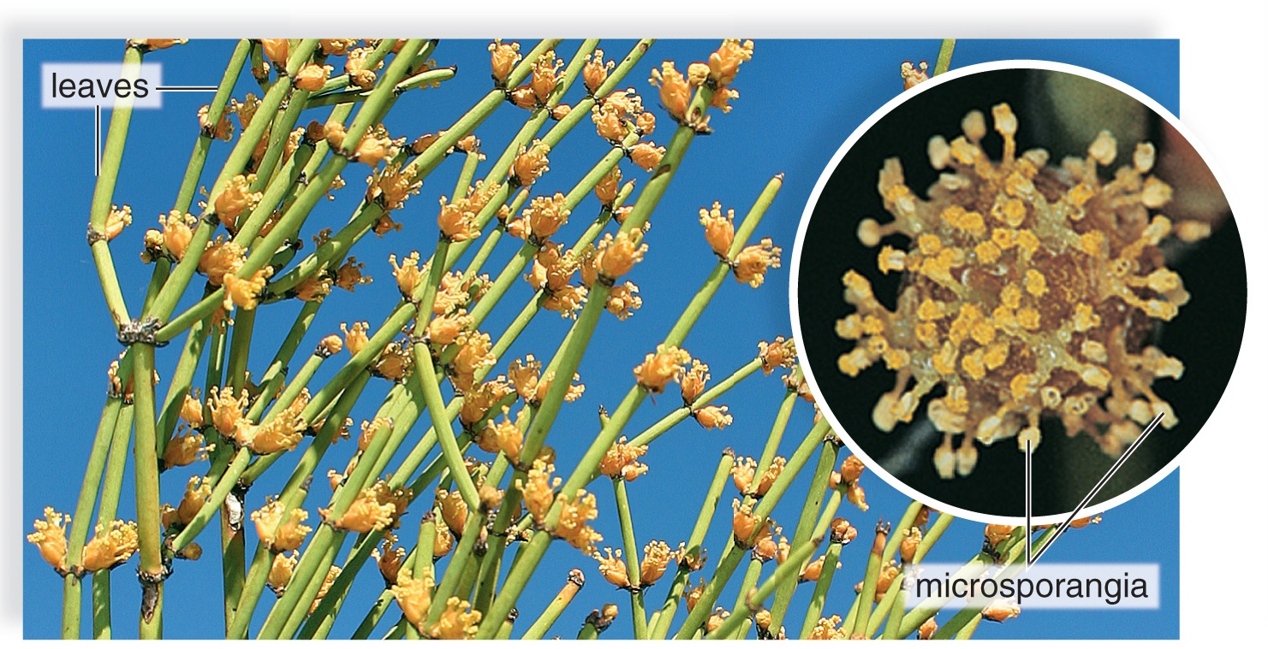
Ephedra, a Type of Gnetophyte
Ephedra, a type of gnetophyte
Figure 23.19
(c): (plant): Evelyn Jo Johnson/McGraw-Hill; (microsporangia): Karl J. Niklas
Notes:
IMAGE DESCRIPTION
This example is a branched shrub with small, scale-like leaves. Pollen is produced in microsporangia.
ADDS TO
Gnetophytes (23.5.74)
EXAM FOCUS (Low)
Ephedra photo (shrub with small scale-like leaves); see 23.5.74.

Slide 76
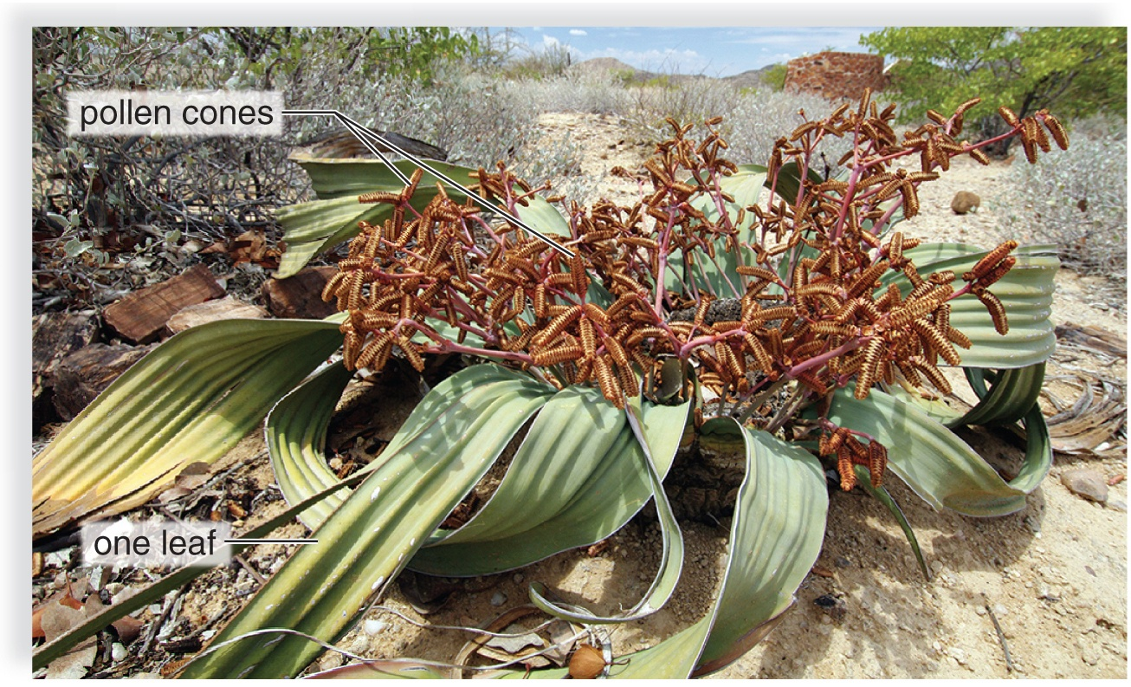
Welwitschia, a Type of Gnetophyte
Welwitschia, a type of gnetophyte
Figure 23.19
(d): TravelMuse/Alamy Stock Photo
Notes:
IMAGE DESCRIPTION
This example produces 2 straplike leaves that fray and split.
COVERED ELSEWHERE
Gnetophytes (23.5.74)
EXAM FOCUS (Low)
Welwitschia photo (two strap-like leaves); see 23.5.74.

Slide 77
Angiosperms
    Flowering plants
    Called angiosperms because their ovules are always enclosed within diploid tissues
    Exceptionally large and successful group of plants
      352,000 known species
    Range in size from tiny duckweed to Eucalyptus, over 100 m tall
    All fruits, vegetables, nuts, herbs, and grains, which are the staples of the human diet, are angiosperms
    Provide us with clothing, food, medicines, and other commercially valuable products
Notes:
NOT EXPLAINED YET
• Ovule: a small structure where the female gametophyte (with its egg) develops; after fertilization it becomes the seed. (27.1.14)
COVERED ELSEWHERE
Gymnosperms vs angiosperms (23.5.56)
EXAM FOCUS (Medium)
Likely: Angiosperms = flowering plants; their ovules are always enclosed within diploid tissue; the largest, most successful plant group; staples of the human diet.
Unlikely: 352,000 species; duckweed and Eucalyptus sizes.
How: 'Why are angiosperms called angiosperms?' -> their ovules are enclosed within tissue (an ovary). Trap: 'their seeds are naked' (gymnosperms).
Write: Nothing new beyond the 23.5.56 entry.

Slide 78
Origin and Radiation of Angiosperms
Until recently, the earliest known angiosperm fossil was Archaefructus liaoningensis
  Dates back 135 million years to the Jurassic
  Archaefructus fossil has fruit and flowers
Pollen can be used to date the appearance of a seed plant in an area
  Paleobotanists working in Switzerland discovered 240-million-year-old fossilized pollen from the Triassic
Living angiosperm of today that might be most closely related to the first angiosperms is Amborella
  Lives only on the island of New Caledonia in the South Pacific
  Botanists hope that much may be learned about the early adaptive radiation of angiosperms during the Tertiary period
Notes:
NOT EXPLAINED ON ANY SLIDE
• Triassic, Jurassic and Tertiary: periods in Earth's history: about 252-201, 201-145 and 66-2.6 million years ago.
• Paleobotanists: scientists who study fossil plants.
• Adaptive radiation: one ancestral species quickly evolving into many new species that fit different ways of life.
HOME NOTE
• Origin of flowering plants
Also write here:
– Evolution of Flowering Plants: Amborella trichopoda (23.5.79): Amborella has small, cream-white flowers growing in clusters where the leaves meet the stem.
EXAM FOCUS (Low)
Likely: Amborella is the living plant that may be most closely related to the first flowering plants; fossil pollen can date when seed plants appeared in an area.
Unlikely: Archaefructus, the 135 and 240 MYA dates, Switzerland, New Caledonia.
How: 'Which living plant may be most closely related to the first angiosperms?' -> Amborella. Trap: Archaefructus (a fossil, not a living plant).
Write: One line: Amborella = closest living relative of the first flowering plants.

Slide 79
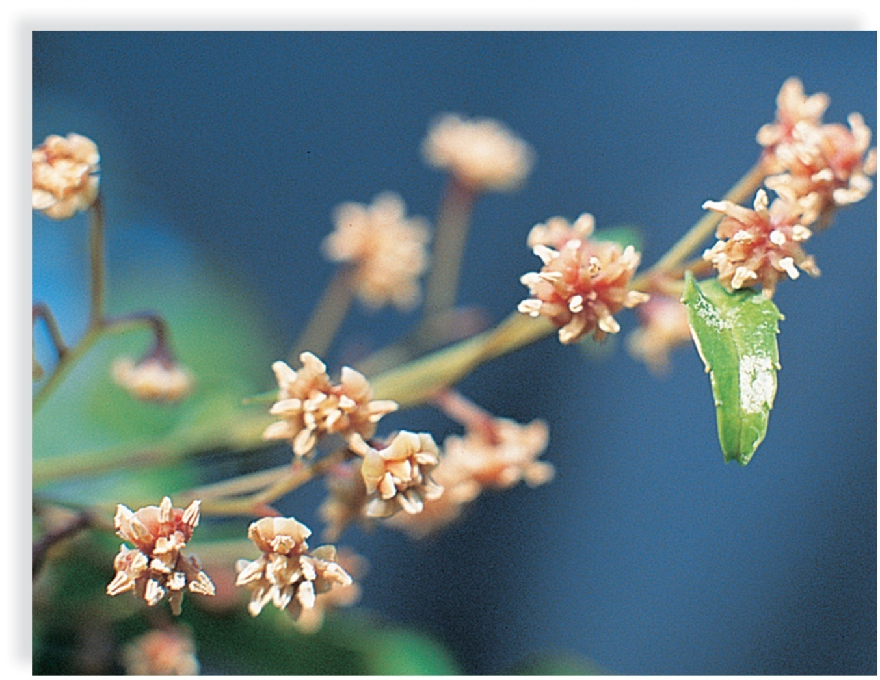
Evolution of Flowering Plants: Amborella trichopoda
Amborella trichopoda
Figure 23.20
(b): Stephen McCabe
Notes:
IMAGE DESCRIPTION
Close-up of a plant shows small, creamy white flowers arranged in inflorescence borne in the axils of foliage leaves.
NOT EXPLAINED YET
• Inflorescence: a cluster of flowers. (23.5.91)
• Axil: the angle where a leaf joins the stem. (24.5.50)
ADDS TO
Origin of flowering plants (23.5.78)
EXAM FOCUS (Low)
Amborella photo; see 23.5.78.

Slide 80
Monocots and Eudicots
Most flowering plants belong to one of two classes:
  Monocotyledones (monocots)
    Examples include corn, tulips, pineapples, and sugarcane
  Eudicotyledones (eudicots)
    Examples include cacti, strawberries, dandelions, poplars, and beans
Cotyledons are the seed leaves containing nutrients that nourish the embryo
  Monocots: One cotyledon in seed
  Eudicots: Two cotyledons in seed
Notes:
ADDS TO
Monocots vs eudicots (23.5.81)
EXAM FOCUS (High)
Likely:
• Most flowering plants are monocots or eudicots.
• Cotyledons = seed leaves with nutrients that nourish the embryo: monocots have 1, eudicots 2.
• Monocots: corn, tulips, pineapples, sugarcane; eudicots: cacti, strawberries, dandelions, poplars, beans.
Unlikely: Nothing to skip; every point here is testable.
How:
• 'A seed has a single cotyledon. The plant is a...' -> monocot. Trap: eudicot.
• 'Which of these is a monocot?' -> corn. Trap: beans, cacti (eudicots).
Write: Nothing here; the examples go in the 23.5.81 table.

Slide 81
Key Features of Monocots and Eudicots
Table 23.2 Key Features of Monocots and Eudicots
Monocots | Eudicots
One cotyledon | Two cotyledons
Flower parts In threes or multiples of three | Flower parts In fours or fives or multiples of four or five
Pollen grain with one pore | Pollen grain with three pores
Usually herbaceous | Woody or herbaceous
Usually parallel venation | Usually net venation
Scattered bundles In stem | Vascular bundles in a ring
Fibrous root system | Taproot system
Table divided into two columns summarizes key features of monocots and eudicots. The column headers are: Monocots and eudicots.
Notes:
NOT EXPLAINED ON ANY SLIDE
• Pollen pore: an opening in the pollen grain's wall.
NOT EXPLAINED YET
• Flower parts: sepals, petals, stamens and carpels. (23.5.84)
• Herbaceous vs woody: herbaceous plants have soft, green, non-woody stems; woody plants make wood, so their stems also grow thicker each year. (24.4.42)
• Venation: the pattern of veins in a leaf: parallel (side by side, like grass) or net (branching, like a maple leaf). (24.2.24)
• Vascular bundles: strands of xylem and phloem running through the stem. (24.4.38)
• Taproot vs fibrous roots: a taproot is one thick main root growing straight down (like a carrot); a fibrous root system is many thin roots of similar size (like grass). (24.3.32)
HOME NOTE
• Monocots vs eudicots
Also write here:
– Monocots and Eudicots (23.5.80): Examples: monocots: corn, tulips, pineapples, sugarcane; eudicots: cacti, strawberries, dandelions, poplars, beans. Cotyledons are "seed leaves" that hold nutrients for the embryo.
EXAM FOCUS (High)
Likely:
• Cotyledons: 1 vs 2.
• Flower parts: in 3s vs in 4s or 5s.
• Pollen pores: 1 vs 3.
• Usually herbaceous vs woody or herbaceous.
• Leaf veins: parallel vs net.
• Stem vascular bundles: scattered vs in a ring.
• Roots: fibrous vs taproot.
Unlikely: Nothing to skip; every point here is testable.
How:
• 'A plant has net-veined leaves, flower parts in fives and a taproot. It is a...' -> eudicot. Trap: choices that mix in monocot features.
• 'Vascular bundles scattered through the stem indicate a...' -> monocot. Trap: eudicot (bundles in a ring).
• 'How many pores does a eudicot pollen grain have?' -> three. Trap: one (monocots).
Write: The full two-column table (monocot | eudicot) with the 7 rows above, plus the examples from 23.5.80; Ch 24 adds more rows.

Slide 82
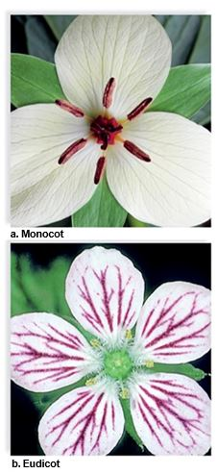
Flower Diversity
Figure 23.21
(a): Ed Reschke/Stone/Getty Images; (b) Steven P. Lynch
Notes:
IMAGE DESCRIPTION
A) Three white colored petals (monocots). B) Five petals flower in white with stripes of pink (eudicot).
Regardless of size and shape, flowers, such as this
monocot, and
eudicot, share certain features.
COVERED ELSEWHERE
Monocots vs eudicots (23.5.81)
EXAM FOCUS (Low)
Photos: monocot flower (3 petals) vs eudicot flower (5); see 23.5.81.

Slide 83
The Flower
Although flowers vary widely in appearance, most have certain structures in common:
  Sepals are collectively called the calyx
    Protect the flower bud before it opens
    Sepals may drop off or may be colored like the petals
    Usually, however, sepals are green and remain attached to the flower stalk.
  Petals are collectively called the corolla
    Very diverse in size, shape, and color
    Petals are often used to attract a particular pollinator
Notes:
ADDS TO
Parts of a flower (23.5.84)
EXAM FOCUS (Medium)
Likely:
• Sepals (together: the calyx) protect the flower bud; usually green.
• Petals (together: the corolla) are diverse and often attract a particular pollinator.
Unlikely: Sepals that fall off or are colored like petals.
How: 'Which flower part protects the bud before it opens?' -> sepals. Trap: petals.
Write: Nothing here; it goes in the flower-parts table (23.5.84).

Slide 84
Parts of Flower
  Stamens are the male structures and consist of two parts:
    Filament: a slender stalk that holds up the anther
    Anther: saclike container that produces pollen
  Carpels are the female structure and are comprised of three major regions:
    Stigma, an enlarged, sticky knob
    Style, a slender stalk
    Ovary, an enlarged base that encloses one or more ovules
      Ovule becomes the seed, and the ovary becomes the fruit. Fruit is often instrumental in the distribution of seeds.
Notes:
NOT EXPLAINED YET
• Ovule: a small structure where the female gametophyte (with its egg) develops; after fertilization it becomes the seed. (27.1.14)
HOME NOTE
• Parts of a flower
Also write here:
– The Flower (23.5.83): Sepals (together called the calyx) protect the flower bud before it opens; they're usually green but may fall off or be colored like petals. Petals (together called the corolla) vary a lot in size, shape and color and often attract a particular pollinator.
COVERED ELSEWHERE
Fruit (27.3.27)
EXAM FOCUS (High)
Likely:
• Stamen (male) = filament (stalk) + anther (sac that makes pollen).
• Carpel (female) = stigma (sticky knob) + style (stalk) + ovary (encloses the ovules).
• Ovule -> seed; ovary -> fruit, which often helps spread the seeds.
Unlikely: Nothing to skip; every point here is testable.
How:
• 'Which part of the flower becomes the fruit?' -> the ovary. Trap: the ovule (it becomes the seed).
• 'Pollen is produced in the...' -> anther. Trap: stigma, filament.
• 'Which part of the carpel is sticky and receives pollen?' -> the stigma. Trap: the style.
Write: Flower-parts table (part · job · becomes):
• Sepals (calyx): protect the bud
• Petals (corolla): attract pollinators
• Stamen (male) = anther (makes pollen) + filament (stalk)
• Carpel (female) = stigma (sticky knob) + style (stalk) + ovary (holds the ovules); ovary -> fruit, ovule -> seed

Slide 85
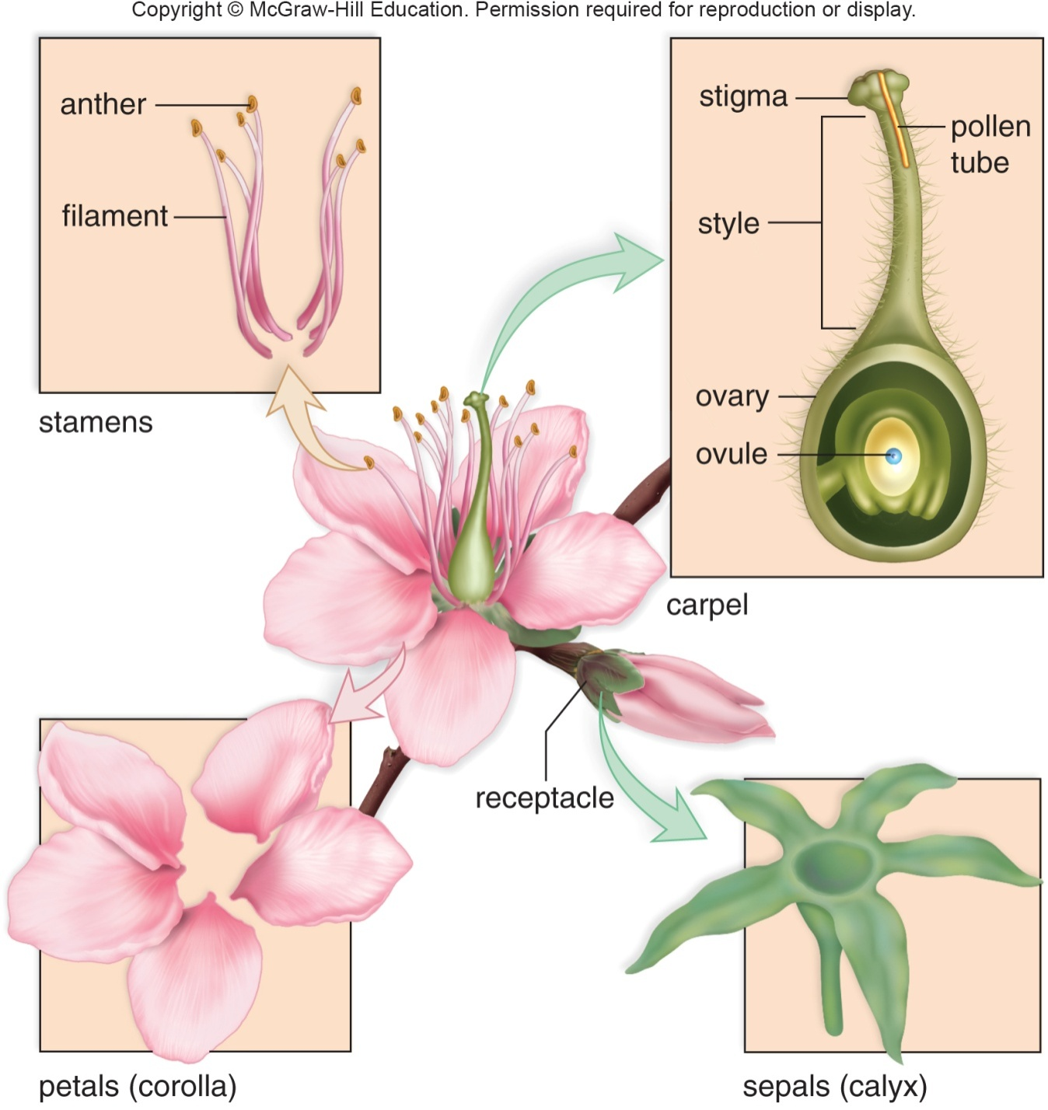
Generalized Flower
Figure 23.22
Notes:
IMAGE DESCRIPTION
A flower has 4 main parts: sepals, petals, stamens (anther and filament), and carpels (stigma, style, ovule, pollen tube, and ovary).
NOT EXPLAINED YET
• Ovule: a small structure where the female gametophyte (with its egg) develops; after fertilization it becomes the seed. (27.1.14)
COVERED ELSEWHERE
Parts of a flower (23.5.84)
EXAM FOCUS (Low)
Labeled flower diagram; see 23.5.84.

Slide 86
Flowering Plant Life Cycle 1
Flowering plants are heterosporous, producing two types of spores:
  Megaspore
    Located in an ovule within an ovary of a carpel
    Develops into an egg-bearing female gametophyte, called the embryo sac
      Usually has seven cells, two have special functions:
        One is an egg
        One contains two polar nuclei
          “Polar” because they come from opposite ends of the embryo sac
Notes:
ADDS TO
Ovule and embryo sac (27.1.14)
COVERED ELSEWHERE
Homospory and heterospory (23.3.34) · Flowering plant life cycle (23.5.89)
EXAM FOCUS (High)
Likely:
• Flowering plants are heterosporous.
• The megaspore (in an ovule, in the ovary of a carpel) becomes the female gametophyte = the embryo sac.
• The embryo sac usually has 7 cells; two matter here: the egg, and the cell with two polar nuclei.
Unlikely: Why the nuclei are called "polar".
How:
• 'What is the female gametophyte of a flowering plant called?' -> the embryo sac. Trap: ovule, ovary, pollen grain.
• 'Which embryo-sac cell joins a sperm to form endosperm?' -> the cell with the two polar nuclei. Trap: the egg.
Write: Nothing here; it goes in the flowering-plant life-cycle box (23.5.89).

Slide 87
Flowering Plant Life Cycle 2
  Microspores
    Produced within anthers
    Become pollen grains that, when mature, are male gametophytes with sperm
    Mature male gametophyte consists of only three cells: the tube cell and two sperm cells
During pollination, pollen is transported from the anther to the stigma of a carpel
  Tube cell produces a pollen tube
  Two sperm travel through the tube to the micropyle (small opening) of an ovule
Notes:
NOT EXPLAINED YET
• Ovule: a small structure where the female gametophyte (with its egg) develops; after fertilization it becomes the seed. (27.1.14)
ADDS TO
Pollen tube (27.1.17)
COVERED ELSEWHERE
Flowering plant life cycle (23.5.89) · Pollen grain (27.1.12) · Pollination (27.1.15)
EXAM FOCUS (High)
Likely:
• Microspores are made in anthers and become pollen grains = male gametophytes with sperm.
• The mature male gametophyte has only 3 cells: the tube cell and 2 sperm.
• Pollination: pollen carried from the anther to the stigma.
• The tube cell makes the pollen tube; the 2 sperm travel down it to the micropyle (small opening) of an ovule.
Unlikely: Nothing to skip; every point here is testable.
How:
• 'The mature male gametophyte of a flowering plant consists of...' -> a tube cell and two sperm. Trap: '7 cells including an egg' (the embryo sac).
• 'Pollination is the transfer of pollen from the...' -> anther to the stigma. Trap: stigma to anther; ovary to ovule.
• 'Which cell produces the pollen tube?' -> the tube cell. Trap: the generative cell.
Write: Nothing here; it goes in the flowering-plant life-cycle box (23.5.89).

Slide 88
Flowering Plant Life Cycle 3
Flowering plants undergo double fertilization
  One sperm unites with an egg
    Forms a diploid zygote
  Other sperm unites with polar nuclei
    Forms a triploid endosperm nucleus
Ovule becomes a seed
  Contains the embryo (the sporophyte of the next generation)
  Stores food (endosperm) enclosed within a seed coat
Fruit is derived from an ovary
  Some fruits, such as apples provide a moist, fleshy covering
  Other fruits, such acorns, provide a dry covering for seeds
Notes:
NOT EXPLAINED YET
• Ovule: a small structure where the female gametophyte (with its egg) develops; after fertilization it becomes the seed. (27.1.14)
• Polar nuclei: two nuclei in the middle of the embryo sac (the female gametophyte); the second sperm fuses with them to make the endosperm. (27.1.14)
ADDS TO
Fruit (27.3.27)
COVERED ELSEWHERE
Flowering plant life cycle (23.5.89)
EXAM FOCUS (High)
Likely:
• Double fertilization: sperm 1 + egg -> diploid zygote; sperm 2 + the 2 polar nuclei -> triploid endosperm nucleus.
• Ovule -> seed: embryo (the next sporophyte) + endosperm (stored food) inside a seed coat.
• Ovary -> fruit: fleshy (apples) or dry (acorns).
Unlikely: Nothing to skip; every point here is testable.
How:
• 'In double fertilization, the second sperm fuses with the polar nuclei to form...' -> the triploid endosperm. Trap: the zygote, the seed coat.
• 'What is the ploidy of the endosperm?' -> triploid (3n). Trap: diploid (2n).
• 'After fertilization, the ovary develops into the...' -> fruit. Trap: seed.
Write: Nothing here; it goes in the flowering-plant life-cycle box (23.5.89).

Slide 89
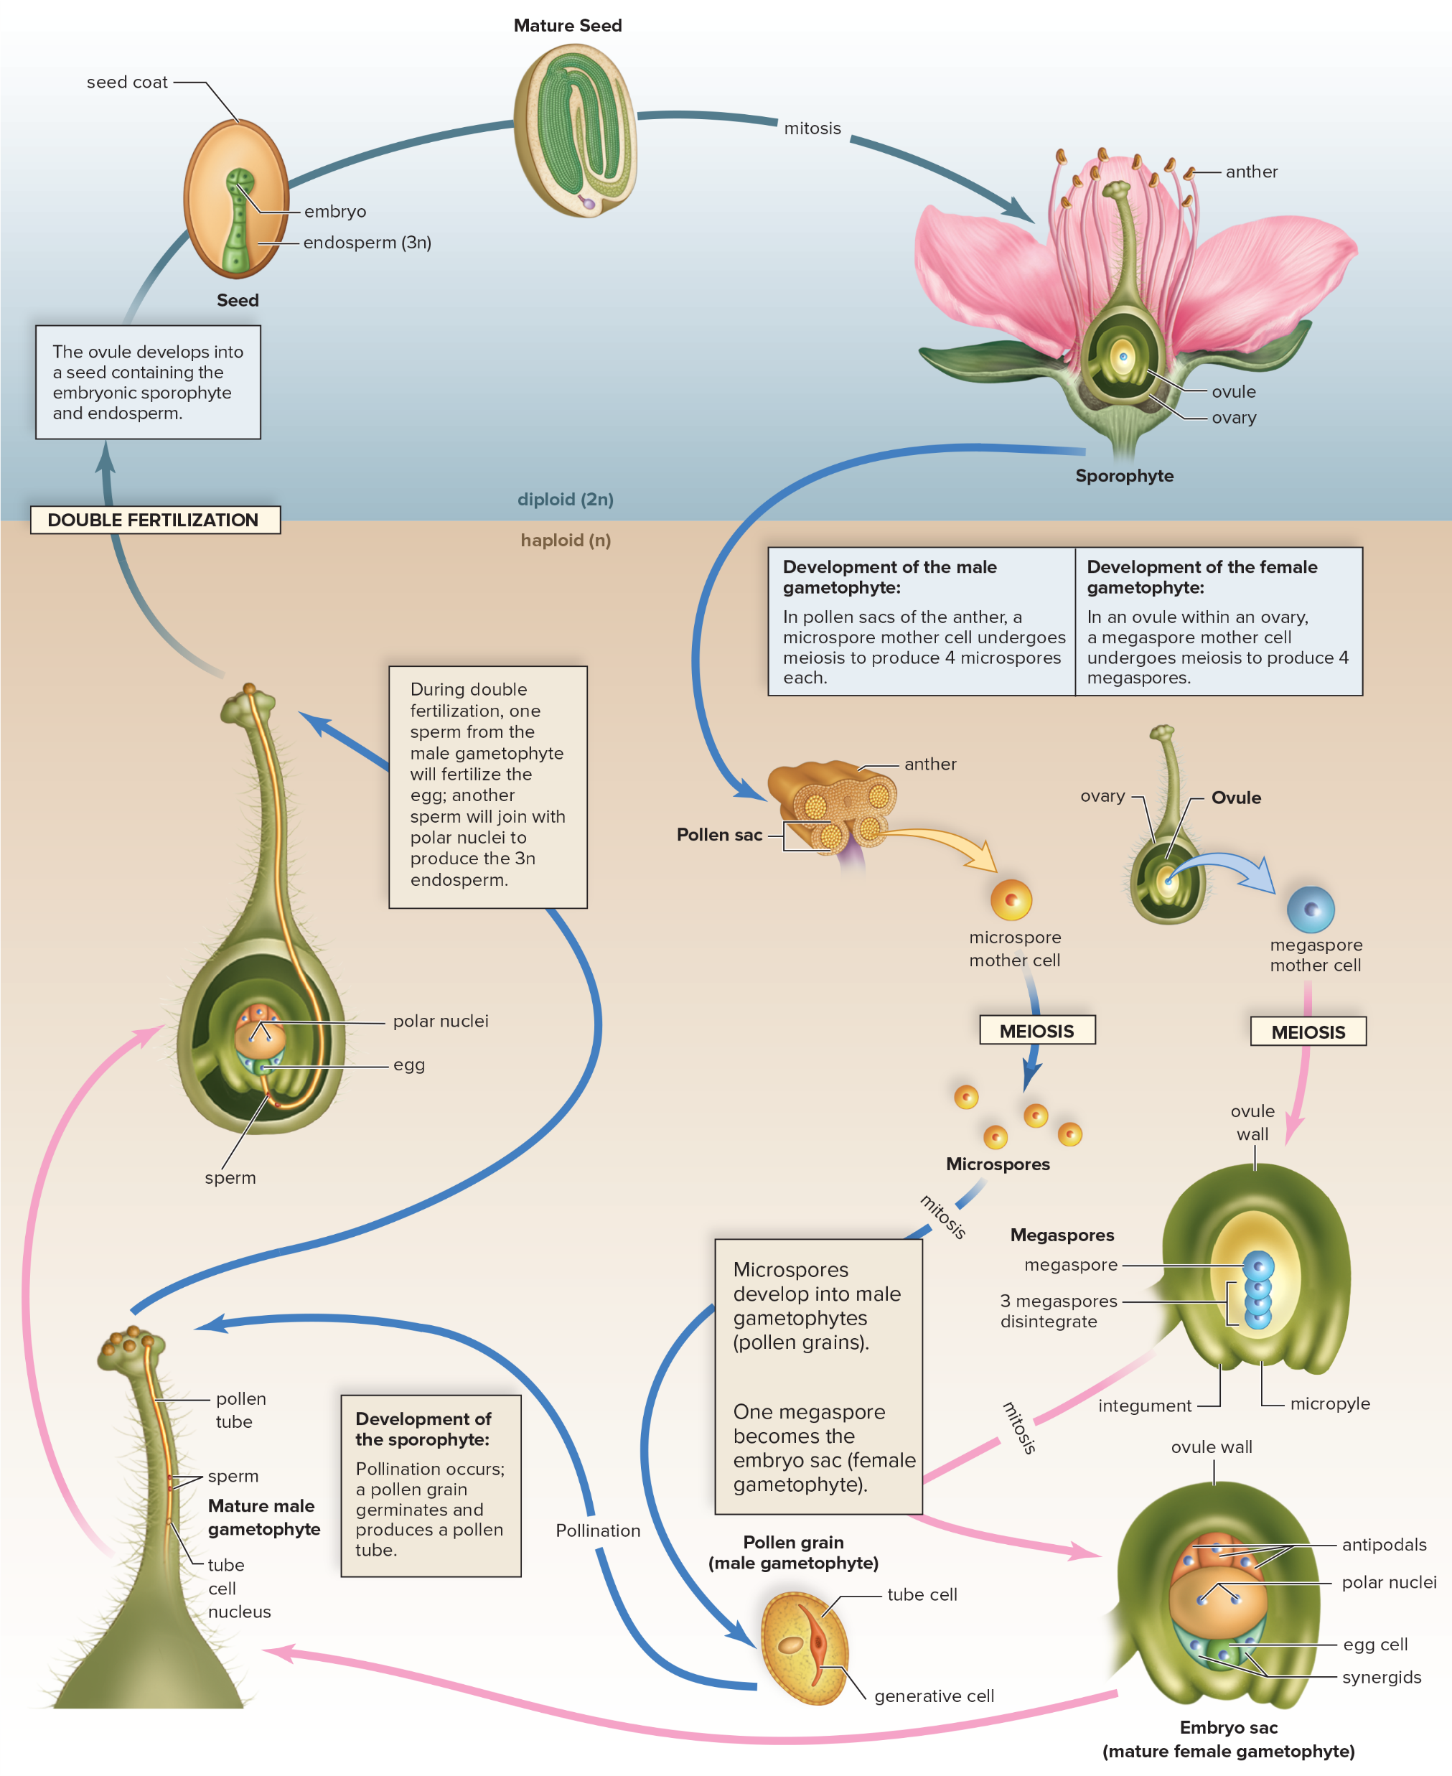
Life Cycle of Flowering Plant
Figure 23.23
Access the text alternative for slide images.
Notes:
IMAGE DESCRIPTION
Details of a typical flowering plant cycle are shown.1. The stamen: An anther at the top of a stamen has four pollen sacs. Pollen grains are produced in pollen sacs. The carpel: The ovary at the base of a carpel contains one or more ovules. The contents of an ovule change during the flowering plant lifecycle. 2. The pollen sacs: In pollen sacs (microsporangia) of the anther, meiosis produces microspores. The ovules: In an ovule (megasporangium) within an ovary, meiosis produces four megaspores. 3. The microspores: Each microspore in a pollen sac undergoes mitosis to become an immature pollen grain with two cells: the tube cell and the generative cell. The pollen sacs open, and the pollen grains are windblown or transported by an animal carrier, usually to other flowers. This is known as pollination. The megaspores: Inside the ovules of an ovary, three megaspores disintegrate, and only the remaining one undergoes mitosis to become a female gametophyte. 4. The mature male gametophyte: A pollen grain that lands on the carpel of the same type of plant germinates and produces a pollen tube, which grows within the style until it reaches an ovule in the ovary. Inside the pollen tube, the generative cell nucleus divides and produces two nonflagellated sperm. A fully germinated pollen grain is the mature male gametophyte. The mature female gametophyte: The ovule now contains the mature female gametophyte (embryo sac), which typically consists of eight haploid nuclei embedded in a mass of cytoplasm. The cytoplasm differentiates into cells, one of which is an egg and another that contains two polar nuclei. 5. Double fertilization: On reaching the ovule, the pollen tube discharges the sperm. One of the two sperm migrates to and fertilizes the egg, forming a zygote; the other unites with the two polar nuclei, producing a 3n (triploid) endosperm nucleus. The endosperm nucleus divides to form endosperm, food for the developing embryo. 6. The seed: The ovule now develops into the seed, which contains an embryo and food enclosed by a protective seed coat. The wall of the ovary and sometimes adjacent parts develop into a fruit that surrounds the seed(s). 7. The sporophyte: The embryo within a seed is the immature sporophyte. When a seed germinates, growth and differentiation produce the mature sporophyte of a flowering plant.
HOME NOTE
• Flowering plant life cycle
COVERED ELSEWHERE
Pollen grain (27.1.12) · Ovule and embryo sac (27.1.14) · Pollination (27.1.15) · Pollen tube (27.1.17) · Fruit (27.3.27)
EXAM FOCUS (High)
Likely:
• Meiosis: microspores in the anther's pollen sacs; megaspores in the ovule (3 of the 4 disintegrate).
• Microspore -> pollen grain with a tube cell and a generative cell; the generative cell divides into 2 sperm.
• Megaspore -> embryo sac (egg + a cell with two polar nuclei).
• Pollination -> the pollen tube grows down the style to the ovule -> double fertilization.
• Ovule -> seed; ovary wall -> fruit; the seed germinates into a new sporophyte.
Unlikely: Memorizing every label.
How:
• 'Which cell of the pollen grain divides to make the two sperm?' -> the generative cell. Trap: the tube cell.
• 'In flowering plants, how many of the four megaspores survive?' -> one. Trap: all four.
• 'The flowering plant you see is which generation?' -> the sporophyte. Trap: the gametophyte.
Write: Flowering-plant life-cycle box (same rows as moss, fern, pine):
• Dominant: sporophyte (the plant)
• Meiosis: anther pollen sacs -> microspores; ovule -> megaspores (1 of 4 survives)
• Gametophytes: male = pollen grain (tube cell + generative cell -> 2 sperm; mature = 3 cells); female = embryo sac (7 cells: the egg, a cell with 2 polar nuclei, and others)
• Fertilization: pollen tube to the micropyle; double fertilization (sperm + egg -> 2n zygote; sperm + polar nuclei -> 3n endosperm); no water needed
• Seed and fruit: ovule -> seed (embryo + endosperm + coat); ovary -> fruit

Slide 90
Flowers and Diversification
Various ways pollen and seeds can be dispersed have resulted in many different types of flowers:
  Wind-pollinated flowers are usually not showy
  Bird-pollinated and insect-pollinated flowers are often colorful
  Night-blooming flowers attract nocturnal mammals or insects
      Usually white or cream-colored and aromatic
  Many flowers are adapted to a specific pollinator
  Fruits of flowers protect and aid in seed dispersal
    Utilize wind, gravity, water, and animals for dispersal
Notes:
ADDS TO
Fruit and seed dispersal (27.3.31)
EXAM FOCUS (Medium)
Likely:
• Flowers are adapted to their pollinators: wind-pollinated flowers are not showy; bird- and insect-pollinated flowers are colorful.
• Night-blooming flowers are white or cream and scented, attracting nocturnal mammals or insects; many flowers fit one specific pollinator.
• Fruits protect seeds and help disperse them by wind, gravity, water and animals.
Unlikely: Nothing to skip; every point here is testable.
How:
• 'A white, strongly scented flower opens at night. Its likely pollinator is...' -> a nocturnal mammal or insect. Trap: wind, birds.
• 'Which flowers are usually not showy?' -> wind-pollinated ones. Trap: insect-pollinated flowers.
Write: Pollinator -> flower table:
• Wind: not showy
• Birds and insects: colorful
• Night animals (mammals, insects): white or cream, scented
• (Fruit dispersal goes at 27.3.31.)

Slide 91
Other Flower Terminology
Table 23.3 Other Flower Terminology
Term | Description of Flower
Complete | All four parts (sepals, petals, stamens, and carpels) present
Incomplete | Lacks one or more of the four parts
Perfect | Has both stamens and (a) carpel(s)
Imperfect | Has stamens or (a) carpel(s), but not both
Inflorescence | A cluster of flowers
Composite | Appears to be a single flower but consists of a group of tiny flowers
Table divided into two columns summarizes other flower terminology. The column headers are: Term and description of flower.
Notes:
HOME NOTE
• Inflorescence
COVERED ELSEWHERE
Complete/incomplete and perfect/imperfect flowers (27.1.10)
EXAM FOCUS (Medium)
Likely:
• Complete = all four parts (sepals, petals, stamens, carpels); incomplete = missing one or more.
• Perfect = has stamens and carpels; imperfect = has one but not both.
• Inflorescence = a cluster of flowers; composite = looks like one flower but is a group of tiny flowers.
Unlikely: Nothing to skip; every point here is testable.
How:
• 'A flower has stamens and carpels but no petals. It is...' -> perfect but incomplete. Trap: complete; imperfect.
• 'A sunflower head looks like one flower but is many tiny flowers. This is a...' -> composite. Trap: perfect or complete (those describe a single flower's parts). A composite head is a kind of inflorescence, but "composite" is the specific term.
Write: Inflorescence and composite here; the complete/perfect pairs go in the 27.1.10 table.

Slide 92
End of main content
Copyright 2022 © McGraw Hill LLC. All rights reserved. No reproduction or distribution without the prior written consent of McGraw Hill LLC.

Slide 93
Accessibility Content: Text Alternatives for Images

Slide 94
Evolutionary History of Plants - Text Alternative
Return to parent-slide containing images.
Common green algal ancestor leads to vascular (seed) through flowering plants and gymnosperms.
Common green algal ancestor leads to vascular (seedless) through ferns and allies and lycophytes.
Common green algal ancestor leads to nonvascular (bryophytes) through hornworts, mosses and liverworts.
Common green algal ancestor leads to charophytes.
Return to parent-slide containing images.

Slide 95
Embryo Difference in Green Algae and Land Plants - Text Alternative
Return to parent-slide containing images.
A) Microscopic view of embryo of Oedogonium is depicted a tube-like alga with unprotected embryo. B) Microscopic view shows a nourished and protected embryo of Capsella encapsulated in seed.
Return to parent-slide containing images.

Slide 96
Leaf Adaptation to Prevent Desiccation
- Text Alternative
Return to parent-slide containing images.
A) Leaves have a waterproof cuticle:
Enlarged diagram shows the presence of white cuticle.
B) Falsely colored scanning electron micrograph of leaf surface:
Micrograph (enlarged 214 times) shows presence of eye shaped stomata across the surface of leaf.
Return to parent-slide containing images.

Slide 97
Alternation of Generations in Land Plants
- Text Alternative
Return to parent-slide containing images.
In diploid phase, zygote(2n) on mitosis leads to sporophyte (2n), which further leads to sporangium (2).
In haploid phase (n), meiosis leads to spores (n), which on mitosis leads to gametophyte (n). Further, on mitosis, gametes (n) are formed which on fertilization leads to formation of zygote in diploid phase.
Return to parent-slide containing images.

Slide 98
Reduction in the Size of the Gametophyte
- Text Alternative
Return to parent-slide containing images.
The data is as follows:
Gametophyte (n):
Moss: rhizoids.
Fern: rhizoids
Gymnosperm: blank
Angiosperm: blank
Sporophytes (2n):
Moss: spores
Fern: spores and roots
Gymnosperm: seed and roots
Angiosperm: seed and roots.
Return to parent-slide containing images.

Slide 99
Liverwort, Marchantia - Text Alternative
Return to parent-slide containing images.
a) Microscopic view shows thallus present between gemma cup and rhizoids.
b) Male gametophytes bearing antheridia is depicted as sac-like structure of sterile cells.
c) Female gametophyte bearing archegonia is depicted as umbrella shaped structure on top of a stalk.
Return to parent-slide containing images.

Slide 100
Moss Life Cycle 4 - Text Alternative
Return to parent-slide containing images.
The mature sporophyte has a foot buried in female gametophyte tissue, a stalk, and an upper capsule (the sporangium), where meiosis occurs and spores are produced.
Return to parent-slide containing images.

Slide 101
Moss Life Cycle 5 - Text Alternative
Return to parent-slide containing images.
When the lid (operculum) of a capsule falls of, the spores are mature. One or two rings of teeth project inward from the margin of the capsule. The teeth close the opening, except when the weather is dry.
Return to parent-slide containing images.

Slide 102
Moss Life Cycle 8 - Text Alternative
Return to parent-slide containing images.
The details of the moss life cycle between fertilization and meiosis are as follows:
1. The mature gametophytes:
In mosses, the leafy gametophyte shoots bear either antheridia or archegonia, where gametes are produced by mitosis.
2. Fertilization:
Flagellate sperm produced in antheridia swim in external water to archegonia, each bearing a single egg.
3. The zygote:
The zygote and developing sporophyte are retained within the archegonium.
4. The sporophyte:
The mature sporophyte has a foot buried in female gametophyte tissue, a stalk, and an upper capsule (the sporangium), where meiosis occurs and spores are produced.
5. The spores:
When the lid (operculum) of a capsule falls of, the spores are mature. One or two rings of teeth project inward from the margin of the capsule. The teeth close the opening, except when the weather is dry.
6. Spore dispersal:
Spores are released when they are most likely to be dispersed by air currents.
7. The immature gametophyte:
A spore germinates into a male or female protonema, the first stage of the male and the female gametophytes.
Return to parent-slide containing images.

Slide 103
Lycophytes Example - Text Alternative
Return to parent-slide containing images.
A) A spike moss, Selaginella.
B) The upper part of club moss consists of strobili (which further consists of sporangia units) and leaves (microphylls), the middle parts consists of branches and the lower part consists of aerial stem, lateral rhizome and root.
Return to parent-slide containing images.

Slide 104
Microphylls and Megaphylls - Text Alternative
Return to parent-slide containing images.
A) Microphyll:
It consists of a single strand of vascular tissue.
Megaphyll:
It consists of branched vascular tissue.
B) Megaphyll evolution process:
The branched stem system leads to one branch began to dominate the stem system, leading to the side branches flattened into a single plane which further leads to tissue filled in the spaces between the side branches and megaphyll leaf.
Return to parent-slide containing images.

Slide 105
Fern Life Cycle 6 - Text Alternative
Return to parent-slide containing images.
Fertilization takes place when moisture is present, because the flagellated sperm must swim in a film of water from the antheridia to the egg within the archegonium.
Return to parent-slide containing images.

Slide 106
Fern Life Cycle 7 - Text Alternative
Return to parent-slide containing images.
The resulting sporophyte zygote begins its development inside an archegonium. As the distinctive first leaf appears above the prothallus, and the roots develop below it, the sporophyte becomes visible.
Return to parent-slide containing images.

Slide 107
Fern Life Cycle 8 - Text Alternative
Return to parent-slide containing images.
Details of the fern life cycle are shown. 1. The sporophyte: The sporophyte portion of the life cycle is dominant in ferns. 2. The sporangia: In this fern, the sporangia are located within sori, on the underside of the leaflets, and protected by the indusium. 3. The spores: Within a sporangium, meiosis occurs and spores are produced. When a sporangium opens, the spores are released. 4. The gametophyte: A spore germinates into a prothallus (the gametophyte), which typically bears archegonia at the notch and antheridia at the tip between the rhizoids. 5. Fertilization: Fertilization takes place when moisture is present, because the flagellated sperm must swim in a film of water from the antheridia to the egg within the archegonium. 6. The zygote: The resulting sporophyte zygote begins its development inside an archegonium. As the distinctive first leaf appears above the prothallus, and the roots develop below it, the sporophyte becomes visible. 7. The fronds: The sporophyte develops a root-bearing rhizome from which the aerial fronds project.
Return to parent-slide containing images.

Slide 108
Pine Life Cycle 3 - Text Alternative
Return to parent-slide containing images.
The pollen sac: A pollen cone has two pollen sacs (microsporangia) that lie on the underside of each scale. The ovules: The seed cone has two ovules (megasporangia) that lie on the upper surface of each scale.
Return to parent-slide containing images.

Slide 109
Pine Life Cycle 6 - Text Alternative
Return to parent-slide containing images.
The mature female gametophyte: Only one of the megaspores undergoes mitosis and develops into a mature female gametophyte, having 2 to 6 archegonia. Each archegonium contains a single large egg lying near the ovule.
Return to parent-slide containing images.

Slide 110
Pine Life Cycle 7 - Text Alternative
Return to parent-slide containing images.
The zygote: Once a pollen grain reaches a seed cone, it becomes a mature male gametophyte. A pollen tube digests its way slowly toward a female gametophyte and discharges two nonflagellated sperm. One of these fertilizes an egg in an archegonium, and a zygote results.
Return to parent-slide containing images.

Slide 111
Pine Life Cycle 8 - Text Alternative
Return to parent-slide containing images.
The sporophyte: After fertilization, the ovule matures and becomes the seed composed of the embryo, reserve food, and a seed coat. Finally, in the fall of the second season, the seed cone, by now woody and hard, opens to release winged seeds. When a seed germinates, the sporophyte embryo develops into a new pine tree, and the cycle is complete.
Return to parent-slide containing images.

Slide 112
Pine Life Cycle 9 - Text Alternative
Return to parent-slide containing images.
Details of a typical conifer life cycle are shown. 1. The pollen cones: Typically, the pollen cones are quite small and develop near the tips of lower branches. The seed cones: The seed cones are larger than the pollen cones and are located near the tips of higher branches. 2. The pollen sac: A pollen cone has two pollen sacs (microsporangia) that lie on the underside of each scale. The ovules: The seed cone has two ovules (megasporangia) that lie on the upper surface of each scale. 3. The microspores: Within the pollen sacs, meiosis produces four microspores. The megaspore: Within an ovule, meiosis produces four megaspores; only one survives. 4. The pollen grains: Each microspore becomes a pollen grain, which has two wings and is carried by the wind to the seed cone during pollination. 5. The mature female gametophyte: Only one of the megaspores undergoes mitosis and develops into a mature female gametophyte, having two to six archegonia. Each archegonium contains a single large egg lying near the ovule. 6. The zygote: Once a pollen grain reaches a seed cone, it becomes a mature male gametophyte. A pollen tube digests its way slowly toward a female gametophyte and discharges two nonflagellated sperm. One of these fertilizes an egg in an archegonium, and a zygote results. 7. The sporophyte: After fertilization, the ovule matures and becomes the seed composed of the embryo, reserve food, and a seed coat. Finally, in the fall of the second season, the seed cone, by now woody and hard, opens to release winged seeds. When a seed germinates, the sporophyte embryo develops into a new pine tree, and the cycle is complete.
Return to parent-slide containing images.

Slide 113
Flower Diversity - Text Alternative
Return to parent-slide containing images.
Regardless of size and shape, flowers, such as this
monocot, and
eudicot, share certain features.
Return to parent-slide containing images.

Slide 114
Life Cycle of Flowering Plant - Text Alternative
Return to parent-slide containing images.
Details of a typical flowering plant cycle are shown.1. The stamen: An anther at the top of a stamen has four pollen sacs. Pollen grains are produced in pollen sacs. The carpel: The ovary at the base of a carpel contains one or more ovules. The contents of an ovule change during the flowering plant lifecycle. 2. The pollen sacs: In pollen sacs (microsporangia) of the anther, meiosis produces microspores. The ovules: In an ovule (megasporangium) within an ovary, meiosis produces four megaspores. 3. The microspores: Each microspore in a pollen sac undergoes mitosis to become an immature pollen grain with two cells: the tube cell and the generative cell. The pollen sacs open, and the pollen grains are windblown or transported by an animal carrier, usually to other flowers. This is known as pollination. The megaspores: Inside the ovules of an ovary, three megaspores disintegrate, and only the remaining one undergoes mitosis to become a female gametophyte. 4. The mature male gametophyte: A pollen grain that lands on the carpel of the same type of plant germinates and produces a pollen tube, which grows within the style until it reaches an ovule in the ovary. Inside the pollen tube, the generative cell nucleus divides and produces two nonflagellated sperm. A fully germinated pollen grain is the mature male gametophyte. The mature female gametophyte: The ovule now contains the mature female gametophyte (embryo sac), which typically consists of eight haploid nuclei embedded in a mass of cytoplasm. The cytoplasm differentiates into cells, one of which is an egg and another that contains two polar nuclei. 5. Double fertilization: On reaching the ovule, the pollen tube discharges the sperm. One of the two sperm migrates to and fertilizes the egg, forming a zygote; the other unites with the two polar nuclei, producing a 3n (triploid) endosperm nucleus. The endosperm nucleus divides to form endosperm, food for the developing embryo. 6. The seed: The ovule now develops into the seed, which contains an embryo and food enclosed by a protective seed coat. The wall of the ovary and sometimes adjacent parts develop into a fruit that surrounds the seed(s). 7. The sporophyte: The embryo within a seed is the immature sporophyte. When a seed germinates, growth and differentiation produce the mature sporophyte of a flowering plant.
Return to parent-slide containing images.

